Slide 1
Algorithms for Dynamic and Sub-Linear Matching

Slide 2




Dynamic Matching with Better-than-2 Approximation in Polylogarithmic Update Time
Dynamic Algorithms for Maximum Matching Size
Sayan Bhattacharya
University of Warwick
Thatchaphol Saranurak
University of Michigan
David Wajc
Technion
Soheil Behnezhad

Slide 3
Settings
Algorithms for Dynamic and Sub-Linear Matching
Peter Kiss

Slide 4

Dynamic Setting
Given simple graph $G=(V,E)$
Undergoes updates
Goal: Maintain a solution to an optimization problem as the graph changes
Objective: Minimize time spent updating the output
Algorithms for Dynamic and Sub-Linear Matching
Peter Kiss

Slide 5
Sub-Linear Setting
Given simple graph $G=(V,E)$
Access the graph through queries
Goal: Return a solution to an optimization problem in sub-linear number of queries
(Usually) approximate solutions
(Usually) properties of the graph
(Size of solution instead of the solution itself)
Algorithms for Dynamic and Sub-Linear Matching
Peter Kiss

Slide 6




Sub-Linear Setting
Access the graph in a sub-linear number of queries
How can we access the graph?
Adjacency matrix queries: does $(u,v)$ exist?
Sub-Linear: $o(n^{2})$ queries
Adjacency list queries: $v$-s $i$-th neighbour?
Sub-Linear: $o(m)$ queries
Algorithms for Dynamic and Sub-Linear Matching
Peter Kiss

Slide 7


Approximate Maximum Matching Problem
Given simple graph $G=(V,E)$
Goal: Return a large matching of the graph
$M$ is $α$-approximate:$\left|M\right|⋅α≥μ(G)$
$μ\left(G\right):$ Maximum matching size of $G$
Maximal matching: can’t be extended by any edge, matches one endpoint of every edge
Algorithms for Dynamic and Sub-Linear Matching
Peter Kiss

Slide 8
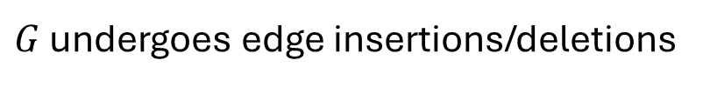
Matching in the Dynamic Model
$G$ undergoes edge insertions/deletions
Goal: Maintain an $α$-approximate matching of the graph
Algorithms for Dynamic and Sub-Linear Matching
Peter Kiss

Slide 9
Dynamic Matching
Extensively studied!
[Ivkovic/Lloyd’93] [Sankowski’07] [Onak/Rubinfeld’10] [Neiman/Solomon’11’,16] [Baswana/Gupta/Sen’11,’15] [Gupta/Peng’13] [Abboud/Vasillevska-Williams’14] [Henzinger/Krinninger/Nanongkai/Saranurak’15] [Bernstein/Stein’15,’16] [Solomon’16] [Peleg/Solomon’16] [Dahlgaard’16] [Abboud/Dahlgaard’16] [Kopelowitz/Pettie/Porat’16] [Bhattacharya/Henzinger/Nanongkai’16,’17] [Stubbs/Vasillevska-Williams’17] [Bhattacharya/Chakrabarty.Henzinger’17] [Bhattacharya/Henzinger/Italiano’18a,’18b] [Charikar/Solomon’18] [Arar/Chechik/Cohen/Stein/Wajc’18] [Solomon/Solomon’18] [Bhattacharya/Kulkarni’19] [Bernstein/Forster/Henzinger’19] [Behnezhad/Derakhshan/Hajiaghayi/Stein/Sudan’19] [van-den-Brand/Nanongkai/Saranurak’19] [Behnezhad/Łacki/Mirrokni’20] [Wajc’20][Bernstein/Dudeja/Langley’21] [Bhattacharya/Kiss’21] [Roghani/Saberi/Wajc’22][Kiss’22][Grandoni/Schwiegelshohn/Solomon/Uzrad’22] [Behnezhad/Khanna’22][Bhattacharya/Kiss/Tatchaphol/Wajc’23][Behnezhad’23][Assadi/Behezhad/Khanna/Li’23….]
Algorithms for Dynamic and Sub-Linear Matching
Peter Kiss

Slide 10

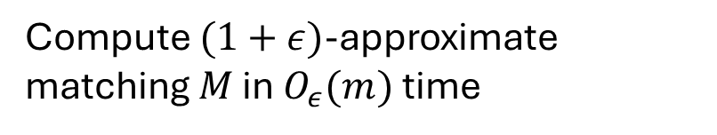
A simple dynamic matching algorithm
Compute $(1+ε)$-approximate matching $M$ in $O_{ε}(m)$ time
Output $M$ for $ε⋅μ(G)$ updates
Recompute
Algorithms for Dynamic and Sub-Linear Matching
Peter Kiss

Slide 11



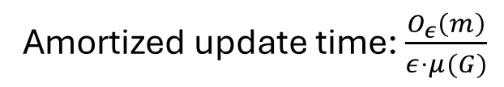

A simple dynamic matching algorithm
Compute $(1+ε)$-approximate matching $M$ in $O_{ε}(m)$ time
$μ\left(G\right), |M|$ changes by 1 each update
$→|M|$ remains $\left(1+O\left(ε\right)\right)$-approximate
Output $M$ for $ε⋅μ(G)$ updates
Amortized update time: $\frac{O_{ε}\left(m\right)}{ε⋅μ(G)}$
$μ\left(G\right)=Ω(\frac{m}{Δ}$)
($(Δ+1)$-edge coloring)
Recompute
$→O_{ε}(Δ)$amortized update time
Algorithms for Dynamic and Sub-Linear Matching
Peter Kiss

Slide 12
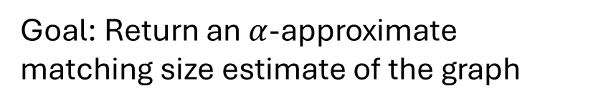

Matching in the Sub-Linear Model
Access $G$ with a small number of queries
Goal: Return an $α$-approximate matching size estimate of the graph
Returning any constant-approximate actual matching is provably hard*
Algorithms for Dynamic and Sub-Linear Matching
Peter Kiss

Slide 13
Sub-Linear Matching: A Naïve Approach
Sample lots of edges!
Issue: dense regions will dominate the sample
Algorithms for Dynamic and Sub-Linear Matching
Peter Kiss

Slide 14

Sub-Linear Matching: A Naïve Approach
Sample lots of edges!
Issue: dense regions will dominate the sample
[KMNT’20]: $Ω(n^{2−o(1)})$ samples needed for constant approximation!
Algorithms for Dynamic and Sub-Linear Matching
Peter Kiss

Slide 15
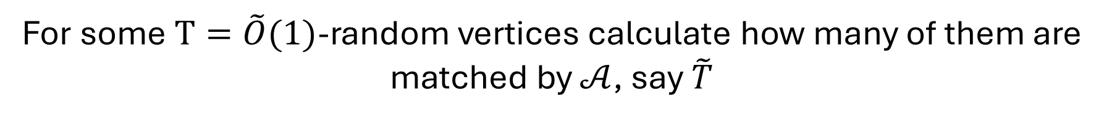
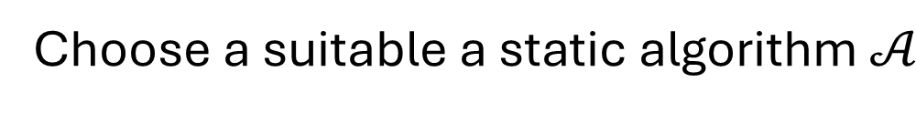
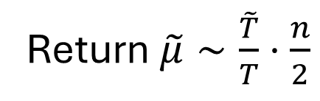
Sub-Linear Matching: A Common Approach
Choose a suitable a static algorithm $𝒜$
Ideally: randomized, small parallel depth
Very ‘local’
For some $T=\tilde{O}(1)$-random vertices calculate how many of them are matched by $𝒜$, say $\tilde{T}$
Return $\tilde{μ}∼\frac{\tilde{T}}{T}⋅\frac{n}{2}$
Algorithms for Dynamic and Sub-Linear Matching
Peter Kiss

Slide 16
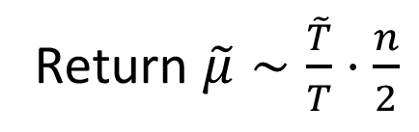
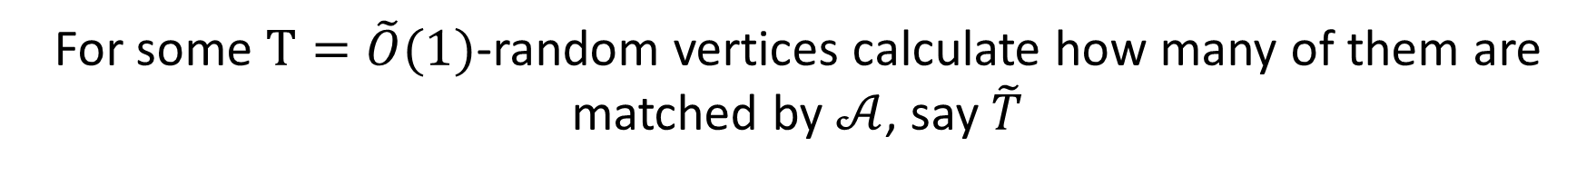
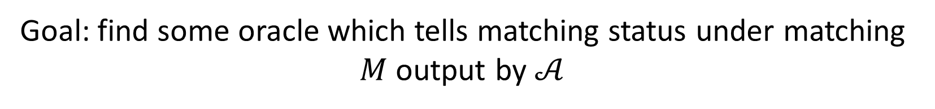
Sub-Linear Matching: A Common Approach
For some $T=\tilde{O}(1)$-random vertices calculate how many of them are matched by $𝒜$, say $\tilde{T}$
Return $\tilde{μ}∼\frac{\tilde{T}}{T}⋅\frac{n}{2}$
Goal: find some oracle which tells matching status under matching $M$ output by $𝒜$
Somehow do this without accessing majority of the edges of the graph
Algorithms for Dynamic and Sub-Linear Matching
Peter Kiss

Slide 17





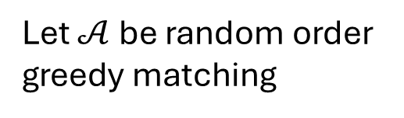








Sub-Linear Matching: A Common Approach
[B21]
$$11$$
$$12$$
$$8$$
$$9$$
$$7$$
$$6$$
$$1$$
Let $𝒜$ be random order
greedy matching
$$5$$
$$10$$
$$3$$
$$2$$
$$13$$
$$4$$
Algorithms for Dynamic and Sub-Linear Matching
Peter Kiss

Slide 18
Sub-Linear Matching: A Common Approach
[B21]
$$11$$
$$12$$
$$8$$
$$9$$
$$7$$
$$6$$
$$1$$
Let $𝒜$ be random order
greedy matching
$$5$$
$$10$$
$$3$$
$$2$$
$$13$$
$$4$$
Algorithms for Dynamic and Sub-Linear Matching
Peter Kiss

Slide 19
Sub-Linear Matching: A Common Approach
[B21]
$$11$$
$$12$$
$$8$$
$$9$$
$$7$$
$$6$$
$$1$$
Let $𝒜$ be random order
greedy matching
$$5$$
$$10$$
$$3$$
$$2$$
$$13$$
$$4$$
Algorithms for Dynamic and Sub-Linear Matching
Peter Kiss

Slide 20
Sub-Linear Matching: A Common Approach
[B21]
$$11$$
$$12$$
$$8$$
$$9$$
$$7$$
$$6$$
$$1$$
Let $𝒜$ be random order
greedy matching
$$5$$
$$10$$
$$3$$
$$2$$
$$13$$
$$4$$
Algorithms for Dynamic and Sub-Linear Matching
Peter Kiss

Slide 21
Sub-Linear Matching: A Common Approach
[B21]
$$11$$
$$12$$
$$8$$
$$9$$
$$7$$
$$6$$
$$1$$
Let $𝒜$ be random order
greedy matching
$$5$$
$$10$$
$$3$$
$$2$$
$$13$$
$$4$$
Algorithms for Dynamic and Sub-Linear Matching
Peter Kiss

Slide 22
Sub-Linear Matching: A Common Approach
[B21]
$$11$$
$$12$$
$$8$$
$$9$$
$$7$$
$$6$$
$$1$$
Let $𝒜$ be random order
greedy matching
$$5$$
$$10$$
$$3$$
$$2$$
$$13$$
$$4$$
Algorithms for Dynamic and Sub-Linear Matching
Peter Kiss

Slide 23
Sub-Linear Matching: A Common Approach
[B21]
$$11$$
$$12$$
$$8$$
$$9$$
$$7$$
$$6$$
$$1$$
Let $𝒜$ be random order
greedy matching
$$5$$
$$10$$
$$3$$
$$2$$
$$13$$
$$4$$
Algorithms for Dynamic and Sub-Linear Matching
Peter Kiss

Slide 24
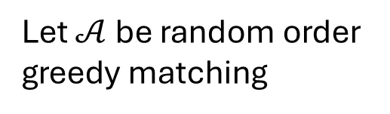
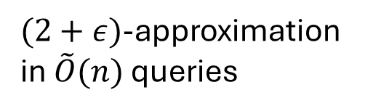
Sub-Linear Matching: A Common Approach
[B21]
$$11$$
$$12$$
Let $𝒜$ be random order
greedy matching
$$8$$
$$9$$
$$7$$
$$6$$
$$1$$
$$5$$
$$10$$
$$3$$
$$2$$
$(2+ε)$-approximation in $\tilde{O}(n)$ queries
$$13$$
$$4$$
In specific: matched status under a maximal matching can be queried in $\tilde{O}(n)$ time
Algorithms for Dynamic and Sub-Linear Matching
Peter Kiss

Slide 25

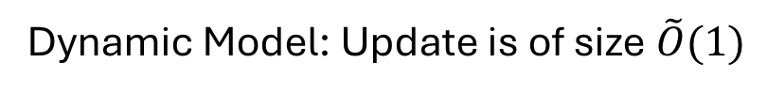
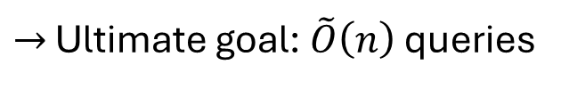
Dynamic and Sub-Linear Matching
Dynamic Model: Update is of size $\tilde{O}(1)$
$→$ Ultimate goal: $\tilde{O}\left(1\right)$ update time
(Describes a near-optimal static algorithm through insertions)
Dynamic Model: No constant approximation can be obtained in $o(n)$
(Adjacency matrix query: graph which is only a perfect matching)
$→$ Ultimate goal: $\tilde{O}\left(n\right)$ queries
Algorithms for Dynamic and Sub-Linear Matching
Peter Kiss

Slide 26
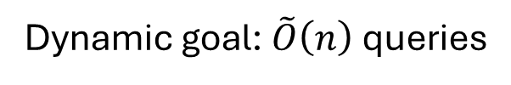
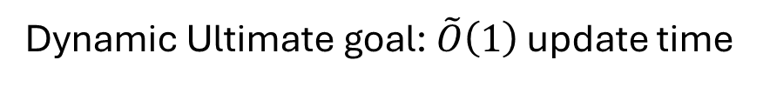

Dynamic and Sub-Linear Matching
Dynamic Ultimate goal: $\tilde{O}\left(1\right)$ update time
Dynamic goal: $\tilde{O}\left(n\right)$ queries
$2,2+ε$ approximation achievable for both models
Implementations of the random order greedy algorithm
Can we go bellow $2?$
[BKSW22, B22]
Algorithms for Dynamic and Sub-Linear Matching
Peter Kiss

Slide 27
A Useful Reduction Connecting the Models
Algorithms for Dynamic and Sub-Linear Matching
Peter Kiss

Slide 28



A Useful Reduction
Assume there exists a sub-linear algorithm with $O(n^{1+δ})$ queries, $α$-approx.
Dynamic setting: query it every $Θ_{ε}(n)$ updates
$μ(G)$ changes by 1 each update
$→$ If $μ\left(G\right)=Ω_{ε}(n)$ : $(α+ε)$-approximate dynamic algorithm for $matching size$
$O_{ε}\left(\frac{n^{1+δ}}{n}\right)=O_{ε}(n^{δ})$ update time
Algorithms for Dynamic and Sub-Linear Matching
Peter Kiss

Slide 29

A Useful Reduction
If $μ\left(G\right)=Ω_{ε}(n)$ : $(α+ε)$-approximate dynamic algorithm for $matching size$
Can we assume $μ\left(G\right)=Ω_{ε}(n)$?
Algorithms for Dynamic and Sub-Linear Matching
Peter Kiss

Slide 30

Vertex Sparsification for Dynamic Matching
[AKL19,BDT20, K21]
Assume $μ\left(G\right)≪n$
Algorithms for Dynamic and Sub-Linear Matching
Peter Kiss

Slide 31
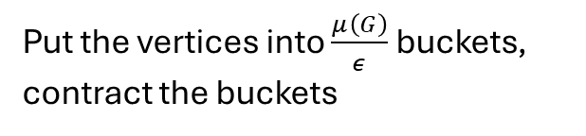
Vertex Sparsification for Dynamic Matching
[AKL19,BDT20, K21]
Assume $μ\left(G\right)≪n$
Put the vertices into $\frac{μ\left(G\right)}{ε}$ buckets, contract the buckets
Algorithms for Dynamic and Sub-Linear Matching
Peter Kiss

Slide 32
Vertex Sparsification for Dynamic Matching
[AKL19,BDT20, K21]
Assume $μ\left(G\right)≪n$
Put the vertices into $\frac{μ\left(G\right)}{ε}$ buckets, contract the buckets
Algorithms for Dynamic and Sub-Linear Matching
Peter Kiss

Slide 33
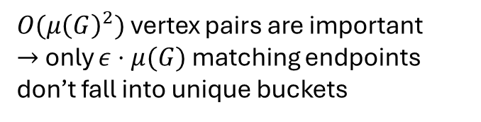
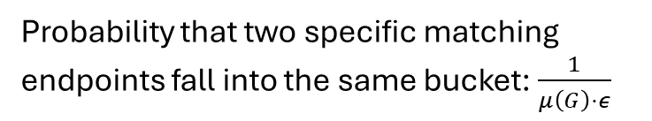
Vertex Sparsification for Dynamic Matching
[AKL19,BDT20, K21]
Assume $μ\left(G\right)≪n$
Put the vertices into $\frac{μ\left(G\right)}{ε}$ buckets, contract the buckets
Probability that two specific matching endpoints fall into the same bucket: $\frac{1}{μ\left(G\right)⋅ε}$
$O(μ{\left(G\right)}^{2})$ vertex pairs are important
$→$ only $ε⋅μ(G)$ matching endpoints don’t fall into unique buckets
Algorithms for Dynamic and Sub-Linear Matching
Peter Kiss

Slide 34

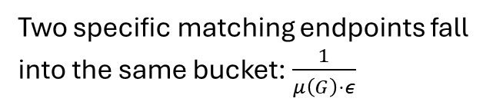
Vertex Sparsification for Dynamic Matching
[AKL19,BDT20, K21]
Assume $μ\left(G\right)≪n$
Put the vertices into $\frac{μ\left(G\right)}{ε}$ buckets, contract the buckets
Probability that two specific matching endpoints fall into the same bucket: $\frac{1}{μ\left(G\right)⋅ε}$
$O(μ{\left(G\right)}^{2})$ vertex pairs are important
$→$ only $ε⋅μ(G)$ matching endpoints don’t fall into unique buckets
Algorithms for Dynamic and Sub-Linear Matching
Peter Kiss

Slide 35

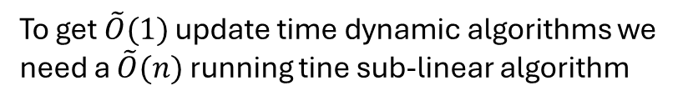
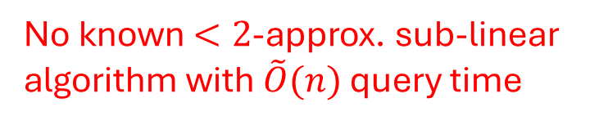
A Useful Reduction
Sub-linear algorithm with $O(n^{1+δ})$ queries, $α$-approx.
To get $\tilde{O}(1)$ update time dynamic algorithms we need a $\tilde{O}(n)$ running tine sub-linear algorithm
Query every $\sim n$ updates
No known $<2$-approx. sub-linear algorithm with $\tilde{O}(n)$ query time
Dynamic algorithm with $\tilde{O}(n^{δ})$ update time, $(α+ε)$-approx.
Algorithms for Dynamic and Sub-Linear Matching
Peter Kiss

Slide 36
Idea
Just repeatedly calling a sub-linear algorithm seems ‘weak’ for the dynamic model
Can we maintain a dynamic datastructure to guide sub-linear queries to break 2-approximation?
Yes, by combining dynamic, sub-linear and streaming algorithms!
Algorithms for Dynamic and Sub-Linear Matching
Peter Kiss

Slide 37
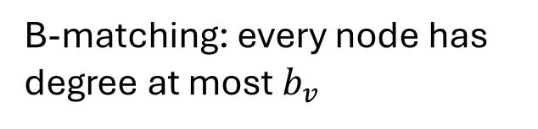
b-Matching
Matching: every node has degree at most 1
1
1
1
1
1
1
1
1
1
B-matching: every node has degree at most $b_{v}$
2
2
2
2
Algorithms for Dynamic and Sub-Linear Matching
Peter Kiss

Slide 38
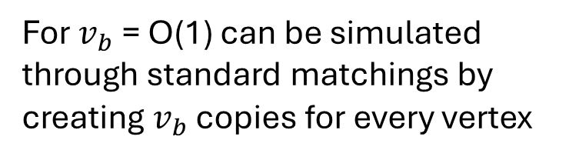
b-Matching
Matching: every node has degree at most 1
1
1
1
1
1
1
1
1
1
B-matching: every node has degree at most $b_{v}$
For $v_{b}$ = O(1) can be simulated through standard matchings by creating $v_{b}$ copies for every vertex
2
2
2
2
Algorithms for Dynamic and Sub-Linear Matching
Peter Kiss

Slide 39
Static Better then 2-Approximate Algorithm
[KMM11]
Step 1: Compute a maximal/greedy matching $M_{1}$
Algorithms for Dynamic and Sub-Linear Matching
Peter Kiss

Slide 40
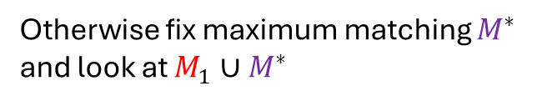
Static Better then 2-Approximate Algorithm
[KMM11]
Step 1: Compute a maximal/greedy matching $M_{1}$
If it’s better then 2-approximate we are done
Otherwise fix maximum matching $M^{∗}$ and look at $M_{1}∪M^{∗}$
Algorithms for Dynamic and Sub-Linear Matching
Peter Kiss

Slide 41
Static Better then 2-Approximate Algorithm
[KMM11]
Step 1: Compute a maximal/greedy matching $M_{1}$
If it’s better then 2-approximate we are done
Otherwise fix maximum matching $M^{∗}$ and look at $M_{1}∪M^{∗}$
Algorithms for Dynamic and Sub-Linear Matching
Peter Kiss

Slide 42

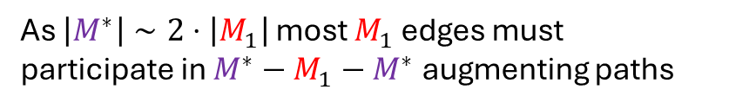
Static Better then 2-Approximate Algorithm
[KMM11]
Step 1: Compute a maximal/greedy matching $M_{1}$
If it’s better then 2-approximate we are done
Otherwise fix maximum matching $M^{∗}$ and look at $M_{1}∪M^{∗}$
As $\left|M^{∗}\right|∼2⋅\left|M_{1}\right|$ most $M_{1}$ edges must participate in $M^{∗}−M_{1}−M^{∗}$ augmenting paths
Algorithms for Dynamic and Sub-Linear Matching
Peter Kiss

Slide 43

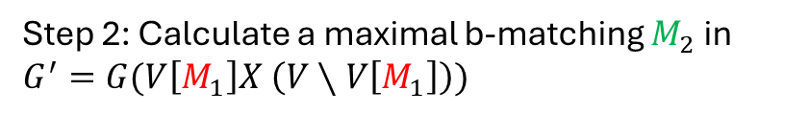
Static Better then 2-Approximate Algorithm
Step 2: Calculate a maximal b-matching $M_{2}$ in $G^{′}=G(V\left[M_{1}\right]X \left(V∖V\left[M_{1}\right]\right))$
2
1
1
2
Endpoints of $M_{1}$ have capacity 1, other nodes 2
Algorithms for Dynamic and Sub-Linear Matching
Peter Kiss

Slide 44
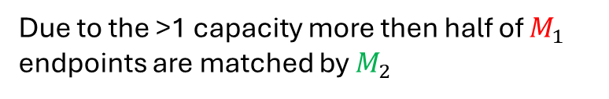
Static Better then 2-Approximate Algorithm
Step 2: Calculate a maximal b-matching $M_{2}$ in $G^{′}=G(V\left[M_{1}\right]X \left(V∖V\left[M_{1}\right]\right))$
2
1
1
2
Endpoints of $M_{1}$ have capacity 1, other nodes 2
Due to the >1 capacity more then half of $M_{1}$ endpoints are matched by $M_{2}$
Algorithms for Dynamic and Sub-Linear Matching
Peter Kiss

Slide 45
Static Better then 2-Approximate Algorithm
Step 2: Calculate a maximal b-matching $M_{2}$ in $G^{′}=G(V\left[M_{1}\right]X \left(V∖V\left[M_{1}\right]\right))$
1
1
1
1
Endpoints of $M_{1}$ have capacity 1, other nodes 2
Due to the >1 capacity more then half of $M_{1}$ endpoints are matched by $M_{2}$
1
1
1
1
Algorithms for Dynamic and Sub-Linear Matching
Peter Kiss

Slide 46
Static Better then 2-Approximate Algorithm
Step 2: Calculate a maximal b-matching $M_{2}$ in $G^{′}=G(V\left[M_{1}\right]X \left(V∖V\left[M_{1}\right]\right))$
1
1
1
1
Endpoints of $M_{1}$ have capacity 1, other nodes 2
Due to the >1 capacity more then half of $M_{1}$ endpoints are matched by $M_{2}$
1
1
1
1
Algorithms for Dynamic and Sub-Linear Matching
Peter Kiss

Slide 47
Static Better then 2-Approximate Algorithm
Step 2: Calculate a maximal b-matching $M_{2}$ in $G^{′}=G(V\left[M_{1}\right]X \left(V∖V\left[M_{1}\right]\right))$
1
1
1
1
Endpoints of $M_{1}$ have capacity 1, other nodes 2
Due to the >1 capacity more then half of $M_{1}$ endpoints are matched by $M_{2}$
2
2
2
2
Algorithms for Dynamic and Sub-Linear Matching
Peter Kiss

Slide 48
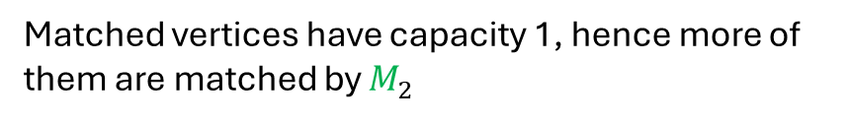

Static Better then 2-Approximate Algorithm
Step 2: Calculate a maximal b-matching $M_{2}$ in $G^{′}=G(V\left[M_{1}\right]X \left(V∖V\left[M_{1}\right]\right))$
1
1
1
1
Endpoints of $M_{1}$ have capacity 1, other nodes 2
Due to the >1 capacity more then half of $M_{1}$ endpoints are matched by $M_{2}$
Due to the higher capacity in $M_{2}$ there are more edges incident on unmatched vertices
2
2
2
2
Matched vertices have capacity 1, hence more of them are matched by $M_{2}$
Algorithms for Dynamic and Sub-Linear Matching
Peter Kiss

Slide 49
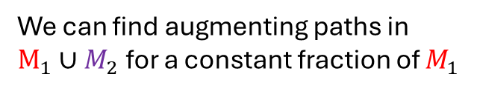
Static Better then 2-Approximate Algorithm
Step 2: Calculate a maximal b-matching $M_{2}$ in $G^{′}=G(V\left[M_{1}\right]X \left(V∖V\left[M_{1}\right]\right))$
2
1
1
2
Endpoints of $M_{1}$ have capacity 1, other nodes 2
Due to the >1 capacity more then half of $M_{1}$ endpoints are matched by $M_{2}$
We can find augmenting paths in $M_{1}∪M_{2}$ for a constant fraction of $M_{1}$
Algorithms for Dynamic and Sub-Linear Matching
Peter Kiss

Slide 50
Static Better then 2-Approximate Algorithm
Step 2: Calculate a maximal b-matching $M_{2}$ in $G^{′}=G(V\left[M_{1}\right]X \left(V∖V\left[M_{1}\right]\right))$
2
1
1
2
Endpoints of $M_{1}$ have capacity 1, other nodes 2
Due to the >1 capacity more then half of $M_{1}$ endpoints are matched by $M_{2}$
We can find augmenting paths in $M_{1}∪M_{2}$ for a constant fraction of $M_{1}$
While some of these overlap, one path may only overlap with O(1) other paths
Algorithms for Dynamic and Sub-Linear Matching
Peter Kiss

Slide 51
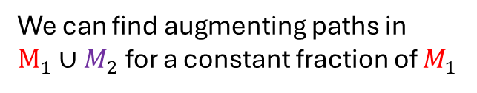
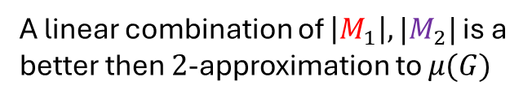
Static Better then 2-Approximate Algorithm
We can find augmenting paths in $M_{1}∪M_{2}$ for a constant fraction of $M_{1}$
2
1
1
2
While some of these overlap, one path may only overlap with O(1) other paths
A linear combination of $\left|M_{1}\right|,|M_{2}|$ is a better then $2$-approximation to $μ(G)$
Algorithms for Dynamic and Sub-Linear Matching
Peter Kiss

Slide 52
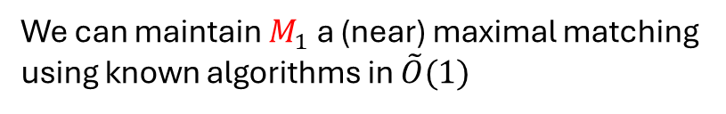


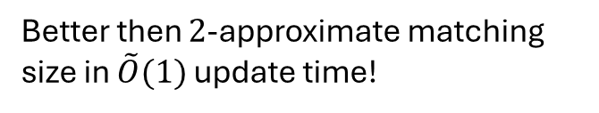
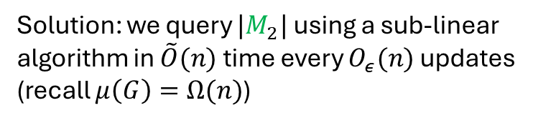

Maintaining $\left|M_{1}\right|,|M_{2}|$
We can maintain $M_{1}$ a (near) maximal matching using known algorithms in $\tilde{O}(1)$
2
1
1
2
Issue: $G^{′}=G(V\left[M_{1}\right]X(V∖V\left[M_{1}\right])$ undergoes vertex updates as $M_{1}$ changes
Solution: we query $|M_{2}|$ using a sub-linear algorithm in $\tilde{O}(n)$ time every $O_{ε}(n)$ updates (recall $μ\left(G\right)=Ω(n)$)
Better then $2$-approximate matching size in $\tilde{O}(1)$ update time!
$1+\frac{1}{\sqrt{2}}\sim 1.7$ approximation once optimized
Algorithms for Dynamic and Sub-Linear Matching
Peter Kiss

Slide 53
Further Applications of the Reduction
[BKS23]
$(1+ε)$-approximate sub-linear matching in ${\tilde{O}}_{ε}(n^{2−f\left(ε\right)})$ time
Reduction
$→$ $(1+ε)$-approximate dynamic matching size in ${\tilde{O}}_{ε}(n^{1−f\left(ε\right)})$ update time
Algorithms for Dynamic and Sub-Linear Matching
Peter Kiss

Slide 54


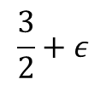






State of the art for Dynamic Matching
[L24] (conditional)
Matching Edges
Update Time
Matching Size
[GP13, PS16, S18…]
$$\tilde{O}(n)$$
[BKS23]
More tradeoffs:
[BHN16, BŁM20, W20, BK21, RSW20]
[BS15,16, K22, GSSU22]
$${\tilde{O}}_{ε}(n^{1−f(ε)})$$
[D16]
(value version)
$$\tilde{O},\hat{O}(\sqrt{n})$$
[BGS15, S16, BHN16, BHN17, CS18, ACSSW18, CZ19, BDHSS19, BFH19, BK19, W20, BK21, K22,…]
[BKSW22,B22,
ABR24]
[B23]
$$\tilde{O}(1)$$
$$1.499$$
$$\frac{3}{2}+ε$$
Approximation Ratio
$$1+ε$$
$$\sim 1.7$$
$$2, 2+ε$$
Algorithms for Dynamic and Sub-Linear Matching
Peter Kiss

Slide 55
Further Applications of Sub-Linear Matching
$(1+ε)$-approximate Earth Mover’s Distance [BR23] in ${\tilde{O}}_{ε}(n^{2−f\left(ε\right)})$ time*
Augmenting path elimination based algorithm
Sublinear Graphic TSP [YSS20] (different tradeoffs)
Almost black-box application
Algorithms for Dynamic and Sub-Linear Matching
Peter Kiss

Slide 56








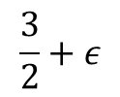



State of the Art for Sub-Linear Matching
$\tilde{O}\left(Δ^{ε^{−2}}\right),\left(1+ε\right)$-approximation
Running Time
[SMA23]
[YYI09]
[BKS23]
[BKS23],
[ABRB25]
$$\tilde{O}(n^{2})$$
[MRT25]
$$\tilde{O}(n^{2−f(ε)})$$
[BRRS24]
[SMAA23]
$$\tilde{O}(n^{1.5})$$
[BRR23]
$$\tilde{O}(n^{1.2})$$
[B21]
$$\tilde{O}(n^{1.01})$$
$$\tilde{O}(n)$$
$$1.499$$
$$\frac{3}{2}+ε$$
$$1.9$$
$$2, 2+ε$$
Approximation Ratio
$$1.99$$
Algorithms for Dynamic and Sub-Linear Matching
Peter Kiss

Slide 57
Open Problems
$2$-Approximation still stands as a barrier for matching in both models
$→$ Can we maintain the edges of a better than 2-approximate matching in $\tilde{O}(1)$ ?
$→$ Can we get better then 2-approximate sub-linear matching in $\tilde{O}(n)$ ?
Algorithms for sub-linear and dynamic matching use very similar data-structures/ideas
Algorithms for Dynamic and Sub-Linear Matching
Peter Kiss

Slide 58
State of the art for Dynamic Matching
[L24] (conditional)
Matching Edges
Update Time
Matching Size
[GP13, PS16, S18…]
$$\tilde{O}(n)$$
[BKS23]
More tradeoffs:
[BHN16, BŁM20, W20, BK21, RSW20]
[BS15,16, K22, GSSU22]
$${\tilde{O}}_{ε}(n^{1−f(ε)})$$
[D16]
(value version)
$$\tilde{O},\hat{O}(\sqrt{n})$$
[BGS15, S16, BHN16, BHN17, CS18, ACSSW18, CZ19, BDHSS19, BFH19, BK19, W20, BK21, K22,…]
[BKSW23,B23,
ABR24]
[B23]
$$\tilde{O}(1)$$
$$1.499$$
$$\frac{3}{2}+ε$$
Approximation Ratio
$$1+ε$$
$$\sim 1.7$$
$$2, 2+ε$$
Algorithms for Dynamic and Sub-Linear Matching
Peter Kiss

Slide 59
Open Problems
$2$-Approximation still stands as a barrier for matching in both models
$→$ Can we maintain the edges of a better than 2-approximate matching in $\tilde{O}(1)$ ?
$→$ Can we get better then 2-approximate sub-linear matching in $\tilde{O}(n)$ ?
Algorithms for sub-linear and dynamic matching use very similar data-structures/ideas
For dynamic matching there are a lot of interesting tradeoffs for better then 2-approximation, poly(n) update time
Algorithms for Dynamic and Sub-Linear Matching
Peter Kiss

Slide 60
State of the Art for Sub-Linear Matching
$\tilde{O}\left(Δ^{ε^{−2}}\right),\left(1+ε\right)$-approximation
Running Time
[SMA23]
[YYI09]
[BKS23]
[BKS23],
[ABRB25]
$$\tilde{O}(n^{2})$$
[MRT25]
$$\tilde{O}(n^{2−f(ε)})$$
[BRRS24]
[SMAA23]
$$\tilde{O}(n^{1.5})$$
[BRR23]
$$\tilde{O}(n^{1.2})$$
[B21]
$$\tilde{O}(n^{1.01})$$
$$\tilde{O}(n)$$
$$1.499$$
$$\frac{3}{2}+ε$$
$$1.9$$
$$2, 2+ε$$
Approximation Ratio
$$1.99$$
Algorithms for Dynamic and Sub-Linear Matching
Peter Kiss

Slide 61
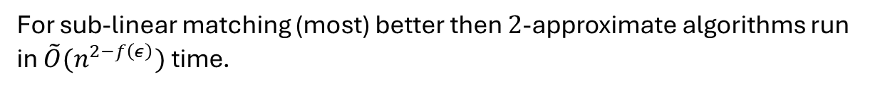
Open Problems
$2$-Approximation still stands as a barrier for matching in both models
$→$ Can we maintain the edges of a better than 2-approximate matching in $\tilde{O}(1)$ ?
$→$ Can we get better then 2-approximate sub-linear matching in $\tilde{O}(n)$ ?
Algorithms for sub-linear and dynamic matching use very similar data-structures/ideas
For dynamic matching there are a lot of interesting tradeoffs for better then 2-approximation, poly(n) update time
For sub-linear matching (most) better then $2$-approximate algorithms run in $\tilde{O}(n^{2−f\left(ε\right)})$ time.
$→$ Are there similar trade-offs for sub-linear matching?
Algorithms for Dynamic and Sub-Linear Matching
Peter Kiss

Slide 62
Thank You!
Algorithms for Dynamic and Sub-Linear Matching
Peter Kiss

