Slide 1
SUBLINEAR-TIME TECHNIQUES IN MOTIF ANALYSIS
TALYA EDEN

Slide 2
MOTIFS:
Recurrent and statistically significant subgraphs of a network

Slide 3
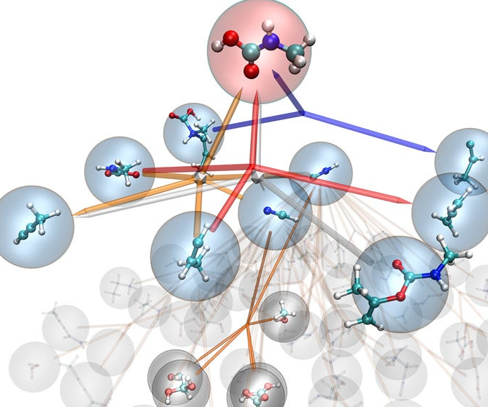
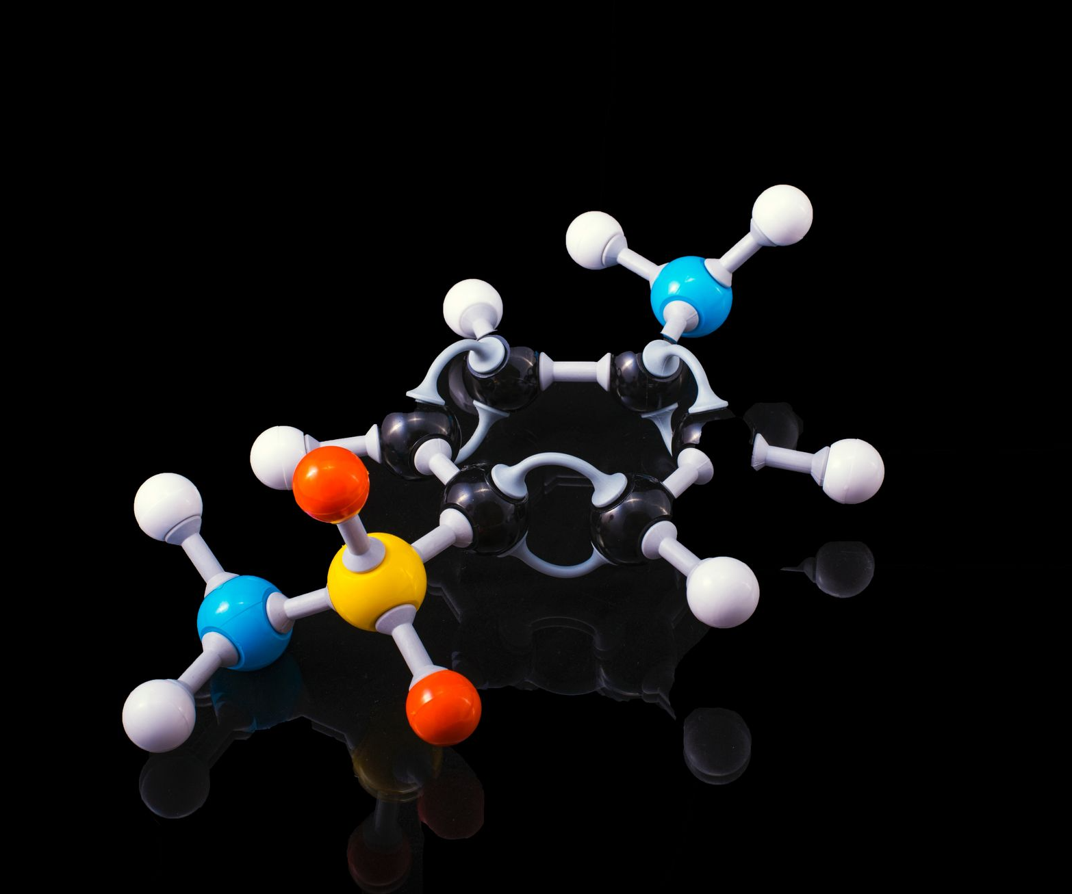
SOCIAL NETWORKS
CHEMISTRY
FLIGHT MAPS
BIOLOGY
FLIGHT MAPS

Slide 4
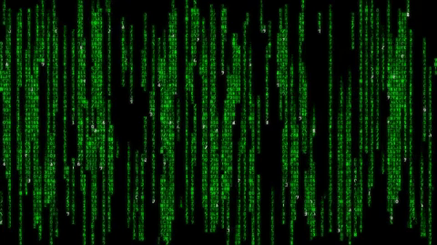
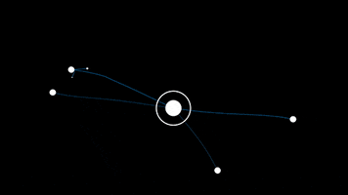
ERA OF DATA
NETWORKS ARE HUGE
CLASSICAL ALGORITHMS ARE TOO SLOW
OR EVEN INFEASIBLE

Slide 5
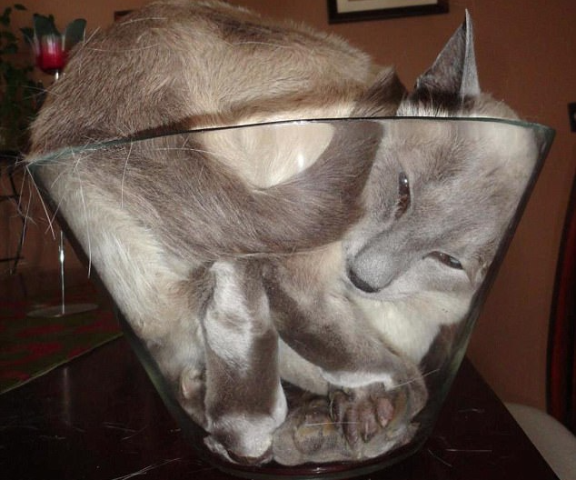
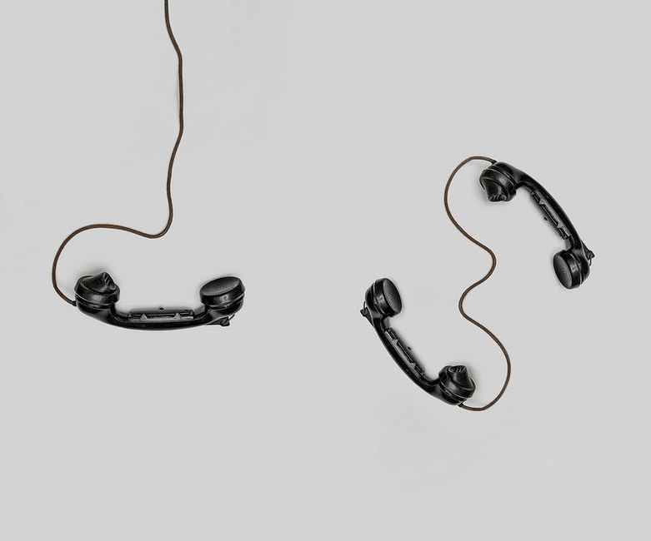
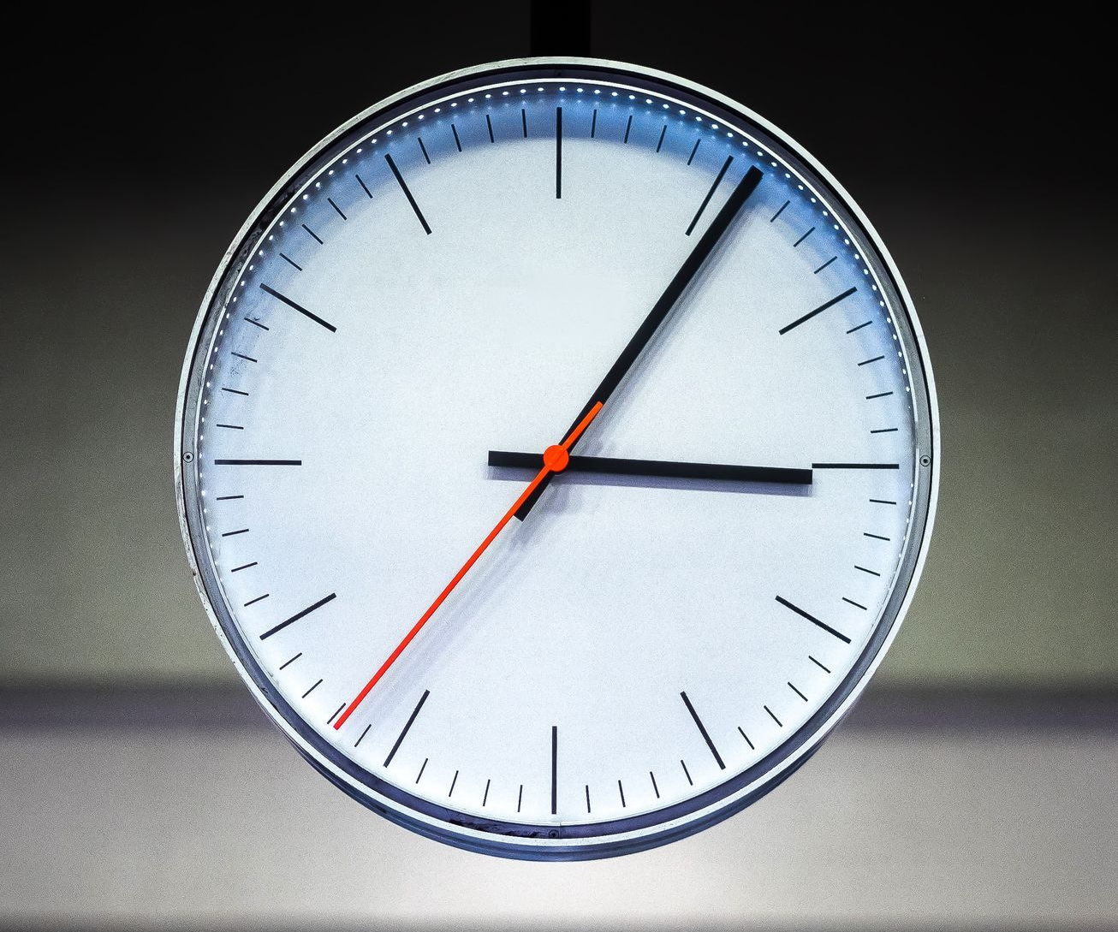
NEW MODELS OF COMPUTATION
Depending on
Access
Representation
Measure to minimize
SPACE
COMMUNICATION
TIME

Slide 6
QUERY ACCESS TO THE GRAPH
ALG
Query
Answer
G
Query
How much of the graph do we need to see in order to return a good estimate?

Slide 7
THE STANDARD QUERY MODEL
Parnas Ron 02
Kaufman Krivelevich Ron 04
$1 2 3 4 5$
$$\begin{matrix}\begin{matrix}1 \\ 2 \\ 3\end{matrix} \\ 4 \\ 5\end{matrix}\left(\begin{matrix}\begin{aligned}0 \\ 1\end{aligned} & \begin{aligned}1 \\ 0\end{aligned} & \begin{aligned}\begin{matrix}1 & \begin{matrix}1 & 0\end{matrix}\end{matrix} \\ \begin{matrix}0 & \begin{matrix}1 & 0\end{matrix}\end{matrix}\end{aligned} \\ 1 & 0 & \begin{matrix}0 & \begin{matrix}0 & 1\end{matrix}\end{matrix} \\ \begin{aligned}1 \\ 0\end{aligned} & \begin{aligned}1 \\ 0\end{aligned} & \begin{aligned}\begin{matrix}0 & \begin{matrix}0 & 1\end{matrix}\end{matrix} \\ \begin{matrix}1 & \begin{matrix}1 & 0\end{matrix}\end{matrix}\end{aligned}\end{matrix}\right)$$
$$1$$
$$1$$
1
2
3
4
$$2$$
2
1
4
pair?
1
$$1$$
$$?$$
3
1
5
$$n$$
$$?$$
$$0$$
4
1
2
5
$$3$$
$$4$$
2
nbr
5
3
4
$$5$$
degree?

Slide 8
Useful Techniques
Assign -> Sample -> Redistribute -> Repeat
Sampling edges incident to a set u.a.r.
Sampling outgoing neighbors
Approximately counting triangles in sublinear time

Slide 9
 | General model: Degree, neighbor and pair queries |  | Augmented model: general + uniform edge samples
 | General graphs | Bounded arboricity graphs | General graphs | Bounded arboricity
edges | [Feige 06, Goldreich Ron 08] | [E Ron Seshadhri 18] | [Motwani Panigrahy Xu 07] [Beretta T$\check{e}$tek 22]
stars | [Gonen Ron Shavitt 11] |  | [Aliakbarpour Biswas Gouleakis Peebles Rubinfeld Yodpinyanee 18]
triangles | [E Levi Ron Seshadhri 15] | [E Ron Seshadhri 20]
cliques | [E Ron Seshadhri 19]
Hamiltonian | [E Levi Rubinfeld Ron - Soon! ] |  | Better algs for even cycles?
arbitrary motifs |  |  | [Assadi Kapralov Khanna 18] [Fichtenberger Gao Peng 20] [E Biswas Rubinfeld 22]
model
motif
?
?
?

Slide 10
COUNTING CLIQUES

Slide 11
COUNTING TRIANGLES

Slide 12
COUNTING TRIANGLES
$$G$$
Task: Output $\hat{t}$ such that
$$\left(1−ε\right)t≤\hat{t}≤\left(1+ε\right)t$$
Query
Answer
Query Complexity
$${\tilde{O}}_{ε}\left(\frac{n}{t^{1/3}}+\min\left\{m,\frac{m^{3/2}}{t}\right\}\right)$$
Let $m$ denote the number of edges
(for simplicity, assume known)
Let $t$ denote the number of triangles
(for simplicity, assume crude estimate is known)
Classical (combinatorial) algorithm:
$$O\left(n +{ m}^{3/2}\right)$$

Slide 13
COUNTING TRIANGLES
$$G$$
Task: Output $\hat{t}$ such that
$$\left(1−ε\right)t≤\hat{t}≤\left(1+ε\right)t$$
Query
Answer
Query Complexity
$${\tilde{O}}_{ε}\left(\frac{n}{t^{1/3}}+\min\left\{m,\frac{m^{3/2}}{t}\right\}\right)$$
Let $m$ denote the number of edges
(for simplicity, assume known)
Let $t$ denote the number of triangles
(for simplicity, assume crude estimate is known)
Optimal (up to poly($\log{n},ε$) factors)
E Rosenbaum APPROX18

Slide 14
$${\tilde{O}}_{ε}\left(\frac{n}{t^{1/3}}+\frac{m^{3/2}}{t}\right)$$
$$S$$
uniform vertices
$$deg⁡(v)$$
$$nbr\left(v,i\right)$$
$$pair\left(u.w\right)$$
How large should the sets $S$and $R$ be?
Alg
(Assign triangles to vertices /* to bound the variance */)
Sample a set of vertices $S$ u.a.r
/* sufficiently large to ensure number of assigned triangles is as expected */
(Re-distribute the triangles to the $E_{S})$
Sample a set $R$ of edges from $E_{S}$ u.a.r.
Estimate their weight by trying to extend edges to triangles
Assign
Sample Redistribute Repeat
How to sample from $E_{S}$?
How to extend?

Slide 15
DETOUR: ARBITRARY WEIGHTS
Task: approximate sum of arbitrary weights

Slide 16
DETOUR: ARBITRARY WEIGHTS
TRIANGLES
Query_weight(i)
Task: approximate sum of arbitrary weights
weight
No sublinear algorithm
node index
$$Chebyshev^{′}s inequality:$$
1
2
3
i
$$n$$
$$queries∝\frac{Var\left[weight\right]}{ε^{2}⋅Ex{\left[weight\right]}^{2}}≤\frac{Ex\left[wt^{2}\right]}{Ex{\left[wt\right]}^{2}}≤\frac{max\left\{wt\right\}⋅Ex[wt]}{Ex{\left[wt\right]}^{2}}=\frac{max.{wt}}{avg. wt}$$

Slide 17
BACK TO TRIANGLES
Query_weight(i)
incident
triangles
Query_triangles(i)
weight
node index
1
2
3
i
$$n$$
$$queries∝\frac{max.{weight}}{avg. weight}$$
$$=\frac{}{t/n}$$
Use the structure of the graph to bound the maximum wt. (variance)!

Slide 18
BACK TO TRIANGLES
incident
triangles
Query_triangles(i)
node index
1
2
3
i
$$n$$
$$queries∝\frac{max.{weight}}{avg. weight}$$
$$=\frac{}{t/n}$$
Use the structure of the graph to bound the maximum wt. (variance)!

Slide 19
BACK TO TRIANGLES
incident
triangles
Query_triangles(i)
$$threshold$$
$$εt$$
$$\frac{t^{2/3}}{ε^{1/3}}$$
assigned triangles
node index
Assign triangles to a vertex that is not heavy
$$n$$
1
2
3
$$i$$
$$n$$
1
2
3
$$queries∝\frac{max.{weight}}{avg. weight}$$
$$=\frac{t^{2/3}}{t/n}=\frac{n}{t^{1/3}}$$
Use the structure of the graph to bound the maximum wt. (variance)!

Slide 20
$${\tilde{O}}_{ε}\left(\frac{n}{t^{1/3}}+\frac{m^{3/2}}{t}\right)$$
$$E_{S}$$
$$S$$
How large should the sets $S$and $R$ be?
Alg
Sample a set of vertices $S$ u.a.r
Let $E_{S}$ be their set of incident edges
Sample a set of $R$ edges from $E_{S}$ u.a.r.
Try to extend the edges to triangles
$$\frac{n}{t^{1/3}}$$
$$\frac{m^{3/2}}{t}$$
How to extend?

Slide 21
$$E_{S}$$
$$S$$
uniform vertices
$$deg⁡(v)$$
$$nbr\left(v,i\right)$$
$$pair\left(u,w\right)$$
Naive approach
For each sampled edge in $E_{S}$,
sample a uniform neighbor,
and check for a triangle
Alg
Sample a set of vertices $S$ u.a.r
Let $E_{S}$ be their set of incident edges
Sample a set of $R$ edges from $E_{S}$ u.a.r.
Try to extend the edges to triangles
4. Try to extend the edges to triangles

Slide 22
$$E_{S}$$
$$S$$
Naive approach
For each sampled edge,
sample a uniform neighbor,
and check for a triangle
Problems:
Some triangles are more likely to be sampled than others
2. The search space is very large
Solution
(Orient edges from low to high degree )
(Only consider outgoing edges)
4. Try to extend the edges to triangles
$∀v∈V,$ out-nbrs $≤\sqrt{2m}$

Slide 23
$$E_{S}$$
$$S$$
$\frac{1}{\sqrt{2m}}$
New approach
Counting via uniform sampling!
For each sampled edge in $E_{S}$,
sample a uniform outgoing neighbor,
each w.p.$1/\sqrt{2m}$,
and check for a triangle
Problems:
Some triangles are more likely to be sampled than others
2. The search space is very large
Solution
(Orient edges from low to high degree )
(Only consider outgoing edges)
Requires an additional procedure
$∀v∈V,$ out-nbrs $≤\sqrt{2m}$

Slide 24
$$\operatorname{Pr}\left[(u,v,w)\right]=\frac{1}{\left|E_{S}\right| }⋅\frac{1}{\sqrt{2m}}$$
$$E_{S}$$
$$S$$
$$v$$
$$w$$
$$\operatorname{Pr}\left[triangle\right]=\frac{|T_{s}|}{\left|E_{S}\right|⋅\sqrt{2m} }≈\frac{t}{m}⋅\frac{1}{\sqrt{2m}}$$
$\frac{1}{\sqrt{2m}}$
$$queries ∝\frac{m\sqrt{m}}{t}$$
$$u$$
New approach
Counting via uniform sampling!
For each sampled edge in $E_{S}$,
sample a uniform outgoing neighbor,
each w.p.$1/\sqrt{2m}$,
and check for a triangle
Problems:
Some triangles are more likely to be sampled than others
2. The search space is very large
Solution
(Orient edges from low to high degree )
(Only consider outgoing edges)
$∀v∈V,$ out-nbrs $≤\sqrt{2m}$

Slide 25
CLIQUES?
$$E_{S}$$
$$S$$
$$k−2$$
Alg
Sample a set of vertices $S$ u.a.r
Let $E_{S}$ be their set of incident edges
Sample a set of $R$ edges from $E_{S}$ u.a.r.
Try to extend the edges to triangles
$$k−2$$
$${\tilde{O}}_{ε}\left(\frac{n}{t^{1/3}}+\min\left\{m,\frac{m\sqrt{m}}{t} \right\}\right)$$
$$n_{k}^{1/k}$$
cliques

Slide 26
SUMMARY
$$O_{ε}\left(\frac{n}{t^{1/3}}+\min\left\{m,\frac{m^{3/2}}{t}\right\}\right)$$
Counting via uniform sampling!
Assigning weights
Never need more than $O(n+m)$ queries

Slide 27
Sampling edges uniformly from $E_{S}$
$$(v,u)$$
$S$:
$$v_{1}$$
$$v_{2}$$
$$v_{3}$$
$$v_{s}$$
$$v_{3}$$
$$d(v_{1})$$
$$d(v_{2})$$
$$d(v_{3})$$
$$d(v_{s})$$
$$d_{S}=\sum_{v∈S}{d\left(v\right)=|E_{S}|}$$
Can be constructed in time $O(|S|)$
Sample-in-$E_{S}$-uar
Query $d\left(v\right)$ for all $v∈S$ and compute $d_{S}$
Sample $v∈S$with prob. $\frac{d\left(v\right)}{d_{S}}$
Sample uniform neighbor $u$of $v$
$$\operatorname{Pr}\left[\left(v,u\right)\right]=\frac{d\left(v\right)}{d_{S}}⋅\frac{1}{d\left(v\right)}=\frac{1}{d_{S}}$$

Slide 28
Sampling outgoing nbrs, each w.p. $1/\sqrt{2m}$
Order vertices from low degree to high, and let
$d^{+}\left(v\right)=\#$of outgoing neighbors (to higher deg. nbrs.)
Claim:
$$∀ v∈V, d^{+}\left(v\right)≤\sqrt{2m}$$
For $u∈Low, d^{+}\left(u\right)≤d\left(u\right)≤\sqrt{2m}$
For $v∈High, d^{+}\left(v\right)≤\left|High\right|≤\frac{2m}{\sqrt{2m}}=\sqrt{2m}$
$$u$$
$$v$$
(overall)
$$degree$$
$$ℒow$$
$$\sqrt{2m}$$
$$ℋigh$$

Slide 29
Sampling outgoing nbrs, each w.p. $1/\sqrt{2m}$
Order vertices from low degree to high, and let
$d^{+}\left(v\right)=\#$of outgoing neighbors (to higher deg. nbrs.)
$$v$$
Claim:
$$∀ v∈V, d^{+}\left(v\right)≤\sqrt{2m}$$
$$v$$
For $u∈Low, d^{+}\left(u\right)≤d\left(u\right)≤\sqrt{2m}$
For $u∈High, d^{+}\left(v\right)≤\left|High\right|≤\frac{2m}{\sqrt{2m}}=\sqrt{2m}$
Query a nbr $v$of $u$ u.a.r. (each wp $\frac{1}{d\left(u\right)})$
If $v∈Γ^{+}\left(u\right),$ return it w.p. $\frac{d\left(u\right)}{\sqrt{2m}}$ (otherwise fail)
$⇒∀v∈Γ^{+}\left(u\right),\operatorname{Pr}\left[v\right]=\frac{1}{d\left(u\right)}⋅\frac{d\left(u\right)}{\sqrt{2m}}=\frac{1}{\sqrt{2m}}$
Sample $v∈H$u.a.r. (each wp $\frac{1}{\sqrt{2m}})$
Query $d\left(v\right)$ and query $\left(u,v\right)∈?E$
If $v∈Γ^{+}(u),$ return $v$
$$⇒∀v∈Γ^{+}\left(u\right),\operatorname{Pr}\left[u\right]=\frac{1}{\sqrt{2m}}$$
$$u$$
$$u$$
(overall)
$$degree$$
$$ℒow$$
$$\sqrt{2m}$$
$$ℋigh$$

Slide 30
A MATCHING LOWER BOUND
$$Ω\left(\frac{n}{t^{1/3}}+\min\left\{m,\frac{m^{3/2}}{t}\right\}\right)$$
triangles
$$G$$
$t^{1/3}$-clique
1
2
3
$$n$$
$$t^{1/3}$$
Can we do better for “well-behaved” graphs?

Slide 31
 | General model: Degree, neighbor and pair queries |  | Augmented model: general + uniform edge samples
 | General graphs | Bounded arboricity graphs | General graphs | Bounded arboricity
edges | [Feige 06, Goldreich Ron 08] | [E Ron Seshadhri 18] | [Motwani Panigrahy Xu 07] [Beretta T$\check{e}$tek 22]
stars | [Gonen Ron Shavitt 11] |  | [Aliakbarpour Biswas Gouleakis Peebles Rubinfeld Yodpinyanee 18]
triangles | [E Levi Ron Seshadhri 15] | [E Ron Seshadhri 20]
cliques | [E Ron Seshadhri 19]
Hamiltonian | [E Levi Rubinfeld Ron - Soon! ] |  | Better algs for even cycles?
arbitrary motifs |  |  | [Assadi Kapralov Khanna 18] [Fichtenberger Gao Peng 20] [E Biswas Rubinfeld 22]
model
motif
?
?
?
Thank you!

