Slide 1
CELAR: Automatic, Multi-grain Elasticity Provisioning for the Cloud
M. Dikaiakos, N. Loulloudes, G. Pallis, H-L. Truong, D. Tsoumakos
Tutorial T2
8th IEEE/ACM International Conference on Utility and Cloud Computing (UCC 2015)
7th December 2015
Limassol, Cyprus

Slide 2
Cloud Computing
The NIST Definition of Cloud Computing, NIST, 2011
Ubiquitous, convenient, on-demand network access
Shared pool of configurable resources
Rapid provisioning and release
Minimal management effort
Minimal interaction with the service provider

Slide 3
Cloud Models
The NIST Definition of Cloud Computing, NIST, 2011
Service Models | Deployment Models
Software as a Service ( SaaS ) Platform as a Service ( PaaS ) Infrastructure as a Service ( IaaS ) | Private Community Public Hybrid

Slide 4
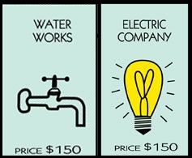

A Public Utility
(Cloud) Computing is dubbed as the 5th utility
R. Buyya et al., 2009
… Computing may someday be organised as a public utility, just as the telephone system is organised as a public utility…
John McCarthy, 1961

Slide 5
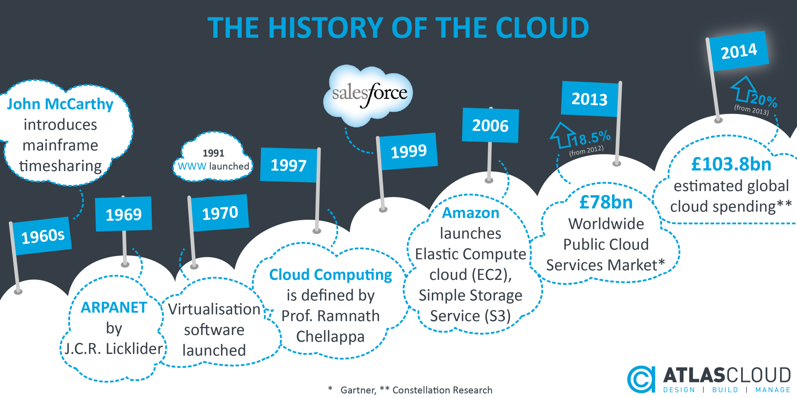
The History of The Cloud

Slide 6
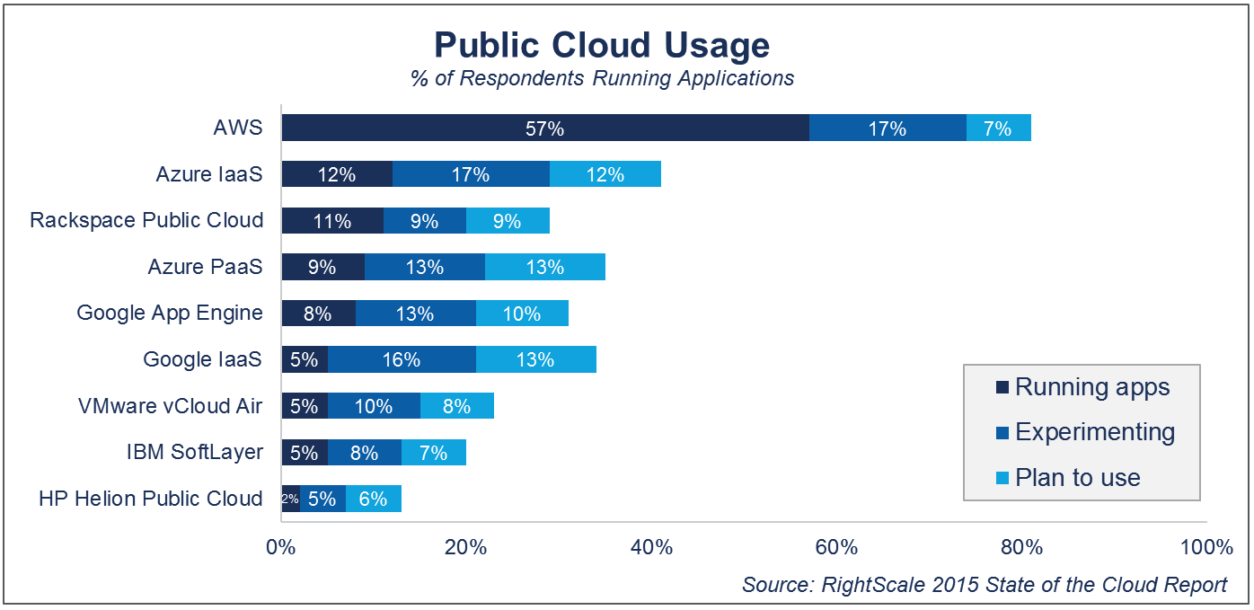

Slide 7

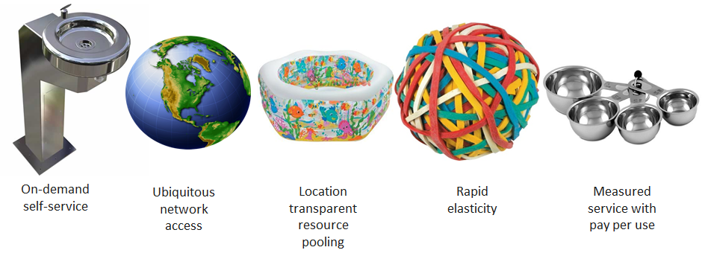
5 Essential Cloud Characteristics
The NIST Definition of Cloud Computing, NIST, 2011

Slide 8
Tutorial Outline
Cloud Computing
Main topics:
  Elasticity
  Application Management
CELAR Architecture
Elasticity and Monitoring
  SYBL & rSYBL
  JCatascopia
Eclipse CAMF
Conclusions

Slide 9
Elasticity - Definition
Ability of a system to expand or contract its dedicated resources to meet the current demand
Allocate resources to increase throughput
Stakeholders state that elasticity (54%) and cost reduction (48%) are driving cloud adoption
[FOC Survey 2013]
Workload (req/s)
De-allocate unused resources to reduce cost
Provision only the required resources
Time (s)
9

Slide 10
Three Types of Elasticity
Horizontal: On-demand provisioning
  E.g.: Get more VMs
Vertical: Resource re-configuration
  E.g.: Main memory ballooning
Live Migration:
  E.g.: Move to another provider

Slide 11







The Elasticity Controller
Cloud
Provider
Application Server Tier
Database Backend
Load Balancer
store/extract video
Distribute
client requests
.
.
.
upload/download
video
.
.
.
clients
if (metricA > X) then add VM
else if (metricA < X) then remove VM
else if (metricB > Y) then increase RAM
…
Elasticity
Controller
add/remove resources

Slide 12
Tutorial Outline
Cloud Computing
Main topics:
  Elasticity
  Application Management
CELAR Architecture
Elasticity and Monitoring
  SYBL & rSYBL
  JCatascopia
Eclipse CAMF
Conclusions

Slide 13
Emerging Cloud Applications
Increasing complexity
Dynamic behavior
A variety of deployment platforms with different:
  configuration mechanisms
  offered services
  availability and pricing
  elasticity capabilities

Slide 14
Use Case 1: Cancer Genome Detection
CPU and Disk I/O intensive
Memory Intensive
Disk I/O and Memory Intensive

Slide 15
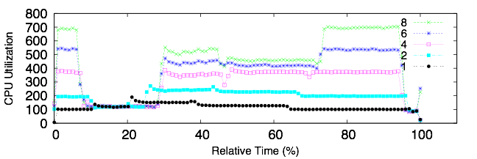
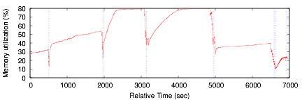
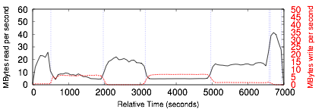
Elasticity Profile
”Analysing Cancer Genomics in the Elastic Cloud”
C. Smowton, A. Balla, D. Antoniades, Miller, G. Pallis, M. Dikaiakos, W. Xing, CCGridLife 2015
CPU
Memory
I/O

Slide 16
Use Case 1: Big Data Analysis Game

Slide 17
Use Case 1: Big Data Analysis Game

Slide 18
Use Case 1: Big Data Analysis Game

Slide 19
Use Case 1: Big Data Analysis Game

Slide 20
Cloud Application Management Challenges
“Enabling Interoperable Cloud Application Management through an Open Source Ecosystem”
N. Loulloudes, C. Sofokleous, D. Trihinas, M. Dikaiakos, and G. Pallis. IEEE Internet Computing, May/June 2015
Time-consuming - requires manual effort
Steep learning curve
Relies on vendor-specific tools
Offers limited portability
Migration entails significant cost

Slide 21
Cloud Management Platforms
Integrated software stacks for management of Cloud environments [Gartner]
Goal: ease the description & deployment of applications over Cloud infrastructures
A critical component to the overall success of a cloud initiative [Gartner, CMP Landscape, 2012]
Expected to provide application portability: “define once, deploy anywhere”
Notes:
Cloud management platforms are integrated products that provide for the management of public, private and hybrid cloud environments. The minimum requirements to be included in this category are products that incorporate self-service interfaces, provision system images, enable metering and billing, and provide for some degree of workload optimization through established policies. More-advanced offerings may also integrate with external enterprise management systems, include service catalogs, support the configuration of storage and network resources, allow for enhanced resource management via service governors and provide advanced monitoring for improved “guest” performance and availability.

Slide 22
Cloud Management Platforms
Requirements
Self-service interface
Provision system images
Metering and billing
Include service catalogs
Support configuration of resources
Policy-based workload optimization
Application Monitoring
Notes:
Cloud management platforms are integrated products that provide for the management of public, private and hybrid cloud environments. The minimum requirements to be included in this category are products that incorporate self-service interfaces, provision system images, enable metering and billing, and provide for some degree of workload optimization through established policies. More-advanced offerings may also integrate with external enterprise management systems, include service catalogs, support the configuration of storage and network resources, allow for enhanced resource management via service governors and provide advanced monitoring for improved “guest” performance and availability.

Slide 23
Tutorial Outline
Cloud Computing
Main topics:
  Elasticity
  Application Management
CELAR Architecture
Elasticity and Monitoring
  SYBL & rSYBL
  JCatascopia
Eclipse CAMF
Conclusions

Slide 24

Fully Automated
Open-Source
Intelligent Decision Making Algorithms
Vendor
Neutrality
Multi-Dimensional Control
Application Management
Multi-layer Scalable Monitoring
Multi-Grain Elasticity Control
http://www.celarcloud.eu
Notes:
Fully Automated Elastic Resource Provisioning

Slide 25








ΑΤΗΕΝΑ
www.celarcloud.eu

Slide 26
CELAR Architecture
CELAR Architecture
CELAR is deployed around the
Cloud Infrastructure

Slide 27
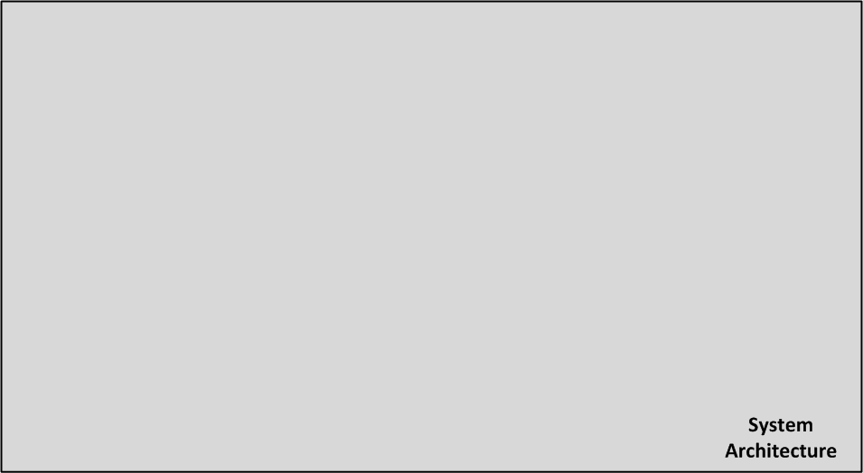
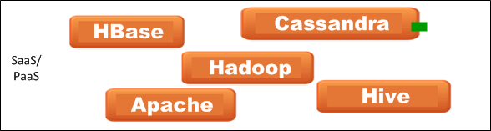
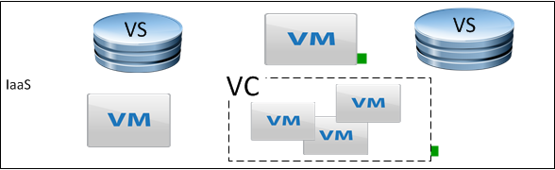
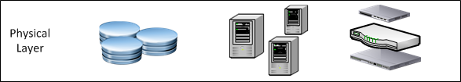
Notes:
Explain green markers for elasticity capabilities

Slide 28
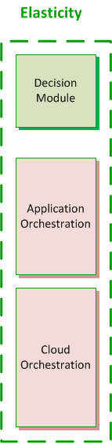
Notes:
Cloud Manager for deployment. The Orchestrator consists of two sub- components. The first component is the Cloud Orchestrator, which is the interface that interacts with the IaaS provider to (de-)allocate the requested Cloud resources. The second component is the App Orchestrator, which performs the execution of application specific scripts and ensures the configuration and deployment correctness.

Slide 29
Elasticity Platform
Components
CELAR Manager
Cloud Orchestrator
Decision Making Module
Application Profiler
CELAR DataBase

Slide 30
CELAR Manager
CELAR’s endpoint
Receives and processes requests:
  Application description
  Application submission (new deployments)
API for client communication
Provides information regarding deployments and their states

Slide 31
Cloud Orchestrator
Responsible for application provisioning
Enforces resizing actions:
  Horizontal scaling (VM addition/removal)
  Vertical scaling (CPU/RAM increase/decrease)
  Disk attach/detach
  Application reconfiguration (no IaaS contact needed)
Orchestrates the actions:
  Cloud level (IaaS contact and (de)allocation)
  Application level (application use the resources)

Slide 32
Decision Making Module
The “brain” of the CELAR Platform
Monitoring data
  Fetches and organizes them
  Estimate the application’s Load & State
Learning mechanism:
  First: investigates each action’s effects
  Eventually: picks the appropriate action
User tuning:
  Receives constraint-based user policies
    e.g.: minimize cost when latency < 10ms

Slide 33
Application Profiler
Creates knowledge basis for unknown apps
Application model:
  blackbox with different configurations parameters
Main idea:
  Pick representative deployment setups
  Deploy application
  Guess performance for all the deployment setups
Utilized by the DMM when no experience of the app:
  First deployment steps

Slide 34
CELAR DataBase
The “backend” of the platform.
Contains information regarding:
  Application structure
  Application state
  Monitoring metrics
  Cloud resources (flavors, images, etc.).
  Many more..
Deployable in a Highly Availably manner to increase availability and robustness.

Slide 35
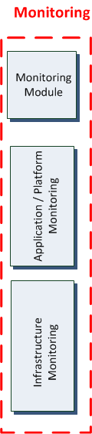

Slide 36
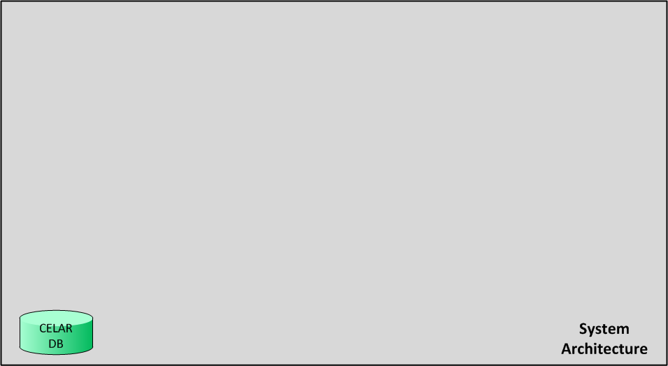

Slide 37
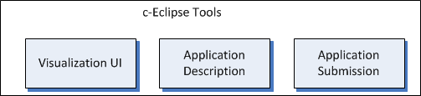

Slide 49
Elasticity Platform
Components:
  CELAR Manager
  Provisioner Orchestrator
  Decision Making Module
  Application Profiler
  CELAR DataBase

Slide 50
CELAR Manager
CELAR’s endpoint
Receives and processes requests:
  Application description
  Application submission (new deployments)
API for client communication
Provides information regarding deployments and their states

Slide 51
Provisioner Orchestrator
Responsible for application provisioning
Enforces resizing actions:
  Horizontal scaling (VM addition/removal)
  Vertical scaling (CPU/RAM increase/decrease)
  Disk attach/detach
  Application reconfiguration (no IaaS contact needed)
Orchestrates the actions:
  Cloud level (IaaS contact and (de)allocation)
  Application level (application use the resources)

Slide 52
Decision Making Module
The “brain” of the CELAR Platform
Monitoring data
  Fetches and organizes them
  Estimate the application’s Load & State
Learning mechanism:
  First: investigates each action’s effects
  Eventually: picks the appropriate action
User tuning:
  Receives constraint-based user policies
    e.g.: minimize cost when latency < 10ms

Slide 53
Application Profiler
Creates knowledge basis for unknown apps
Application model:
  blackbox with different configurations parameters
Main idea:
  Pick representative deployment setups
  Deploy application
  Guess performance for all the deployment setups
Knowledge used by the DMM when it has no experience of the app:
  First deployment steps

Slide 54
CELAR DataBase
The “backend” of the platform.
Contains information regarding:
  Application structure
  Application state
  Monitoring metrics
  Cloud resources (flavors, images, etc.).
  Many more..
Deployable in a Highly Availably manner to increase availability and robustness.

Slide 55
Tutorial Outline
Cloud Computing
Main topics:
  Elasticity
  Application Management
CELAR Architecture
Elasticity and Monitoring
  SYBL & rSYBL
  JCatascopia
Eclipse CAMF
Conclusions

Slide 56
The Elasticity Controller
Cloud
Provider
Application Server Tier
Database Backend
Load Balancer
store/extract video
Distribute
client requests
.
.
.
upload/download
video
.
.
.
clients
if (metricA > X) then add VM
else if (metricA < X) then remove VM
else if (metricB > Y) then increase RAM
…
Elasticity
Controller
add/remove resources
Elasticity constraints are too complex for users
Mostly, based on low-level metrics

Slide 57
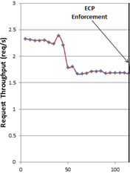
Elasticity Control and Estimation
How should we interpret a sudden drop in request throughput at the business tier of a 3-tier cloud service?
  There are less clients; this makes the business tier inefficiently utilized
    Right Decision: Remove an Application Server
  Video storage backend under-provisioned, requests are getting queued at business tier
    Right Decision: Add another Database Node
Elasticity Controller with simple IF-THEN-ELSE policies based on metric violations cannot determine the right ECP to improve QoS or cost

Slide 58






Current Elasticity Controllers
Manual or semi-automated elasticity control
Vendor-specific
Elasticity modelled as a one-dimensional property
  No control over cost, performance and quality
Only “horizontal” elasticity control
  e.g. add / remove virtual instances
AutoScaling

Slide 59
CELAR Elasticity Building Blocks
Source: Hong-Linh Truong (TUW), CloudCom ‘14
Conceptualizing and modelling elastic objects and execution environments
Defining and capturing elasticity primitive operations associated with elastic objects
Programming elastic objects and actions
Runtime deployment, control and monitoring techniques for elastic objects

Slide 60
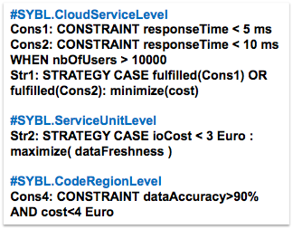
Elasticity in CELAR
Dependency Graph capturing application structure and enabling a multi-level specification of elasticity: Application unit, service topology, application
Elasticity requirement specification - SYBL: Monitoring, constraint, strategy
Multi-dimensional Modeling & analysing Elasticity of Cloud Services - MELA: Resources, cost, quality
Multi-level elasticity control through rSYBL

Slide 61
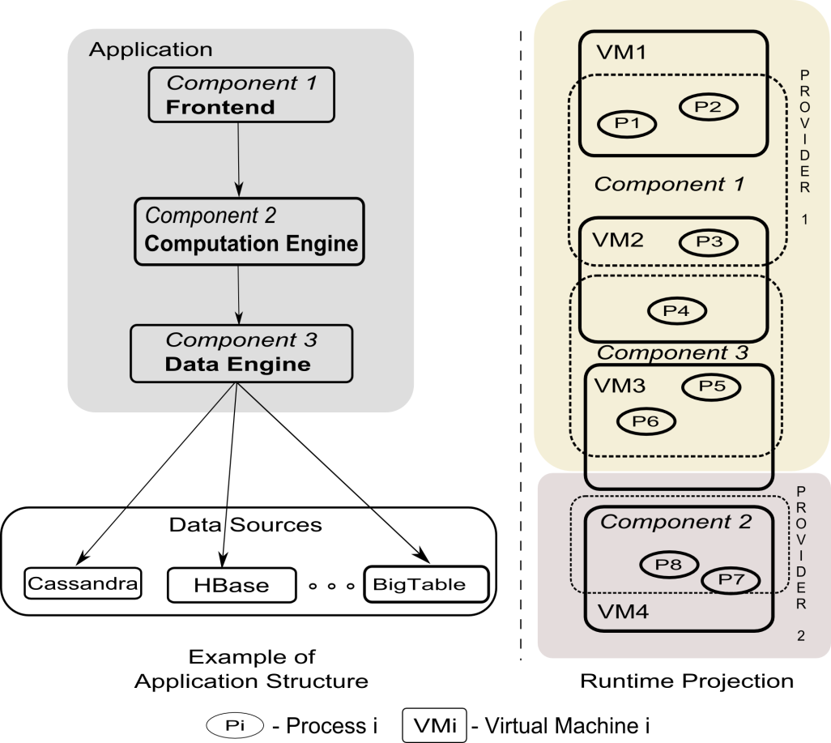
Dependency Graph
Service/Application Structure
Cost
“If the cost is greater than 800 Euro…”
Cloud Service
Resources
“allocated memory should be at least 6 GB…”
Service Topology
Quality
“Response time should be less than an amount varying…”
Service Unit
Code Region
Notes:
Clarify the relationship between high level elasticity requirements and low level ones
Linh: what would be a single statement to emphasize this slide? e.g., complexity of cloud services and elasticity can be applied/occur in all these levels?

Slide 62
SYBL and rSYBL
SYBL (Simple Yet Beautiful Language)
  A language for specifying elasticity controls
  Directive-based and XML-based
rSYBL – Runtime SYBL
  A set of runtime services that accept SYBL-based specifications and control the elasticity of cloud applications at runtime
Prototype:
  https://github.com/tuwiendsg/rSYBL
Full Syntax
  http://dsg.tuwien.ac.at/research/viecom/SYBL

Slide 63




End to End Elasticity
Run time
MELA
JCatascopia
Design time
c- lipse
CELAR Server
CELAR Manager
Decision Module
Elasticity Quantification
Smart Deployment
Elasticity Relationships
Elasticity Behavior
Data Elasticity
Smart deployment DMM
Integrated
Integrating
Integrated
Integrated
end-to-end elasticity

Slide 64
SYBL - Simple Yet Beautiful Language
Stimulated by directive programming models
  Goals: easy to use, high-level, multiple levels of control
Language for elasticity requirements specification
Possible users: cloud provider, application owner, application developer, software provider
Targeted: Data/compute intensive cloud services

Slide 65
Elasticity Directive Primitives
”Programming Directives for Elastic Computing”,
S. Dustdar, Y. Guo, R. Han, B. Satzger, H-L.Truong, IEEE Internet Computing 16(6): 72-77 (2012)

Slide 66
SYBL Main Concepts
„Monitoring“
  Directives for describing what needs to be monitored and under what conditions
„Constraint“
  Directive for describing what needs to true and under what conditions
„Strategy“
  Directive for describing how to achieve certain goals and under what conditions

Slide 67
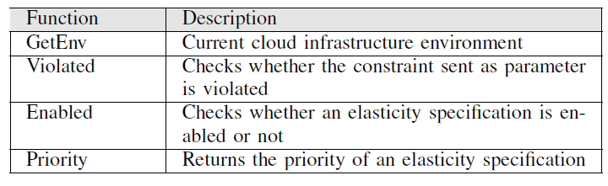
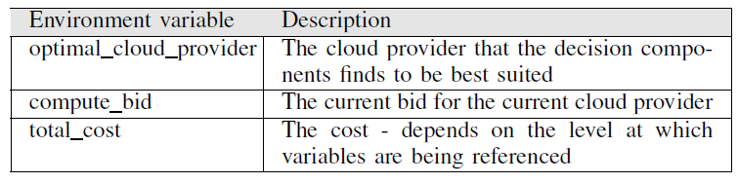
SYBL Main Concepts
Other constructs: predefined functions and environment variables

Slide 68
SYBL Elasticity Requirements
Simple Example
#SYBL.CloudServiceLevel
  Mon1 MONITORING rt = Quality.responseTime
  Cons1 CONSTRAINT rt < 2 ms. when nbOfUsers < 1000
  Cons2 CONSTRAINT rt < 4 ms. when nbOfUsers < 10000
  Cons3 CONSTRAINT totalCost < 800 Euro
  Str1 STRATEGY CASE Violated(Cons1) OR Violated(Cons2): ScaleOut
  Priority(Cons1)=3, Priority(Cons2)=5
#SYBL.ServiceUnitLevel
  ComponentID = Component3; ComponentName= DataEngine
  Cons4 CONSTRAINT totalCost < 600 Euro
#SYBL.ServiceUnitLevel
  ComponentID = Component2 ComponentName= ComputingEngine
  Cons5 CONSTRAINT cpuUsage < 80%
#SYBL.CodeRegionLevel
Cons6 CONSTRAINT dataAccuracy>90% AND cost<400

Slide 69
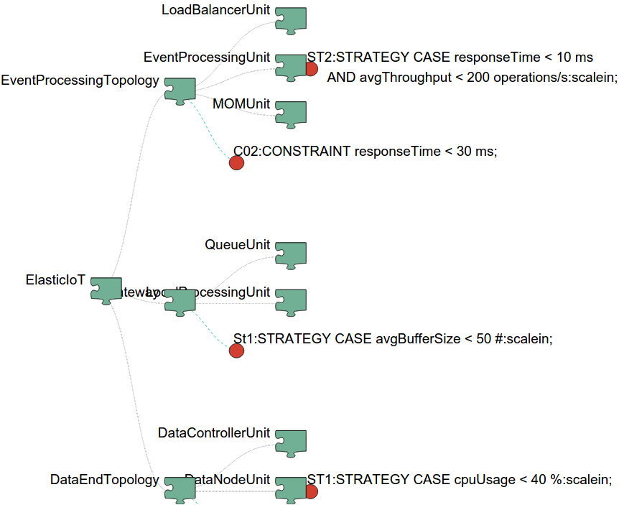
Example of elasticity requirements integrated with cloud application structure
#SYBL.CloudServiceLevel
Cons1: CONSTRAINT responseTime < 5 ms
Cons2: CONSTRAINT responseTime < 10 ms WHEN nbOfUsers > 10000
Str1: STRATEGY CASE fulfilled(Cons1) OR fulfilled(Cons2): minimize(cost)
#SYBL.ServiceUnitLevel
Str2: STRATEGY CASE ioCost < 3 Euro : maximize( dataFreshness )
#SYBL.CodeRegionLevel
Cons4: CONSTRAINT dataAccuracy>90% AND cost<4 Euro
Daniel Moldovan, Georgiana Copil, Hong Linh Truong, Schahram Dustdar: MELA: elasticity analytics for cloud services. IJBDI 2(1): 45-62 (2015)

Slide 70
SYBL
Example in XML
Integrated with TOSCA

Slide 71
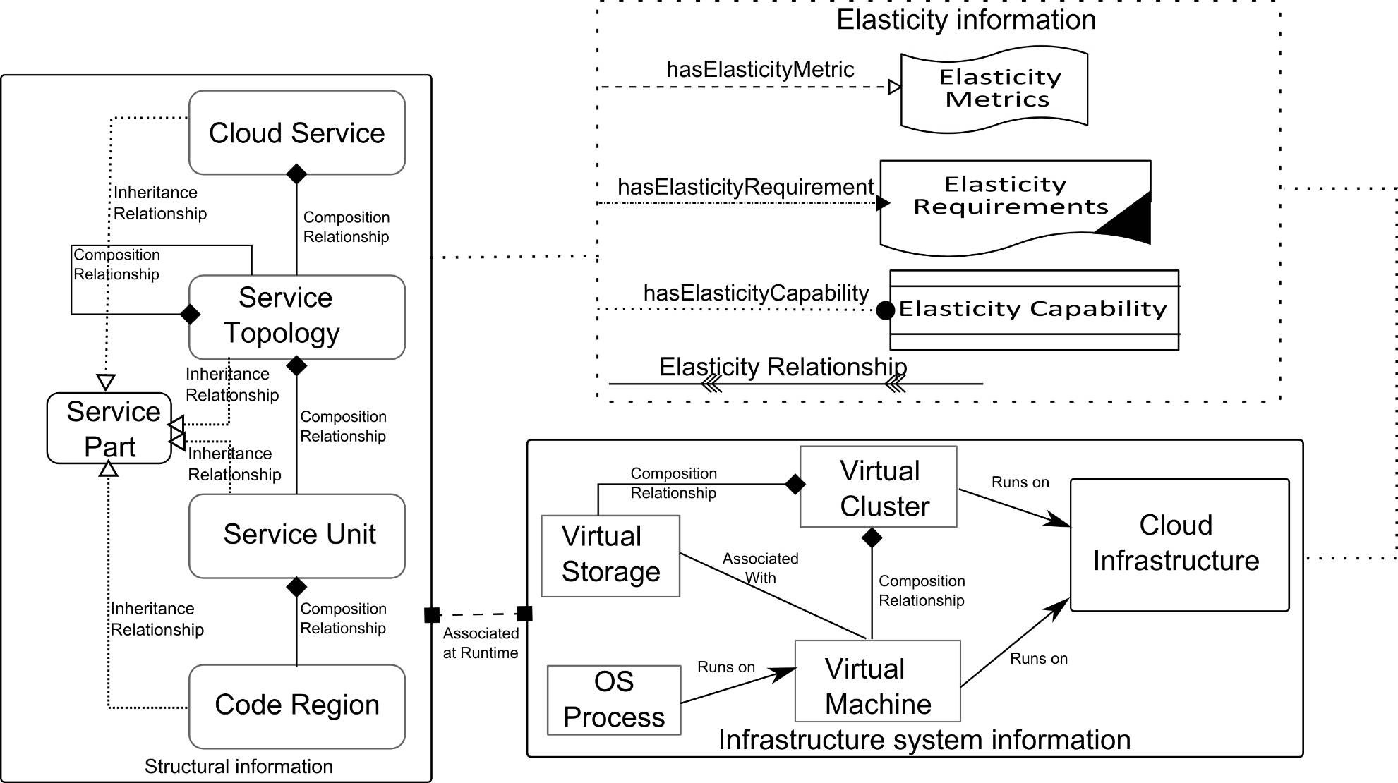
Multi-level Elasticity Control

Slide 72
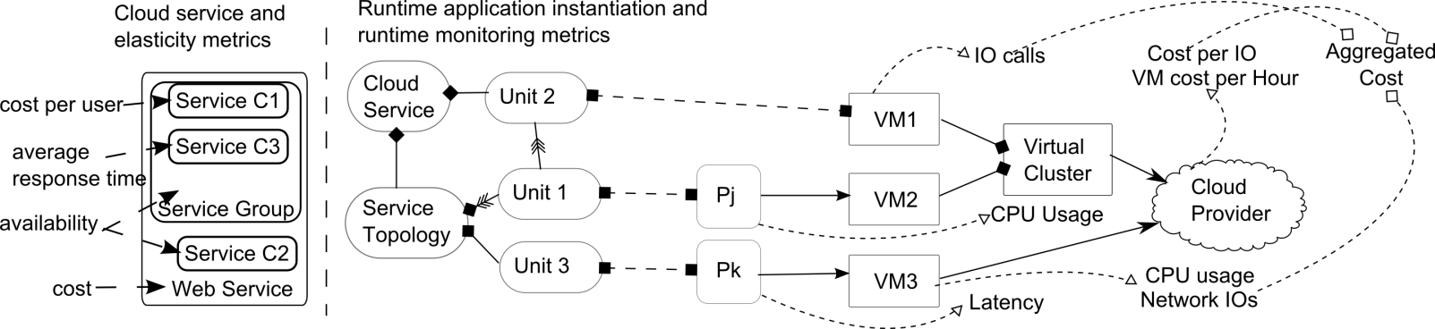
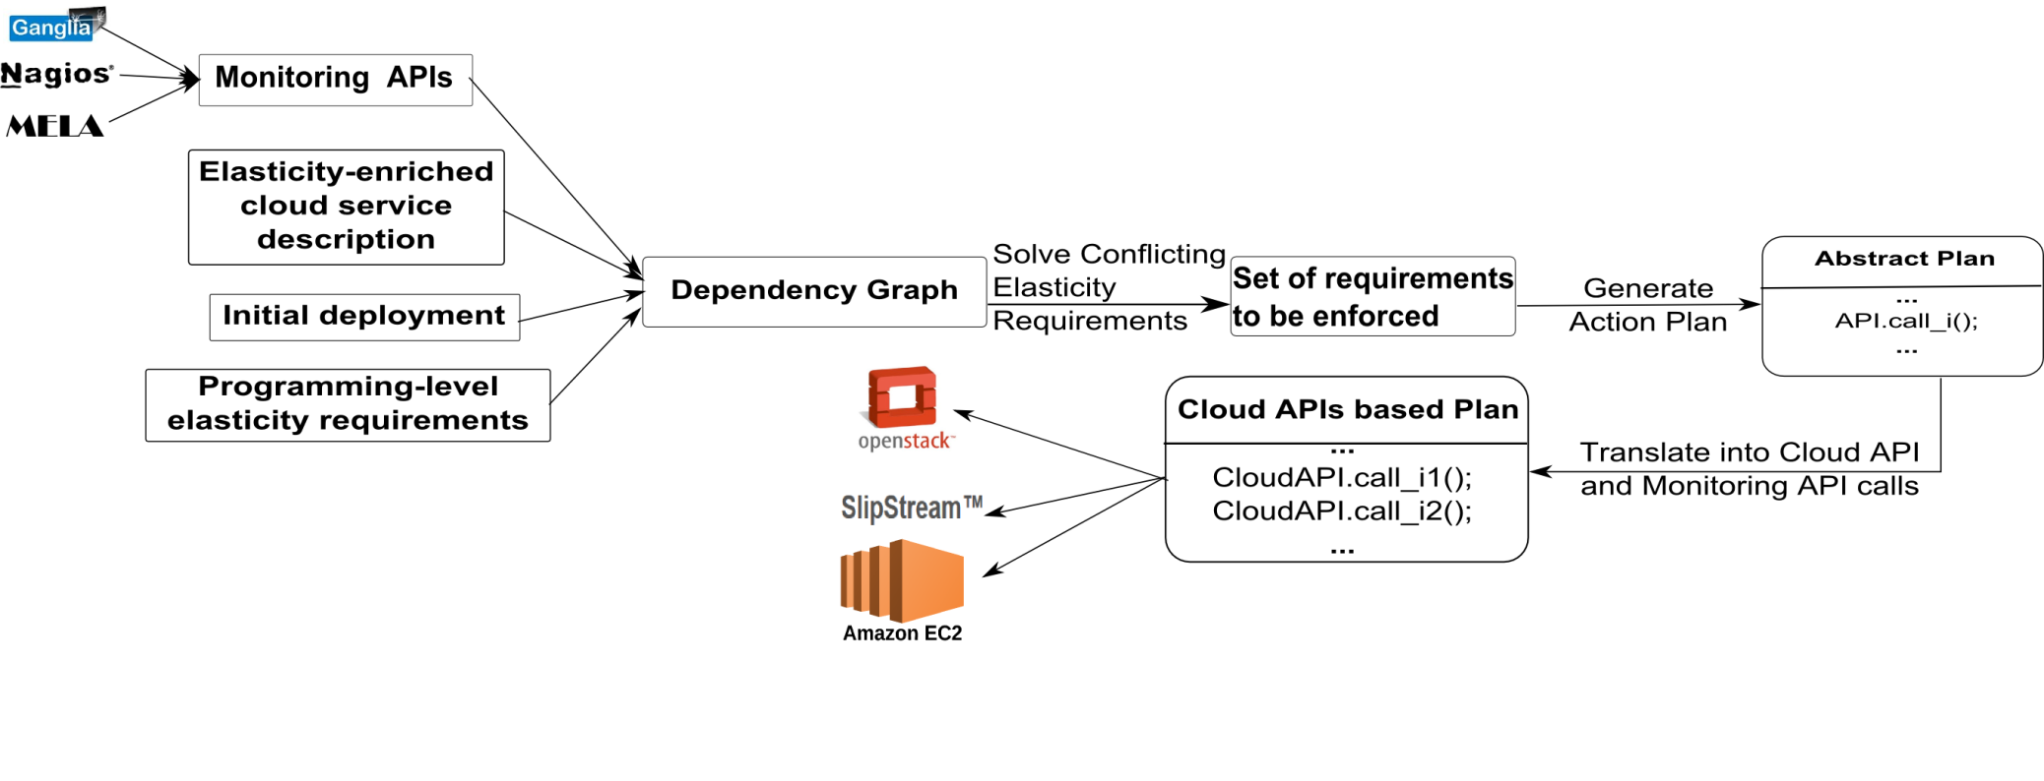
Mapping Services Structures to Elasticity Metrics
"Multi-level Elasticity Control of Cloud Services”,
G. Copil, D. Moldovan, H-L. Truong, S. Dustdar, ICSOC 2013
Elasticity directives can be changed at runtime

Slide 73
Complex Mapping and Generation actions for Enforcing Elasticity (1)
Constructing and maintaining the elastic cloud service dependengy graph

Slide 74
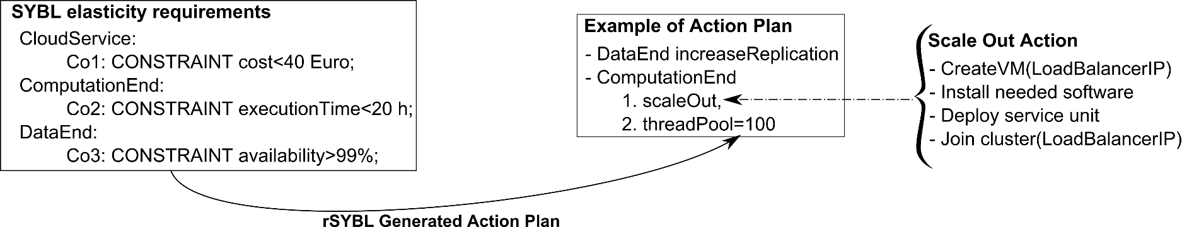
Complex Mapping and Generation actions for Enforcing Elasticity (2)
Steps in enforcing elasticity
Example of an action plan

Slide 75
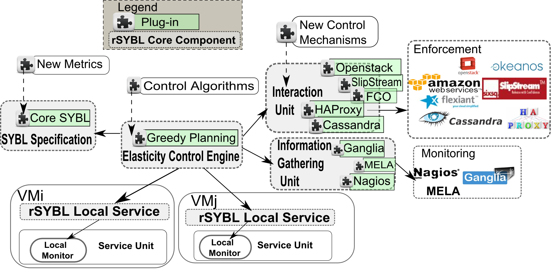
rSYBL – Elasticity Control as a Service
https://github.com/tuwiendsg/rSYBL/docs

Slide 76
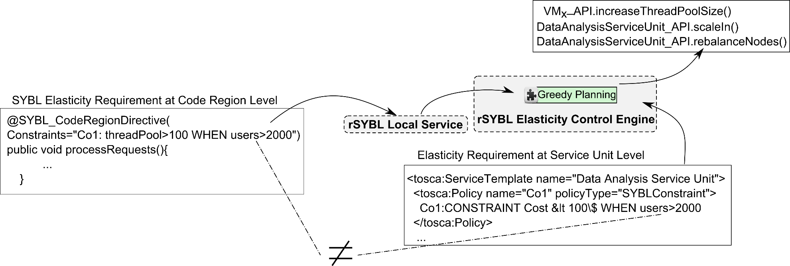
Linking Elasticity Requirements to Enforced Actions
Determine suitable elasticity capabilities, based on the elasticity requirements
Trigger the enforcement of elasticity capabilities

Slide 77
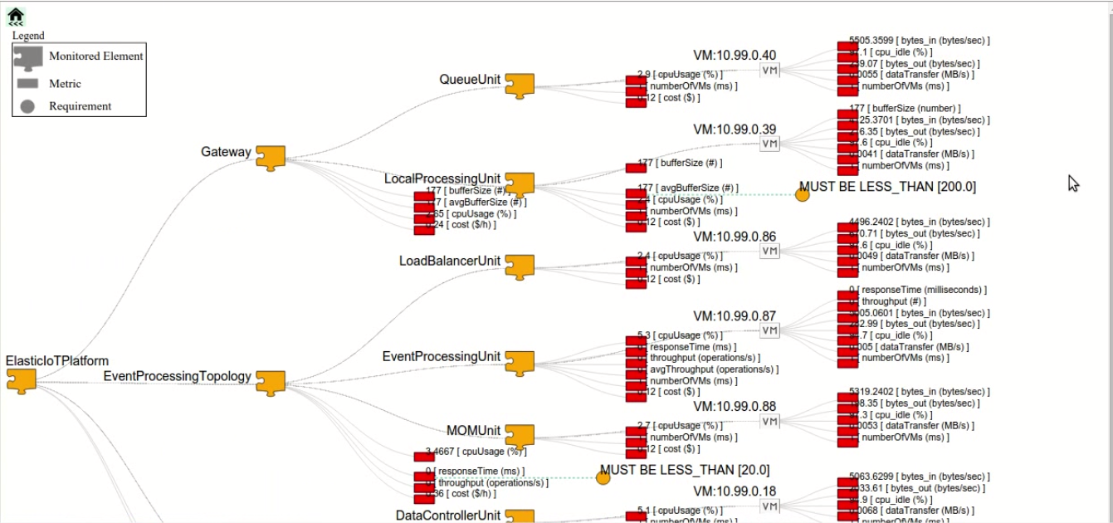
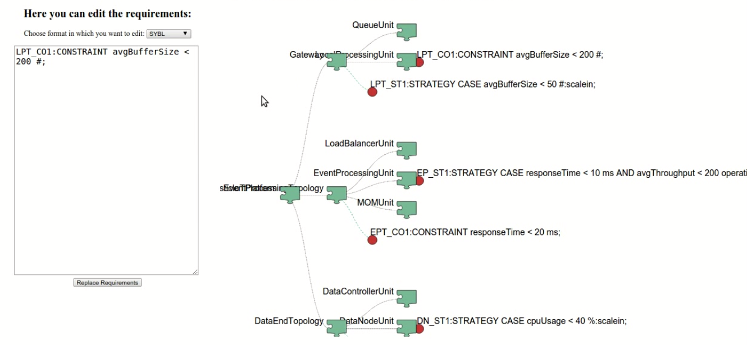
Enable Elasticity Reconfiguration at Runtime
Analysis detects problems but predefined strategies do not always work!
Changing elasticity specifications at runtime without stoping services

Slide 78
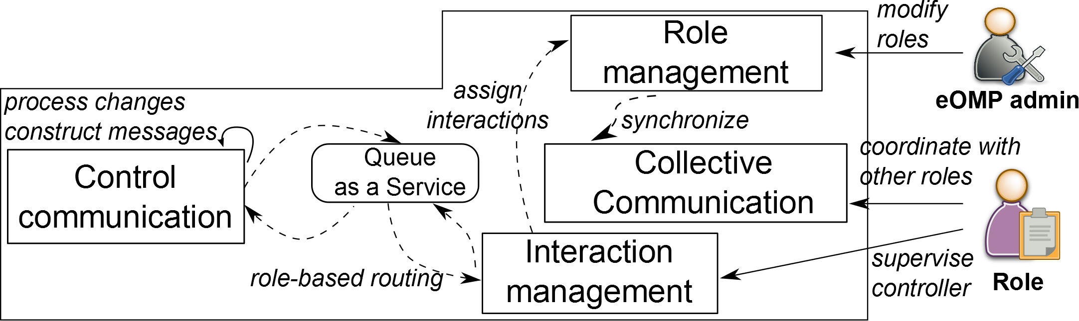
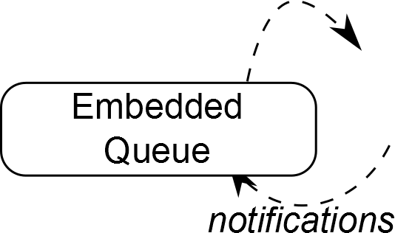
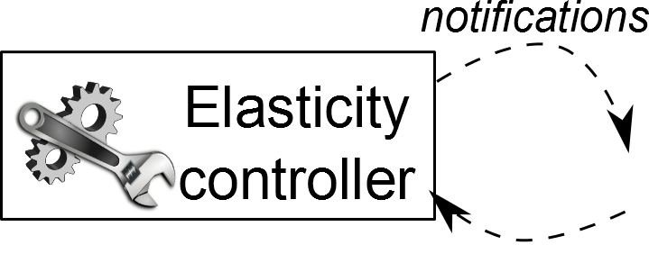
Human-in-the-loop Elasticity Operation Management
Goal:
  Notify elasticity conflicts/incidents to people
  People can solve the conflicts by introducing new specification

Slide 79
Monitoring for Elasticity Control
“JCatascopia: Monitoring Elastically Adaptive Applications in the Cloud”
D. Trihinas, G. Pallis, M. Dikaiakos, IEEE/ACM International Symposium on Cluster, Cloud and Grid Computing, 2014.
MAPE-K control loop (Monitoring, Analyzing, Planning, Executing using Knowledge)
Analyse
Plan
Knowledge
Resource
Utilization
Monitor
Execute
Application
Behaviour
Elastic Cloud Service

Slide 80
Cloud Monitoring
Challenges
Monitor heterogeneous types of run-time information and resources
Extract metrics from multiple levels of the cloud
  Low-level metrics (i.e. CPU usage, network traffic)
  High-level metrics (i.e. application throughput, latency, availability)
Metrics collected at different time granularities
Non-intrusiveness

Slide 81
Cloud Monitoring Challenges
Platform Independence
Portable cloud services can be moved to another platform due to better pricing schemes, availability, QoS, etc.
Monitoring System?
  Portable
  Easily configurable on new platform
Cloud Service
Cloud Service
Monitoring
Monitoring
Provider A
Provider B

Slide 82
Cloud Monitoring Challenges
Interoperability
Distribute a cloud service across multiple providers due to better resource locality, availability or security concerns
Monitoring System?
  Operate and collect metrics seamlessly across multiple providers
Cloud Service
Cloud Service
Monitoring
Monitoring
Monitoring
Provider A
Provider B
Provider C

Slide 83
Cloud Monitoring Challenges
Elasticity Support
Detect configuration changes in a cloud service
Monitoring System?
  Detect configuration changes automatically without restarting monitoring process or part of it and without any human intervention
VM
VM
VM
. . .
VM
VM
VM
VM
VM
. . .
VM
Cloud Service
Cloud Service
  Application topology changes
  (e.g. new VM added)
  Allocated resource changes
  (e.g. new disk attached to VM)

Slide 84



Cloud Monitoring
State-of-the-Art
Cloud-specific Monitoring Tools
  Limited to a specific number of cloud platforms
  Commercial and proprietary -> limited portability and interoperability
General Purpose Monitoring Tools
  Suitable for only slowly changing fixed infrastructures
  Limited application-level monitoring support
No elasticity support
  Detect configuration changes in:
    Application topology (e.g. new VM added)
    Allocated resource (e.g. new disk attached to VM)
Notes:
Public and Private cloud providers offer monitoring capabilities
Fully documented
Well integrated with underlying platform
REST APIs and graphical web interfaces
Automated notification and alerting mechanisms
Commercial and proprietary -> limited portability and interoperability

Slide 85
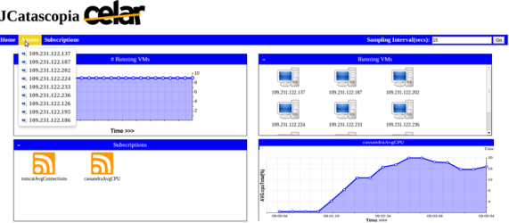
JCatascopia – Cloud Monitoring System
“JCatascopia: Monitoring Elastically Adaptive Applications in the Cloud”,
D. Trihinas, G. Pallis, & M. Dikaiakos, CCGrid2014.
Open-source
Interoperable
Scalable
Multi-Layer Cloud Monitoring
  Customizable and Extensible by Users
  Metric Subscription Rule Language
Platform Independent
  Operates on any cloud platform
  Metric collection, distribution or storage are independent to underlying infrastructure
Elastic by design

Slide 86
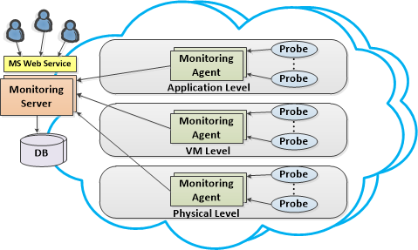
JCatascopia Architecture

Slide 87
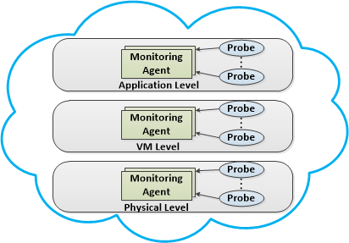
JCatascopia – Monitor Probes
Actual metric collectors managed by Monitoring Agents
Collect system-level and application performance metrics
Push or Pull mechanism to forward metrics to their corresponding Agent
Notes:
Probes are metric collectors responsible for gathering low- level metrics from the cloud element they reside on (i.e. VM or physical server) and performance metrics from running cloud services. Metrics are forwarded to Probe managing entities (Monitoring Agents) in either a push or pull manner.

Slide 88
JCatascopia – Monitor Probes
Well Defined Probe API
Application developers can implement their own custom Probes
Dynamically deployable to Monitoring Agents
Push and Pull metric delivery mechanism
Filtering mechanism at Probe level
  Minimizes communication and storage overhead
  Probe developers can create their own metric filters

Slide 89
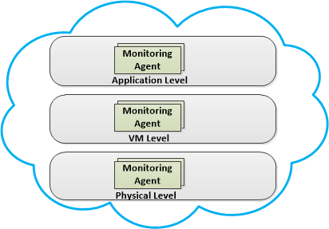
JCatascopia – Monitor Agents
Light-weight monitoring instances
Deployable on physical nodes or virtual instances
Responsible for the metric collection process
Aggregate and distribute collected metrics (pub/sub)
Notes:
Layer-specific Agents
Monitoring Agents are light-weight monitoring instances deployable on any cloud element to be monitored, such as physical nodes or virtual instances. Monitoring Agents are the entities responsible for managing the metric collection process on the respective cloud element which includes processing and distributing monitoring information, originating from Monitoring Probes to Monitoring Server(s). An Agent is con- sidered as the probe manager for the node its deployed on. A Monitoring Agent is responsible for their (de-)activation and configuration, according to user-defined parameter requests.

Slide 91
JCatascopia – Monitor Server
Receives metrics from Monitoring Agents
Aggregates, filters, processes and stores metrics in Database
Handles user metric and configuration requests
Hierarchy of Monitoring Servers for greater scalability

Slide 93
JCatascopia – Dynamic Agent Discovery
Subscriber
Publisher
Server
Agent
Bind to IP and Port
Bind to IP and Port
subscribe
subscribe
status: connected
status: connected
send metadata
event stream
status: received
metric stream
(a) Classic pub/sub
(b) JCatascopia
Benefits
Monitoring Servers are agnostic of Agent network location
Agents appear dynamically
Eliminated the need to
Restart or reconfigure Monitoring System
Depend on underlying hypervisor
Require directory service with Agent locations
Notes:
With the proposed variation, the Monitoring Server is agnostic to the network location of its Monitoring Agents, allowing them to appear and disappear dynamically in a flexible manner by eliminating the need: (i) to restart or reconfigure the Monitoring System; (ii) to depend on the underlying hypervisor; and (iii) to require a directory service that contains these locations.

Slide 94
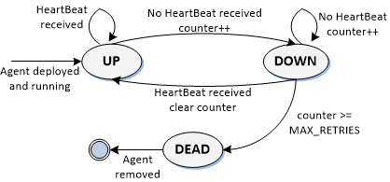
JCatascopia – Dynamic Agent Removal
Heartbeat monitoring to detect when Agents:
  Removed due to scaling down elasticity actions
  Temporary unavailable (network connectivity issues)
Notes:
With the proposed variation, the Monitoring Server is agnostic to the network location of its Monitoring Agents, allowing them to appear and disappear dynamically in a flexible manner by eliminating the need: (i) to restart or reconfigure the Monitoring System; (ii) to depend on the underlying hypervisor; and (iii) to require a directory service that contains these locations.

Slide 95
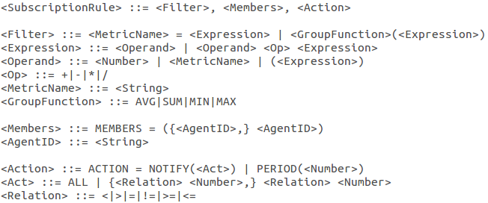
JCatascopia – Metric Subscription Rule Language
Aggregate single instance metrics
Generate high-level metrics at runtime
SUM(errorCount)
Subscription Rule Example
Average DBthroughput from the low-level metrics readps and writeps of a database cluster comprised of N nodes:
DBthroughput = AVG(readps + writeps)
MEMBERS = [id1, ... ,idN]
ACTION = NOTIFY(<25,>75%)
DBthroughput = AVG(readps+writeps)
Notes:
notify elasticity controller when certain metrics exceed set values

Slide 96
JCatascopia – Adaptive Filtering
Simple fixed range filter windows are not effective:
  i.e. filter currentValue if in window previousValue ± R
  No guarantee that any values will be filtered at all
Adaptive filter window range
  Window range (R) is not static but depends on percentage of values previously filtered
Collect
Samples
Check percentage of filtered values
Adjust Window Range (R)

Slide 97
JCatascopia
Evaluation
Validate JCatascopia functionality and performance
Compare JCatascopia to other Monitoring Tools
  Ganglia
  Lattice Monitoring Framework
Testbed
  Different domains of Cloud applications
  Various VM flavors
  3 public Cloud providers and 1 private Cloud

Slide 98
Jcatascopia
TestBed
Cloud Provider | VM no. | VM Flavor | Applications
GRNET Okeanos public Cloud1 | 15 | 1GB RAM, 10GB Disk, Ubuntu Server 12.04 LTS | 12 VMs Cassandra⁷ 3 VMs YCSB Clients⁸
Flexiant FlexiScale platform2 | 10 | 2 VCPU, 2GB RAM, 10GB Disk, Debian 6.07 (Squeeze) | HASCOP⁹
Amazon EC23 | 10 | m1.small with CentOS 6.4 (1VCPU, 1.7GB RAM, 160GB Disk) | HASCOP
UCY Nephelae Private Cloud4 | 60 | 2 VCPU, 2GB RAM, 10GB Disk, Ubuntu Server 12.04 LTS | HASCOP
We have deployed on all VMs JCastascopia Monitoring Agents, Ganglia gmonds⁵ and Lattice⁶ DataSources

Slide 99
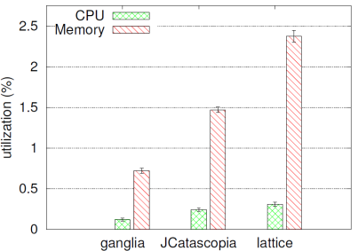
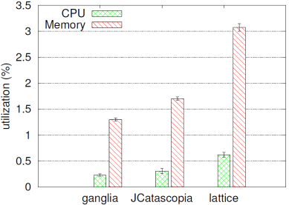
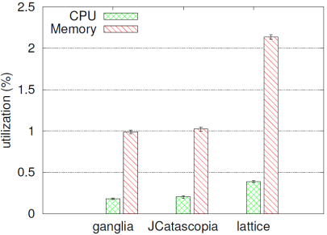
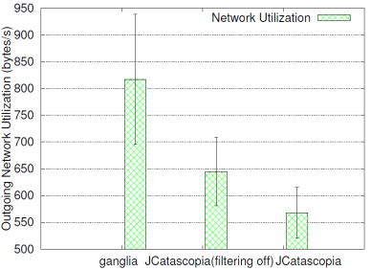
JCatascopia - Monitoring Agent Runtime Footprint
Ganglia footprint x2
difference less than 0.03%
YCSB Agent Client (11 metrics)
Cassandra Agent Utilization (27 metrics)
HASCOP (Distributed Clustering Algorithm) Agent (39 metrics)
More Application-Specific Metrics
When in need of application-level monitoring, for a small runtime overhead, JCatascopia can reduce monitoring network traffic and consequently monitoring cost

Slide 100
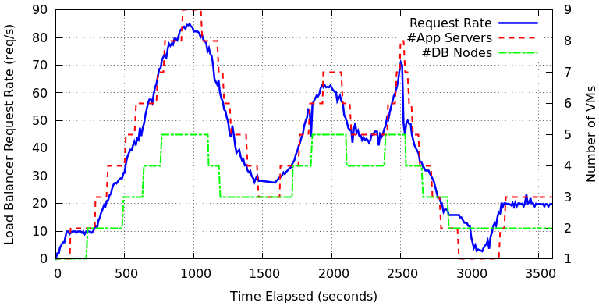
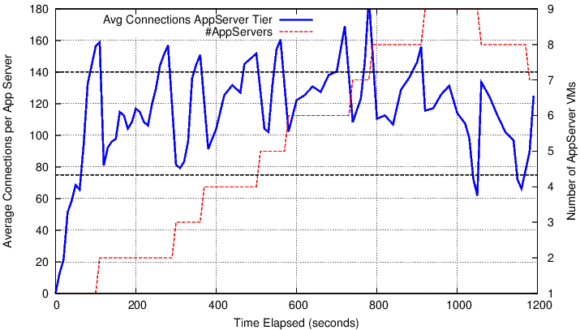
JCatascopia – Multi-Tier Monitoring
JCatascopia Metric Rule Language and Mechanism
avgActiveConnections = AVG(busyThreads)
MEMBERS = [id1, ... ,idN]
ACTION = NOTIFY(<70, >=140)
avgCPUUsage = AVG(1-cpuIdle)
MEMBERS = [id1, ... ,idN]
ACTION = NOTIFY(<30, >=85)

Slide 101



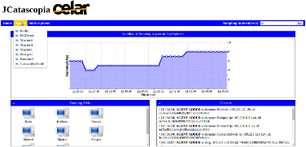
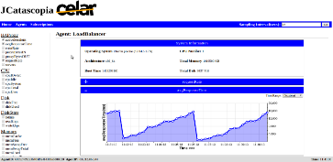

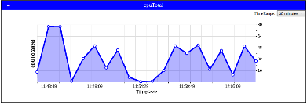


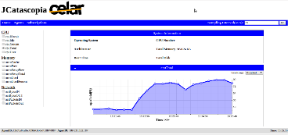
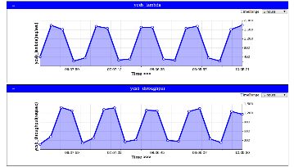
JCatascopia – Portability and Interoperability
Online Gaming
Multi-Tier Video Streaming
Multi-Graph Clustering in the Cloud
XDB In-Memory
Data Analytics
SCAN Genome Pipeline

Slide 102
Testbed - Available Probes
Probe | Metrics | Period (s)
CPU | cpuUserUsage, cpuNiceUsage, cpuSystemUsage, cpuIdle, cpuIOWait | 10
Memory | memTotal, memUsed, memFree, memCache, memSwapTotal, memSwapFree | 15
Network | netPacketsIN, netPacketsOUT, netBytesIN, netBytesOUT | 20
Disk Usage | diskTotal, diskFree, diskUsed | 60
Disk IO | readkbps, writekbps, iotime | 40
Cassandra | readLatency, writeLatency | 20
YCSB | clientThroughput, clientLatency | 10
HASCOP | clustersPerIter, iterElapTime, centroidUpdTime, pTableUpdTime, graphUpdTime | 20

Slide 103
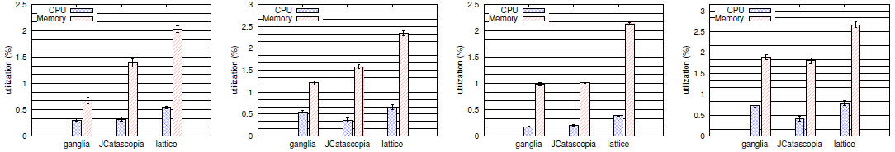
Monitoring Agent Runtime Footprint
for a 3-tier Video Streaming Service
HAProxy Load Balancer
Cassandra DB Node
Online Directory Node
Tomcat Application Server
As metric count increases, Ganglia doubles its runtime footprint since custom application-specific metrics are external processes in contrast to JCatascopia where Probes are loaded as lightweight Java threads

Slide 104

Network Utilisation
for 3-tier Video Streaming Service
When in need of application-level monitoring, for a small runtime overhead, JCatascopia can reduce monitoring network traffic and consequently monitoring cost

Slide 105


Jcatascopia - Scalability Evaluation
1 Monitoring Server
MySQL DB

Slide 106

Jcatascopia - Scalability Evaluation
1 Monitoring Server
1 Cassandra Node

Slide 107

Jcatascopia - Scalability Evaluation
1 Monitoring Server
2 Cassandra Nodes

Slide 108


Jcatascopia - Scalability Evaluation
1 Root Monitoring Server and 2 Intermediates

Slide 109


Jcatascopia - Scalability Evaluation
When archiving time is high, we can direct monitoring metric traffic through multiple Monitoring Servers, allowing the monitoring system to scale

Slide 110






JCatascopia – Release
Open-source under Apache 2.0 Licence
  Github: https://github.com/CELAR/cloud-ms
JCatascopia Website (docs, examples, videos, publications, etc.)
  http://linc.ucy.ac.cy/CELAR/jcatascopia
Packaging (JARs, tarballs, RPMs and Chef recipes) available in CELAR repo
JCatascopia Probe Library and Java Probe API
  https://github.com/dtrihinas/JCatascopia-Probe-Library
  System-level monitoring probes (for both Linux and Windows)
  Application-specific probes (Tomcat, Cassandra DB, HAProxy, Postgres DB, RabbitMQ)
Supporting 2 Different Database Backends (MySQL, Cassandra DB)

Slide 111
So is simple elasticity control based on user defined directives enough?
10 March 2015, University of Cyprus

Slide 112

ADVISE Framework
-> Collect more metrics
-> Refine clusters and discover new correlations
-> Increase our knowledge base
Input
Cloud Service topology description (CAMF)
Multi-layer monitoring metric evolution (JCatascopia)
Elasticity Control Processes (rSYBL)
Cloud specific info (Info Service)
Processing
Project metric evolution on n-dimensional space
Cluster metrics and discover (or better learn) metric correlations
Create execution plan based on historic info to improve resource utilization, QoS and reduce cost
Knowledge Base
Metric evolution
Metric correlations
ECPs and possible plans

Slide 113

Elasticity Control Estimation and Evaluation with ADVISE
"ADVISE: a Framework for Evaluating Cloud Service Elasticity Behavior [Best Paper]", G. Copil, D. Trihinas, H.L Truong, D. Moldovan, G. Pallis, S. Dustdar, M. D. Dikaiakos, 12th International Conference on Service Oriented Computing (ICSOC 2014), Paris, France 2014.
10 March 2015, University of Cyprus

Slide 114


ADVISE-based Multi-Dimensional Control
A single peek causes a “ping-pong” effect which is billing users for resources they aren’t really consuming
AWS uses a hourly charge rate
ADVISE-based Control
“Evaluating Cloud Service Elasticity Behavior", G. Copil, D. Trihinas, H.L Truong, D. Moldovan, G. Pallis, S. Dustdar, M. D. Dikaiakos, International Journal of Cooperative Information Systems (IJCIS), 2015.
10 March 2015, University of Cyprus

Slide 115
Tutorial Outline
Cloud Computing
Main topics:
  Elasticity
  Application Management
CELAR Architecture
Elasticity and Monitoring
  SYBL & rSYBL
  JCatascopia
Eclipse CAMF
Conclusions

Slide 116







Cloud Application Management Frameworks
Goal: ease the description & deployment of applications over Cloud infrastructures.
However:
  Most frameworks are vendor-specific and fail to address one of the main challenges in cloud application management, that is the vendor neutrality [Gartner]
  Proprietary
  Provide limited support for elasticity

Slide 117
Eclipse CAMF – Concept
Application Development
Application Topology Design
Application Deployment
Application Monitoring
Decision Making
Application Lifecycle

Slide 118

Eclipse CAMF
Extensible, multiplatform, standards compliant, plug and play framework
Open-source – build on top of Eclipse platform
Platform independent - Runs on any OS supported by Eclipse
Cloud Agnostic – Integrated with major platforms
  CELARized
  Amazon Web Services
  OpenStack
  Microsoft Azure
Adopts Open Cloud specifications
  OASIS TOSCA – Application Portability
  SYBL - Elasticity Requirements Specification
An official Eclipse Technology Project
www.eclipse.org/camf

Slide 119
Eclipse CAMF
Extensible, multiplatform, standards compliant, plug and play framework
Intuitive drag-and-drop GUI
  Low entry barrier for new end-users
Interface with Monitoring Systems
  JCatascopia Elastic Monitoring Service
  Native IaaS Monitoring System
Interface with Information Systems
  Improve Decision Making
Demonstrated with Real Apps
  DataPlay, SCAN, Scientific Computing, IaaS Integration, Video Streaming (ICWE), Application Portability (See UCC’15 Challenge)

Slide 120


Eclipse CAMF
OASIS TOSCA
TOSCA provides a language to describe:
  Application components & relationships (topology)
  Application management procedures (orchestration)
Component
Orchestration can be inferred from Types’ semantics i.e. interfaces
Composite Component

Slide 121


Eclipse CAMF
OASIS TOSCA
Specifies an XML Binding
  Implemented in CAMF
Specifies CSAR (Cloud Service Archive) an exchange format to package Cloud applications
CSAR Format

Slide 122

Eclipse CAMF Architecture
"c-Eclipse: An Open-Source Management Framework for Cloud Applications"
C. Sofokleous, N. Loulloudes, D. Trihinas, G. Pallis and M. Dikaiakos, EuroPar 2014

Slide 123
Eclipse CAMF Architecture
"c-Eclipse: An Open-Source Management Framework for Cloud Applications"
C. Sofokleous, N. Loulloudes, D. Trihinas, G. Pallis and M. Dikaiakos, EuroPar 2014
Graphical modeling of application’s topology
Drag-and-drop interface

Slide 124
Eclipse CAMF Architecture
"c-Eclipse: An Open-Source Management Framework for Cloud Applications"
C. Sofokleous, N. Loulloudes, D. Trihinas, G. Pallis and M. Dikaiakos, EuroPar 2014
Associated with visual elements by the Modeling Tool

Slide 125
Eclipse CAMF Architecture
"c-Eclipse: An Open-Source Management Framework for Cloud Applications"
C. Sofokleous, N. Loulloudes, D. Trihinas, G. Pallis and M. Dikaiakos, EuroPar 2014
CAMF specific types for Nodes, Relationships etc.

Slide 126
Eclipse CAMF Architecture
"c-Eclipse: An Open-Source Management Framework for Cloud Applications"
C. Sofokleous, N. Loulloudes, D. Trihinas, G. Pallis and M. Dikaiakos, EuroPar 2014
Packages application descriptions as CSAR archives

Slide 127
Eclipse CAMF - Application Modelling Tool
Cloud Project View
Modelling
Canvas
Cloud Resource Navigator
Properties View

Slide 128
Eclipse CAMF - Application Modelling Tool

Slide 129

Eclipse CAMF – Cloud Project View
CAMF organizes files in a structured hierarchy
  Just like any other Eclipse project
Folders are placeholders for files required throughout application’s lifecycle i.e.
  Content needed to realize a deployment (executables, configuration files, VM images etc.)
  Folders’ structure is automatically created on project’s creation

Slide 130

Eclipse CAMF – Cloud Project View
Connections: Different relationship types can be specified i.e. “Depends On”, “Connects To”
Application Components: Application component types + composite component
Images: Provider’s images & user’s custom built images
Monitoring Probes: Monitoring metrics available by the provider’s monitoring system or by the integrated to c-Eclipse monitoring system
Elasticity Actions: Provider supported elasticity actions actions
User Applications: User’s custom created applications
Key Pairs: Generated by the user, used for accessing the deployed components
Deployment Scripts: User’s custom configuration scripts

Slide 131

Eclipse CAMF – Cloud Provider Selection
Ability to:
  Select one or more target Cloud provider for Application Deployment
  Provide Authentication credentials using Vendor API

Slide 132

Eclipse CAMF
Multi-Grain Elasticity Support
  Supports powerful and flexible SYBL definition language
Component, composite component or application level
Application’s constraints related to cost, performance and quality metrics
Express specific strategies to be enforced when constraints are violated
Support for Vertical / Diagonal Scaling
  VM resize
  Attach / Detach Disk
Support for Pre / Post Scaling Actions
  Execution scripts
  Elasticity Strategy and Constraints
Notes:
Constraints: User does not specify the exact actions to be enforced when a constraint is violated. Instead, the appropriate actions are determined by the underlying
intelligent elastic Resource Provisioning System.
If the IaaS resource provisioning system supports dynamic scaling of applications, then the specified elasticity policies are translated, (by
the TOSCA Container) to provider specific elasticity rules. Otherwise, the defined elasticity policies will be ignored.

Slide 133

DataPlay Description In CAMF

Slide 134

SCAN – Cancer Genome Description In CAMF

Slide 135

Eclipse CAMF – Deployment Details
Applications’ deployment request are sent
Applications are up and running on 2 infrastructures
The status of the two deployments is shown in the Application Deployments View

Slide 136
Eclipse CAMF – Project Endpoints
Website
http://www.eclipse.org/camf
Bugzilla
https://bugs.eclipse.org/bugs/describecomponents.cgi?product=Camf
Mailing Lists
Developers: camf-dev@eclipse.org Users: camf-users@eclipse.org
Tutorial
Getting started guide uploaded to http://linc.ucy.ac.cy/CELAR/c Eclipse/getstarted/guide.pdf

Slide 137
Summary and Conclusions
Elasticity works!
  Videos with demos are available online (Youtube channel: CELAR Cloud)
Elastic Monitoring
  Can be performed in a platform-independent and scalable way, non-intrusively.
Eclipse CAMF
  A powerful vendor-neutral environment for the Cloud application lifecycle.
Open-source and available on Eclipse.org and github

Slide 138
Contact
University of Cyprus
TU Wien
NTUA
Marios D. Dikaiakos
mdd
Nicholas Loulloudes
nickl
George Pallis
gpallis
Hong-Linh Truong
truong
Dimitrios Tsoumakos
dtsouma
@ cs.ucy.ac.cy
@ dsg.tuwien.ac.at
@ cslab.ece.ntua.gr

