Slide 1

A Topological Approach to Voxelization
Samuli Laine
NVIDIA

Slide 2
About the Title
Voxelization = Turn a continuous input in R³ into a discrete output in Z³
  Also includes the 2D case (rasterization)
Topological instead of geometrical approach
  Intuitively, things of Boolean nature: connectivity, separability, intersections, etc.
  No things of continuous nature: distances, angles, positions of intersection points, etc.

Slide 3
Preliminaries
We have an input S in the continuous world (R³)
  S might be curve, surface, or volume
We wish to produce a discretized version S^{d} that is somehow a faithful representation of S
  Also, we usually want S^{d} to have specific continuity and separability properties (depends on application)
S^{d} is a set of voxels V that are elements of Z³
  Each V is associated with a cubical volume in R³
Everything applies to 2 dimensions too (R² → Z²)

Slide 4
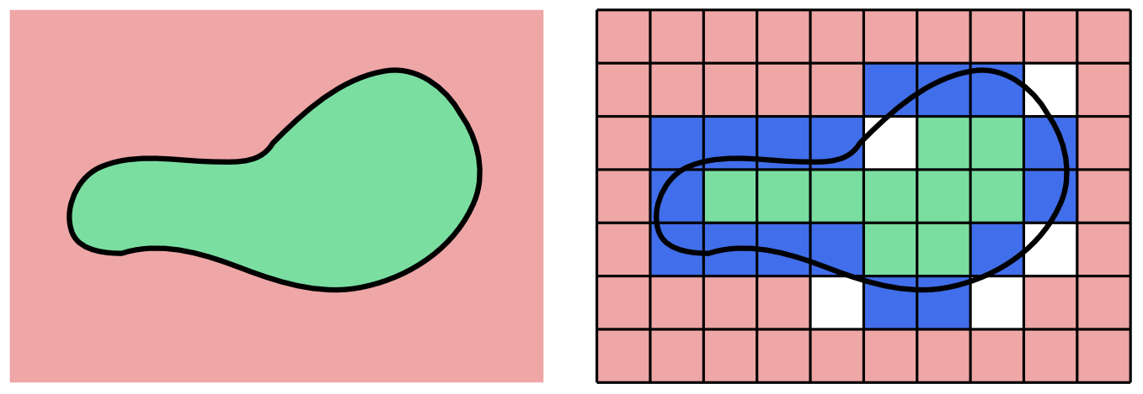
Preliminaries, cont’d
Assume that S separates R³ into sets I and O
Also assume discrete sets I^{d} and O^{d}
S^{d}
O
O^{d}
S
I
I^{d}
Space: R³
Space: Z³

Slide 5
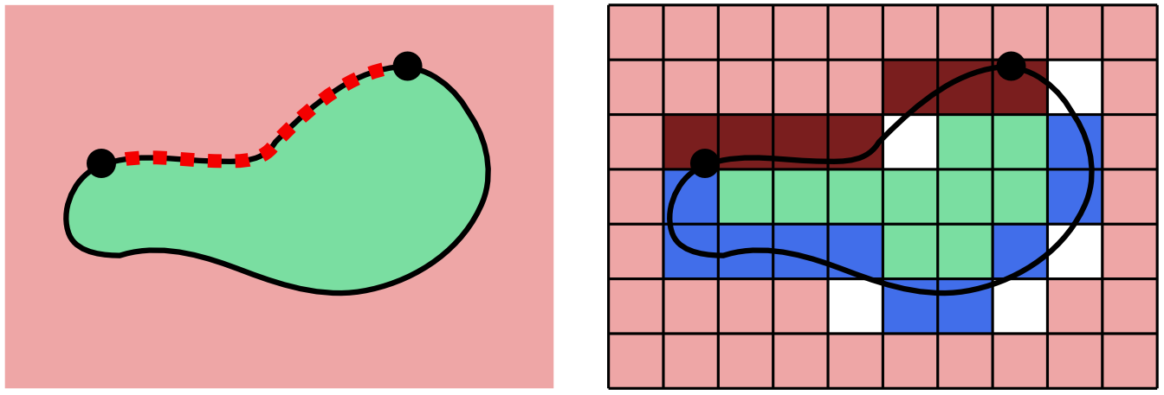
Connectivity
If it is possible to walk along S from point A to point B, and the same holds for S^{d}, then S^{d} is connected
S^{d}
O
O^{d}
S
I
I^{d}
Space: R³
Space: Z³

Slide 6
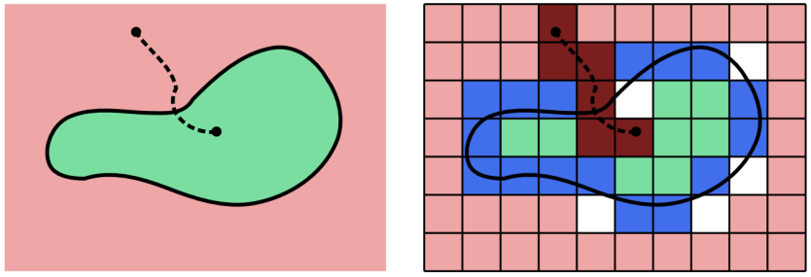
Separability
If S separates point in I^{d} from point in O^{d}, and S^{d} does the same, then S^{d} is separating
S^{d}
O
O^{d}
S
I
I^{d}
Space: R³
Space: Z³

Slide 7
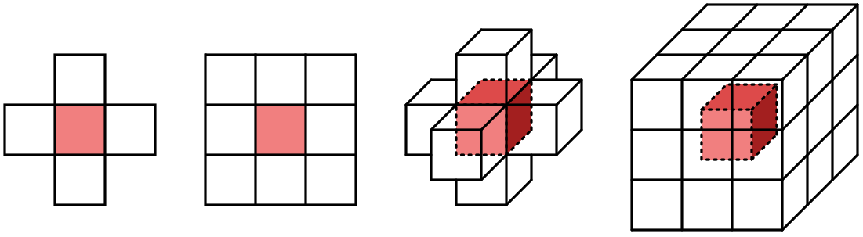
Neighborhoods
Notions of connectivity and separability in discrete spaces depends on the chosen definition of neighborhood
2D
3D
N₄
N₈
N₆
N₂₆

Slide 8
k-connectivity and k-separability
In a discrete k-connected path Π_{k} = (V₀, …, V_{n}) voxels V_{i} and V_{i+1} are k-neighbors
Voxelization S^{d} is k-separating if there is no Π_{k} between any voxel in I^{d} and any voxel in O^{d} that does not pass through S^{d}
Voxelization S^{d} is k-connected if
  existence of a path from A to B on input surface S
  where both A and B are inside voxels belonging to S^{d}
  implies the existence of a Π_{k} with A inside V₀ and B inside V_{n} and all (V₀, …, V_{n}) being in S^{d}

Slide 9
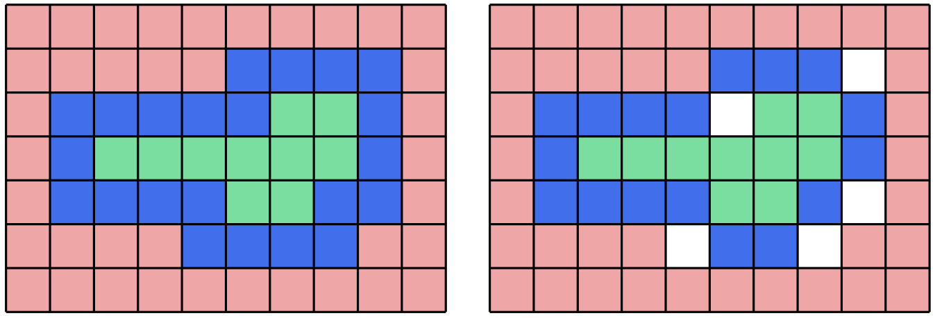
Example
4-connected, 8-separating
8-connected, 4-separating

Slide 10
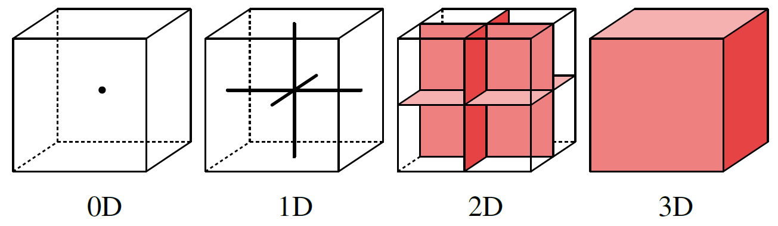
Voxelization with Intersection Targets
Place an intersection target in every voxel V
Include voxel V in the discretized output S^{d} iff the continuous input S intersects the intersection target of V

Slide 11
Choosing the Intersection Target Dimensionality
Intersection target dimensionality depends on the effective dimension of input
Dimensions of input S and the intersection target should sum to dimension of the space

Slide 12
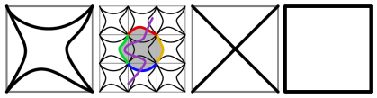
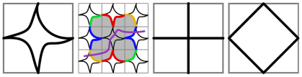
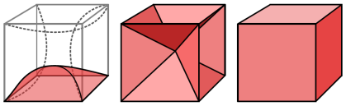
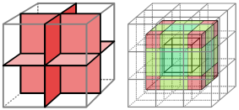
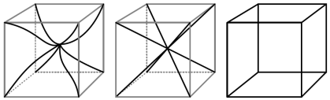
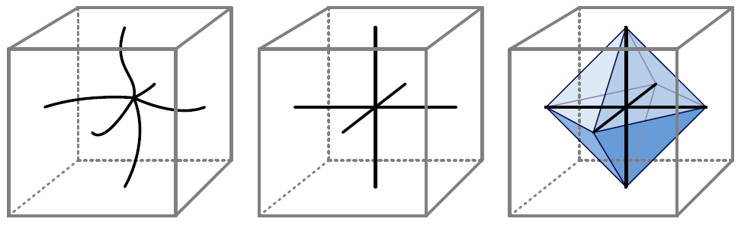
Choosing the Intersection Target Shape
Choice of intersection target determines the connectivity and separability properties of S^{d}
  As well as the number of resulting voxels

Slide 13
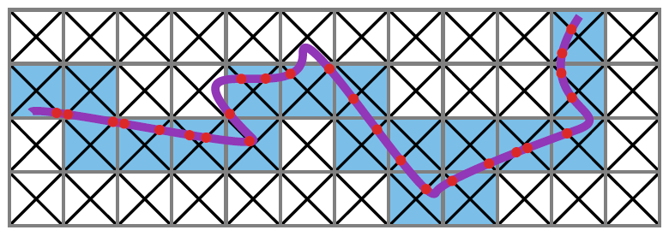

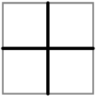
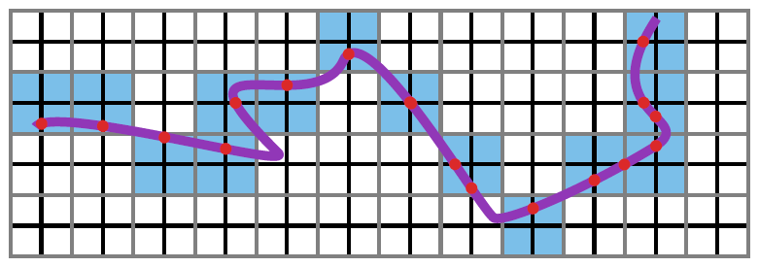
Example
In 2D, we have two sensible 1D targets suitable for voxelizing input that is effectively 1D
4-connected, 8-separating (= ”thick”)
8-connected, 4-separating (= ”thin”)

Slide 14
Main Result of the Paper
Connectivity of the intersection targets determines the separability of resulting S^{d}
I.e., if paths along the intersection target “foam” are k-connected in Z, then voxelization S^{d} is k-separating

Slide 15
Proof, 1/3
Assume the opposite: There exists k-connected discrete path Π = (V₀, …, V_{n}) from I^{d} to O^{d} that does not go through S^{d}
Now construct a continuous path C(Π) so that
  C(Π) starts at a point in V₀ and ends at a point in V_{n}
  Every point of C(Π) is on an intersection target
  Every point in C(Π) is in one of the voxels Vi in Π_{k}
This can always be done by piecing together parts of the intersection targets because they allow k-connected walks in Z

Slide 16
Proof, 2/3
Now, as C(Π) is a continuous path between points in I and O, it must intersect S at some point p (in R) (Jordan curve theorem)
Because C(Π) is entirely contained within voxels in Π, the intersection point p must be in one of the voxels in Π, say inside V_{i}
All points in C(Π) are on an intersection target → p is on intersection target of V_{i}
p is both on S and on the target of V_{i} → target of V_{i} intersects S → voxel V_{i} must be included in S^{d}

Slide 17
Proof, 3/3
It follows that for any k-connected path Π_{k} through the voxelized surface, we can construct a continuous path C(Π) that contradicts the definition of Π_{k}
Hence, no such Π_{k} can exist, and S^{d} is therefore k-separating

Slide 18
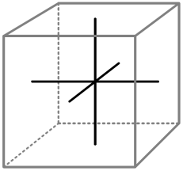
Applications: 6-sep. surfaces in 3D
When voxelizing surfaces in 3D, this intersection target yields 6-separability
Equivalent to rasterization in three projections
  Note: also works for curved primitives!
  Perhaps not easy to see without the above reasoning

Slide 19
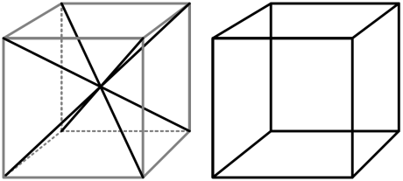
Applications: 26-sep. surfaces in 3D
Similarly, both of these yield 26-separability
No need to intersect S against the full voxel
  Which is the traditional ”thick” voxelization
Simpler to calculate, produces fewer voxels

Slide 20
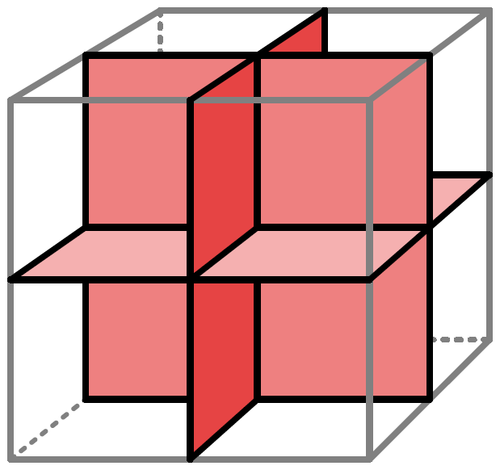
Applications: 26-conn. curves in 3D
Although not discussed here, this target gives a 26-connected voxelization for effectively 1D input
  Paper shows why this is the case
Useful when voxelizing, e.g., a curve, or a thin hair → no pieces missing in the middle

Slide 21
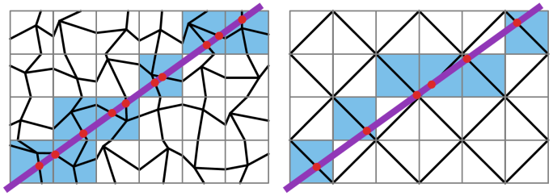
Variations
The intersection target does not need to be identical in every voxel
  As long as its connectivity properties are maintained, all properties of resulting S^{d} are conserved
8-connected, 4-separating,
randomized targets
the same target, with
”arms” pushed to meet at corners

Slide 22
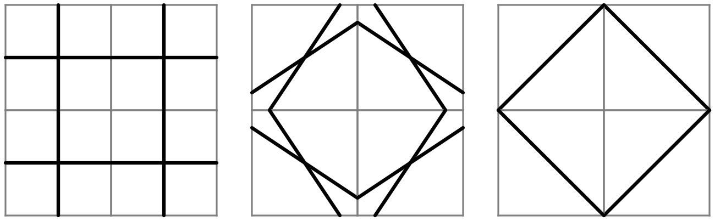
Why?
Consider the following progression:
Hence the rightmost one still produces a 4-separating voxelization of curves in 2D
Original, obviously 4-connected
Still 4-connected ...
Still 4-connected!

Slide 23
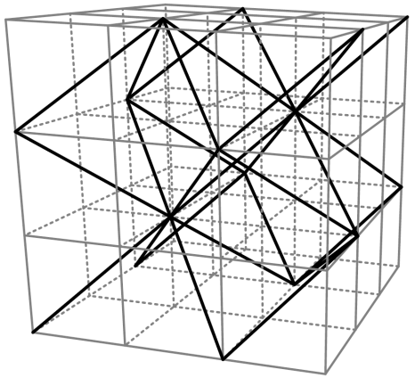
Also in 3D
A single space diagonal per voxel is enough to produce a 6-separating (≈ ”thin”) voxelization of surfaces in 3D

Slide 24
Conclusions
A theory of voxelization using intersection targets
  Allows for easy proofs of resulting properties for S^{d}
  Topological in nature, easy to understand
  Applicable for input of any dimensionality
  Applicable in 2D and 3D
  Does not distinguish between flat and curved input
  Results trivially independent of tessellation of input
Paper has a lot more discussion about connectivity, thinness, relationship to previous methods, etc.

Slide 25
Thank You
Questions

