Slide 1

Stratified Sampling for Stochastic Transparency
Samuli Laine, Tero Karras
NVIDIA Research

Slide 2
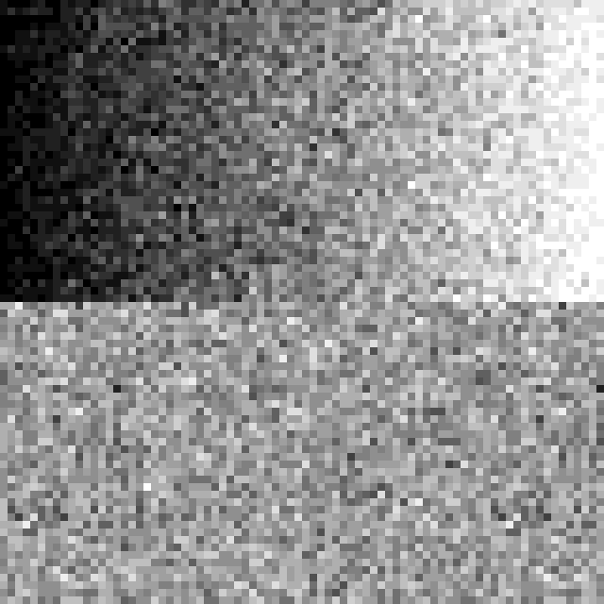
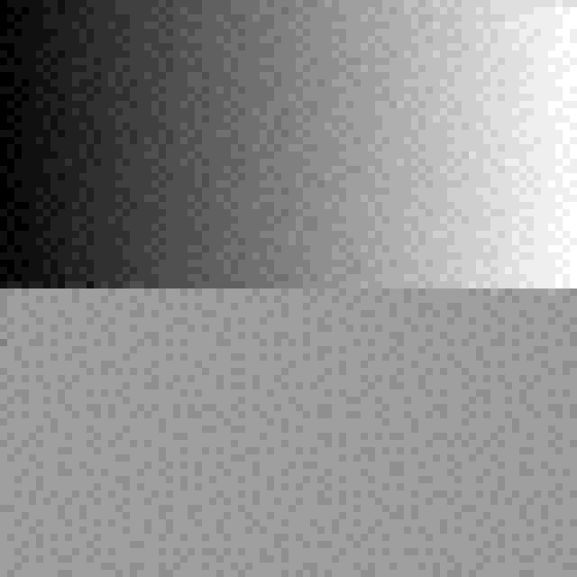
Stratified Stochastic Transparency
Goal: Improve image quality of stochastic transparency [Enderton et al. 2010]
Motivation: As always, good sampling produces less noise than bad sampling
Random sampling
Stratified sampling

Slide 3
What Is Stochastic Transparency?
Order-independent transparency (OIT) algorithm
Draw surface into a sample with probability α
  Binary decision, no blending with previous color
MSAA resolve produces the blended result
+ Fixed storage requirements
+ Correct expected value
− Noise in the result

Slide 4
How to Realize Probability α?
Build on the basic algorithm of Enderton et al.
For each sample
  Pick reference value x
  If α < x, discard
  Otherwise proceed (Z test, stencil, ROP, etc.)
As long as x is properly distributed, the expected value is correct

Slide 5
Choice of α Reference
In each sample, what do we compare α against?
Random number
between 0 and 1
Reference values
spaced 1/N apart
(N = samples / pixel)

Slide 6
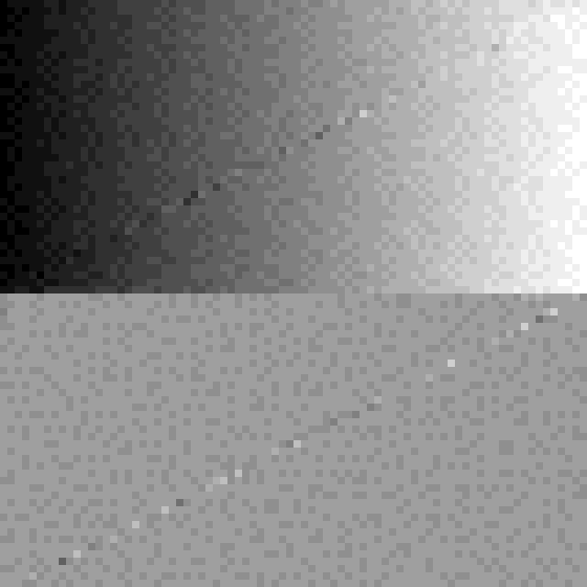
The Hard Part: Multiple Surfaces
Can the reference value assignment be static?
  No, separate surfaces must be uncorrelated
  Current alpha-to-coverage
Can they be changed
between each triangle?
  No, interior edges of
  surfaces become visible

Slide 7
Our Bag of Tricks
Trick 1: Know when a surface changes
Trick 2: Generate good, uncorrelated α reference values for every surface
Trick 3: Improve stratification for partially occluded surfaces

Slide 8
Trick 1: Surface Tracking
Keep a surface ID per pixel
Keep bit per sample indicating current surface coverage
  Bit = 1: We have already touched this sample with the current surface ID

Slide 9
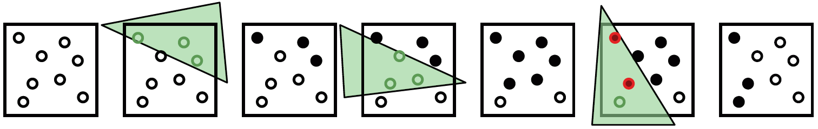
Surface Tracking Example
Start a new surface here
because of conflicts
Change surface
at every triangle
Change surface
when conflict

Slide 10
Trick 2: Generation of α Ref. Values
We need to take
  Surface ID
  Pixel ID
  Sample ID
.. And produce an α reference value that is
  Stratified within the pixel (spaced 1/N apart)
  Well-interleaved between nearby pixels
    For high-quality dithering
    Details in the paper
  Uncorrelated for different surface IDs

Slide 11
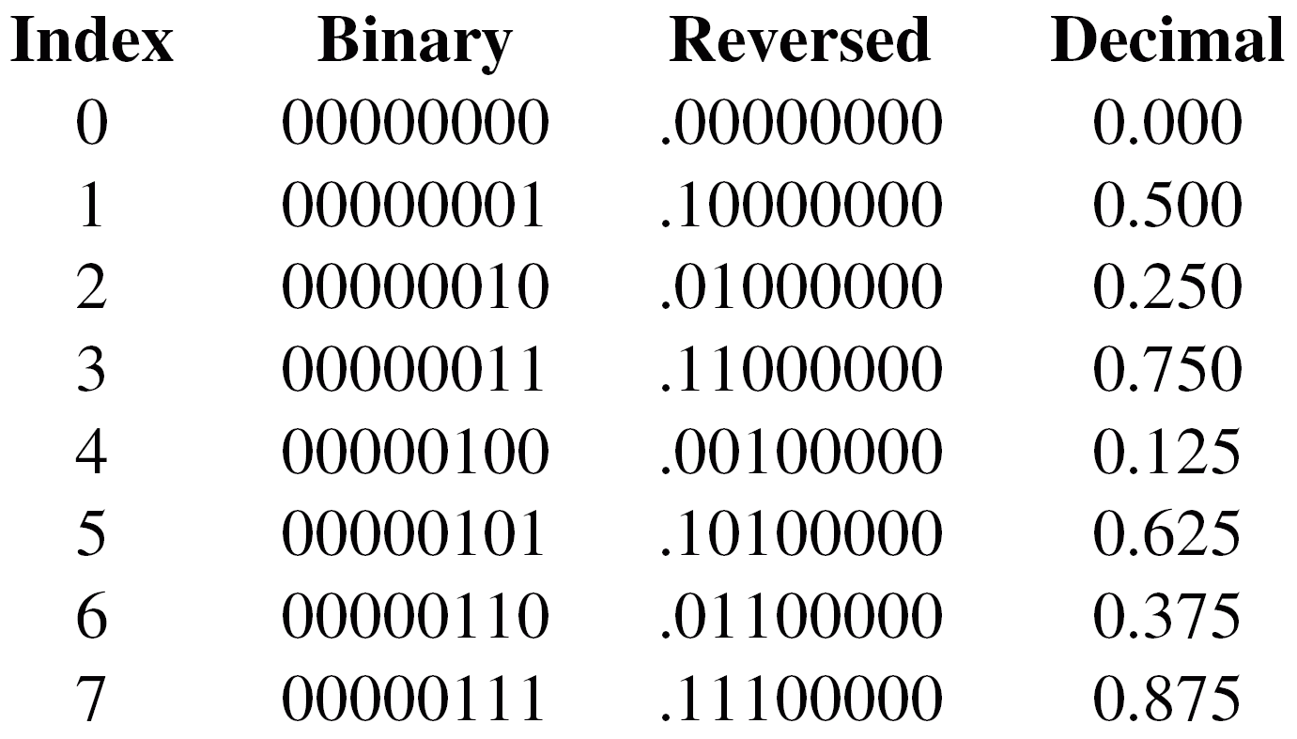
Reference Value Generator
Start with standard base-2 radical inverse
Only one problem: Correlated sub-spans
  E.g., 0..3 and 4..7 are the same, offset 0.125 apart
  Would result in pixels and surfaces being almost perfectly correlated → wrong results

Slide 12
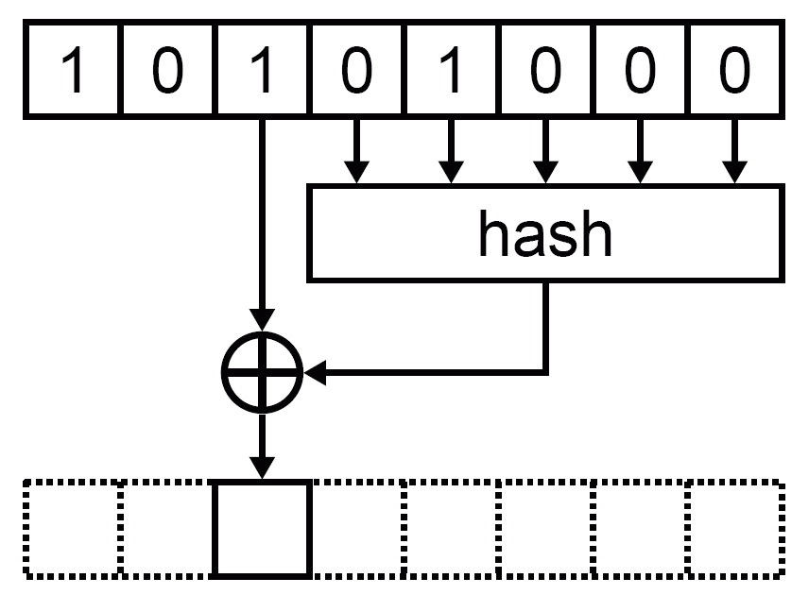
Improving the Reference Values
Add a scramble where each bit is flipped based on a hash of bits below it
Similar to Sobol sequence but more generic

Slide 13
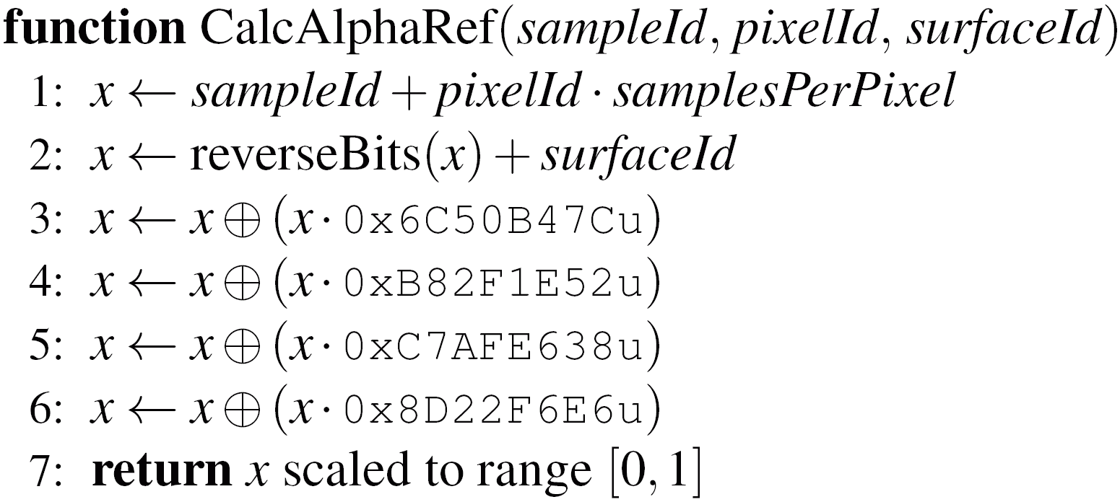
Example Implementation
Hash + XOR for all
bits simultaneously

Slide 14
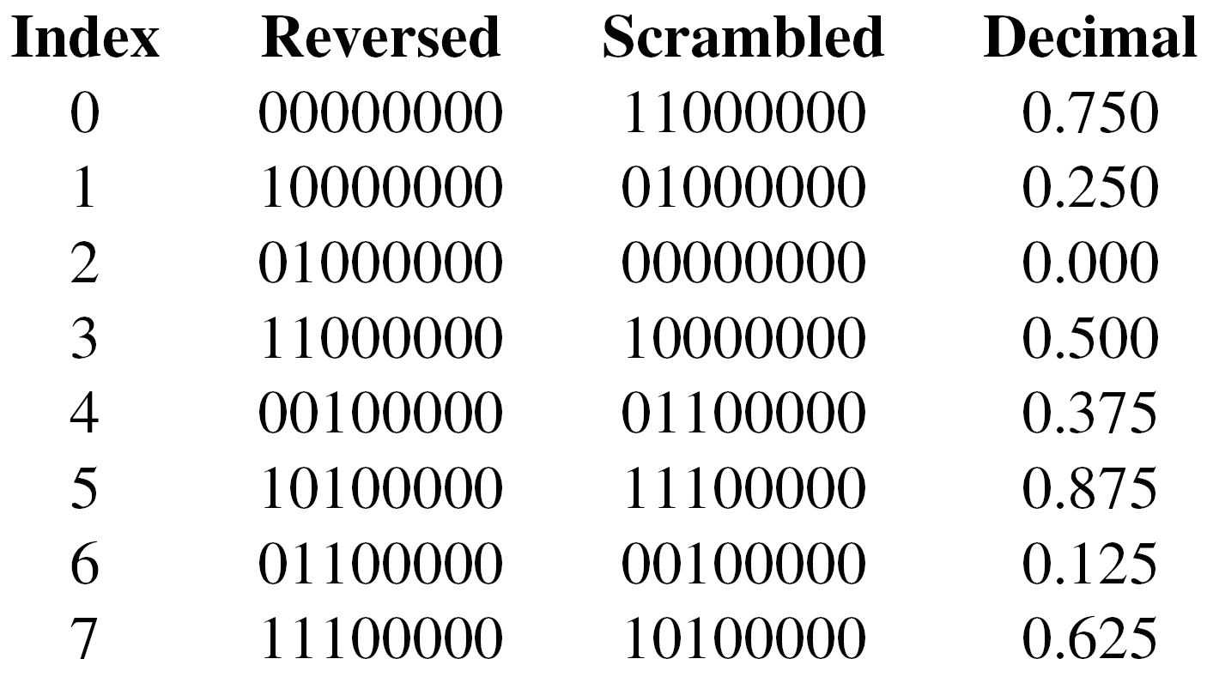
Example Result
With scrambled base-2 inverse
Equally well stratified but now different sub-spans are uncorrelated
  Perfect!

Slide 15
Now for the Hairy Stuff
We now have excellent stratification both spatially and in α domain for single surfaces
What about stratification between multiple surfaces in the same pixel?
+
=
First draw
50% red in front
Then draw
50% green in back
Wrong result
(should be 25% green)

Slide 16
A Fix for Multiple Surfaces?
First stab: Compact samples after Z test
+
=
First draw
50% red in front
Then draw
50% green in back,
ONLY considering
samples that
survive Z test
Correct result

Slide 17
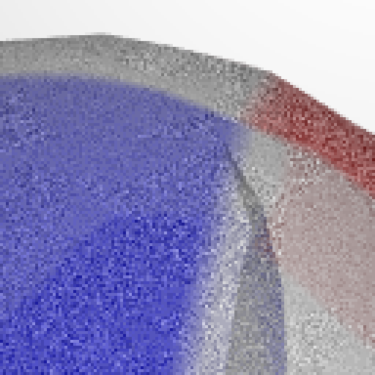
Almost Works, But…
What’s going
on here?
Low noise
High noise

Slide 18
Back-to-Front Still Broken
When rendering back-to-front, the samples are not stratified for previously drawn surfaces
  Compaction after Z test does not help here
+
=
First draw
50% green in back
Then draw
50% red in front
Result is still
wrong

Slide 19
Trick 3: Make It Work Both Ways
Solution: Sort previous samples based on depth
  Groups samples from previous surfaces into
  continuous spans
Each previously drawn surface gets a continuous span of α reference values → good stratification
+
=
First draw
50% green in back
Then 50% red in front,
assigned in sorted order
Correct result

Slide 20

Example Result
Compact after Z, no sort
Compact after Z and sort

Slide 21
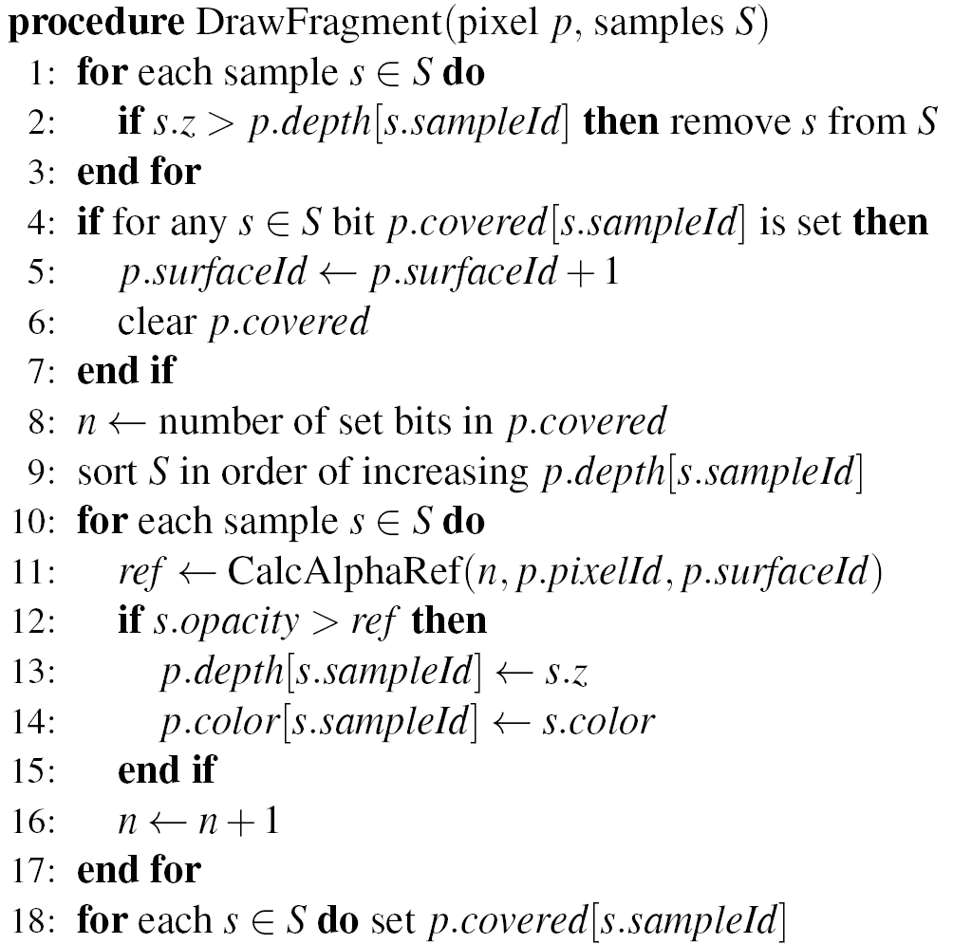
Putting Everything Together

Slide 22
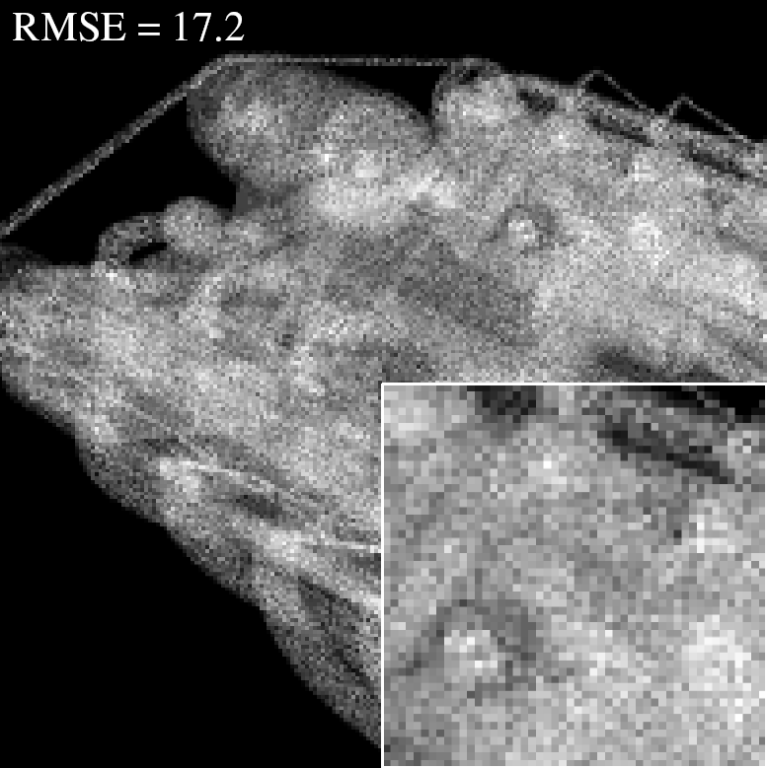
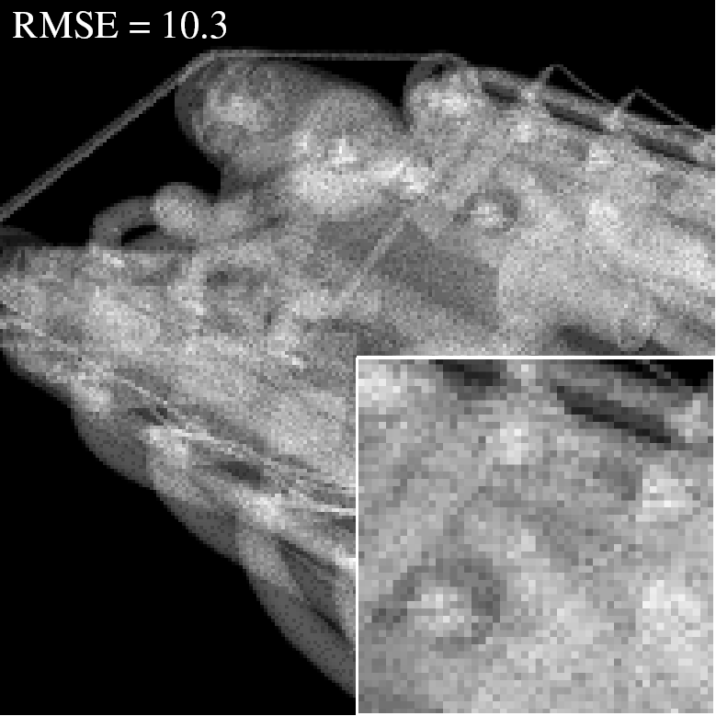
Results, 16 spp
Previous method
RMSE = 17.2
Our method
RMSE = 10.3

Slide 23
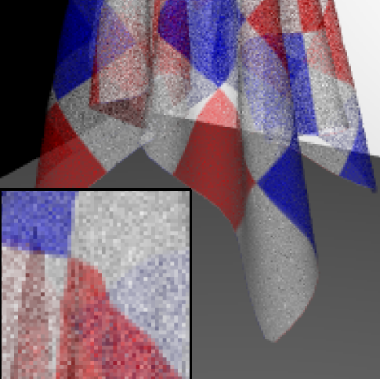
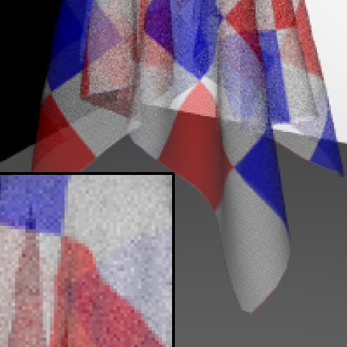
Results, 16 spp
Previous method
RMSE = 8.4
Our method
RMSE = 5.6

Slide 24


Results, 64 spp
Previous method
RMSE = 8.7
Our method
RMSE = 4.0

Slide 25
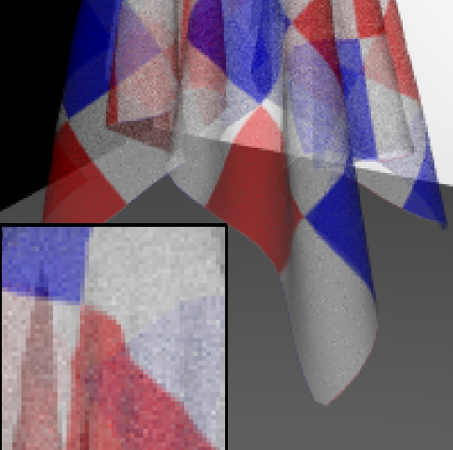

Results, 64 spp
Previous method
RMSE = 4.1
Our method
RMSE = 2.0

Slide 26
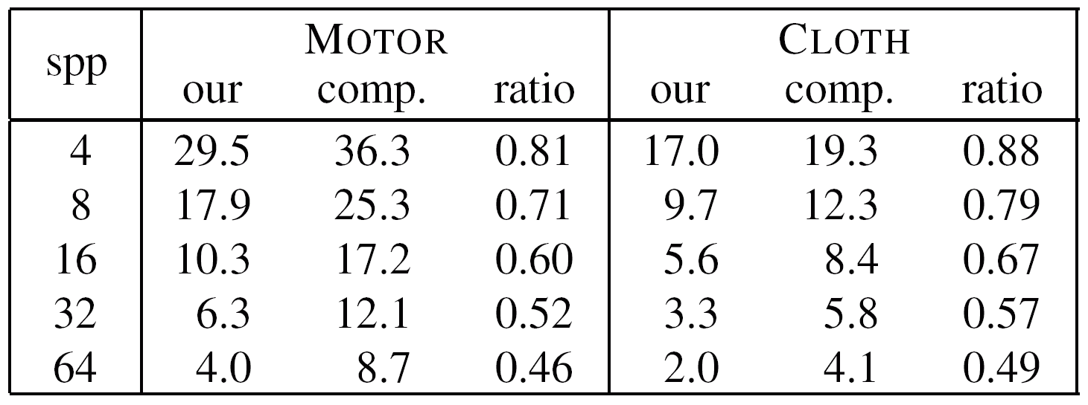
Stratification → Faster Convergence
RMSE results for the test scenes

Slide 27
Thank You
Questions

Slide 28
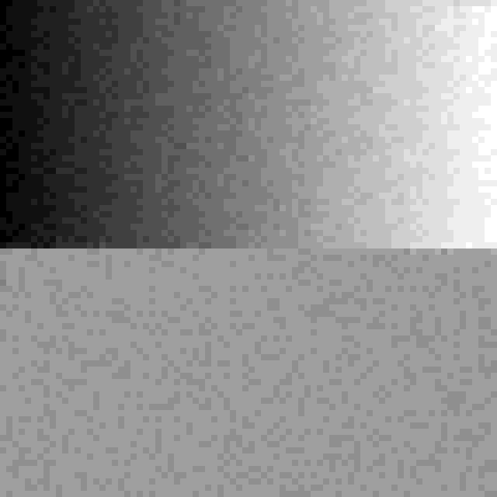
Dithering Example
Stratification between pixels
No cooperation between pixels,
results in random dithering
Stratification within aligned 2x2,
4x4, etc. pixel blocks

