Slide 1
Can We Trust Simulation-Based Inference?
Seminar talk
Konsta Kiirikki / 23.03.2026 / CS-E407526

Slide 2
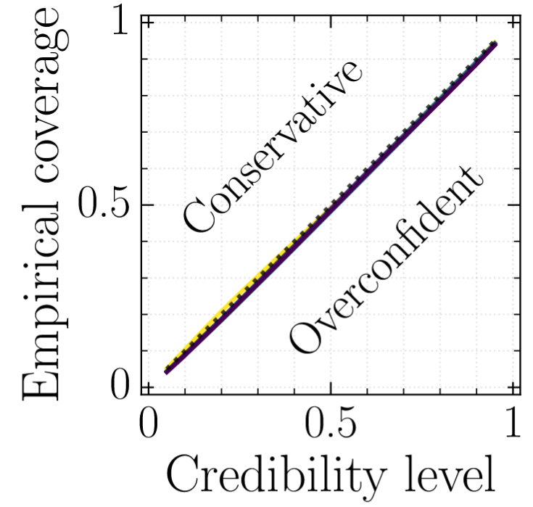
Why this paper matters
SBI fits are almost never perfect and produce conservative or overconfident results.
  Usually tested with the Area Under the Receiver Operating Characteristics curve (auroc).
Domain sciences often seek to constrain parameters of interest.
Wrongly excluding plausible parameters is more detrimental than failing to exclude implausible.
  Conserative estimates are much more favourable than overconfident ones.

Slide 3
Methods from the course
REJ-ABC
SMC-ABC
SNPE
SNL
SNRE
Neural ratio estimation (NRE)
Neural posterior estimation (NPE)
Ensembles (bagging, deep ensembles)
SLCP
Weinberg
M/G/1
Lotka-Volterra
Streams
Gravitational Waves

Slide 4



How they test trust
Coverage
expected coverage probability -> ECP estimator
Can be estimated empirically:
conservative posterior estimator: has coverage at the credibility level of interest.

Slide 5
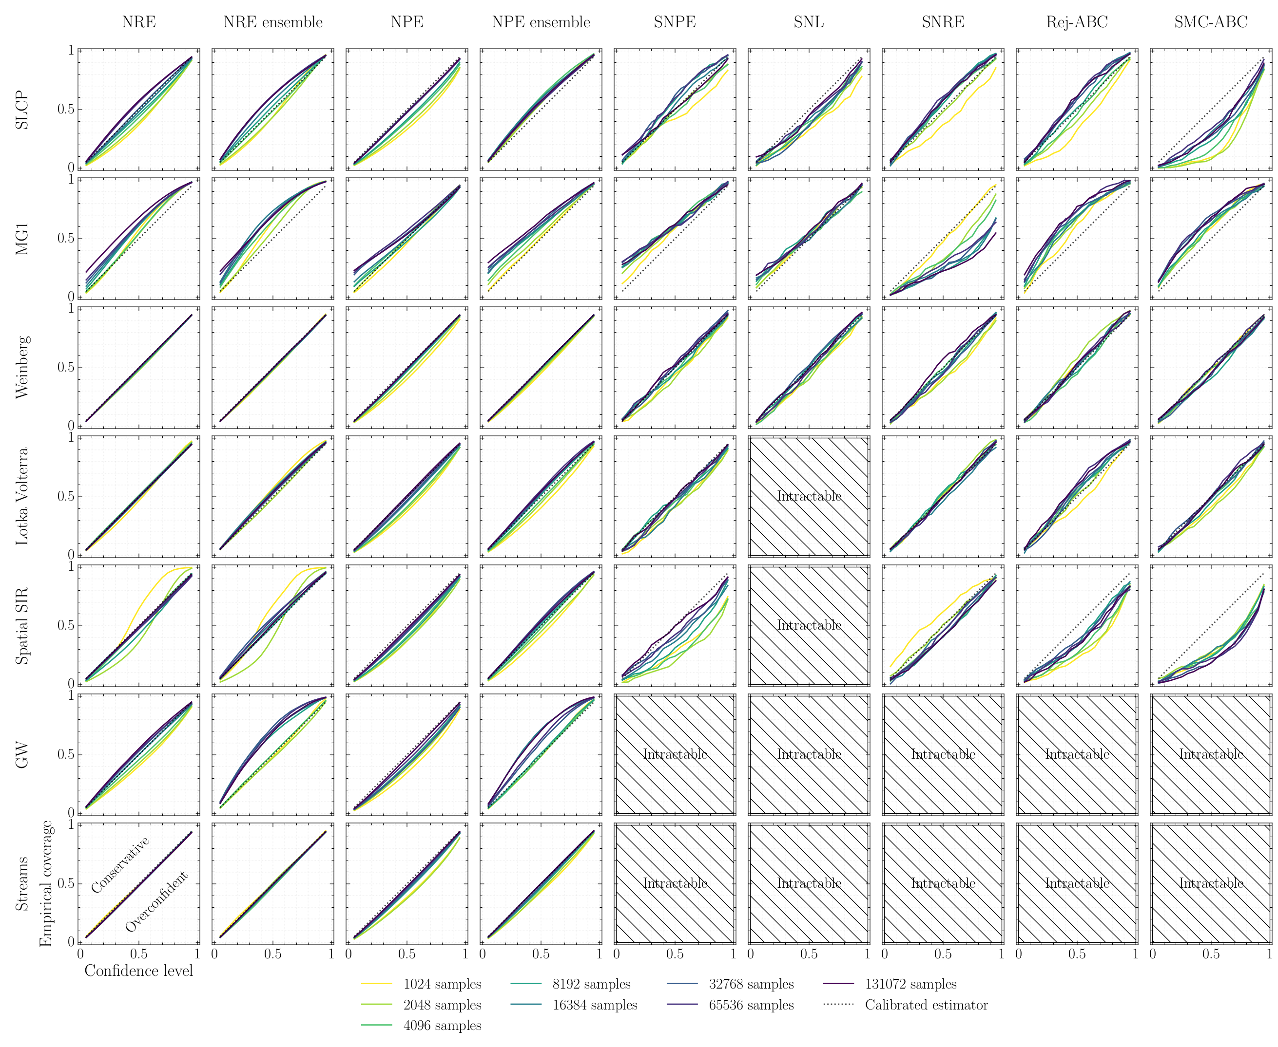
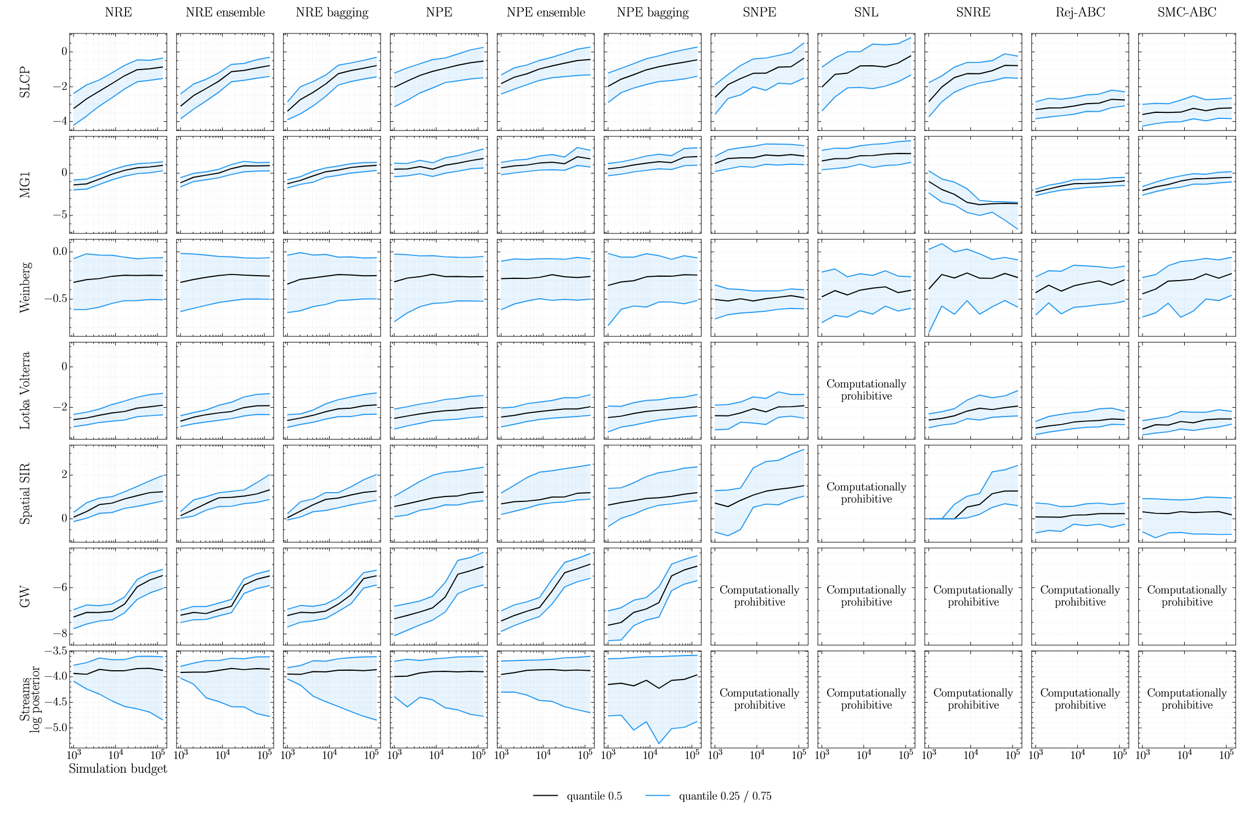
Findings
Amortized approaches tend to be more conservative in contrast to non-amortized approaches.
All benchmarked algorithms may produce non-conservative posterior approximations. This pathology tends to be accentuated with small simulation budgets in both paradigms.
Amortized methods are simulation-efficient, especially when taking hyper-parameter tuning and the evaluation of the expected coverage diagnostic into account.
The expected coverage probability of an ensemble model is larger than the average individual model. The ensemble size positively affects the expected coverage probability as well

Slide 6
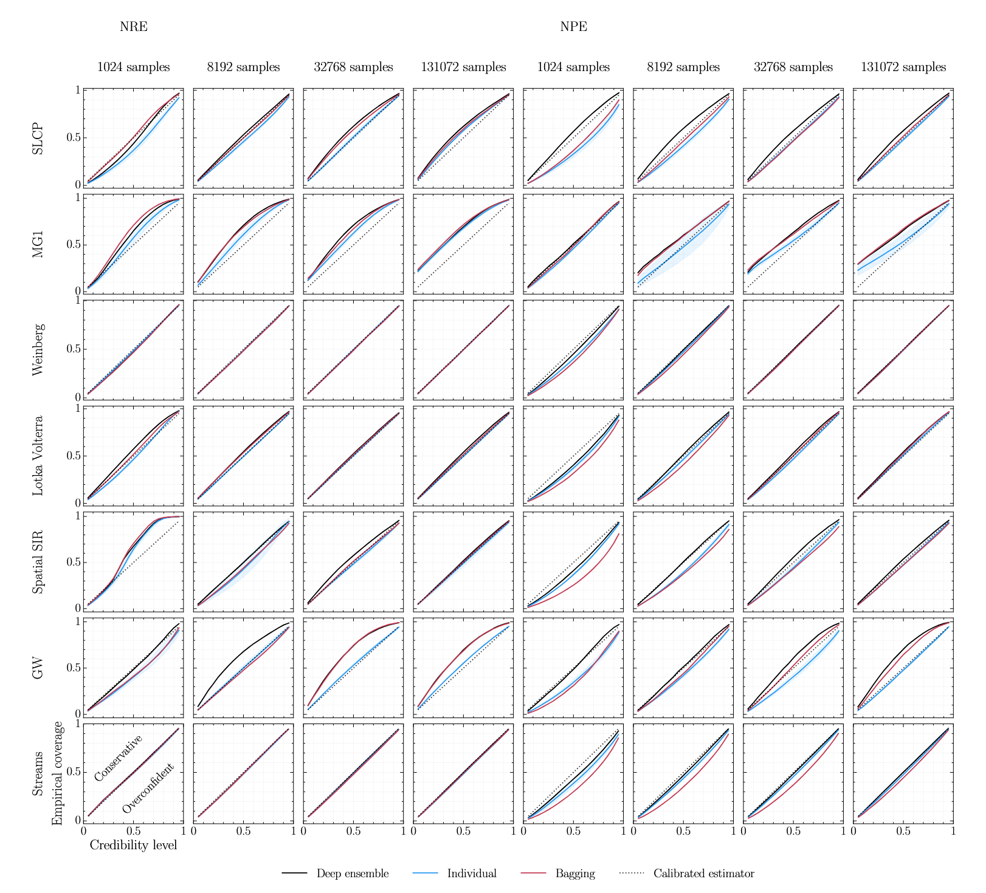
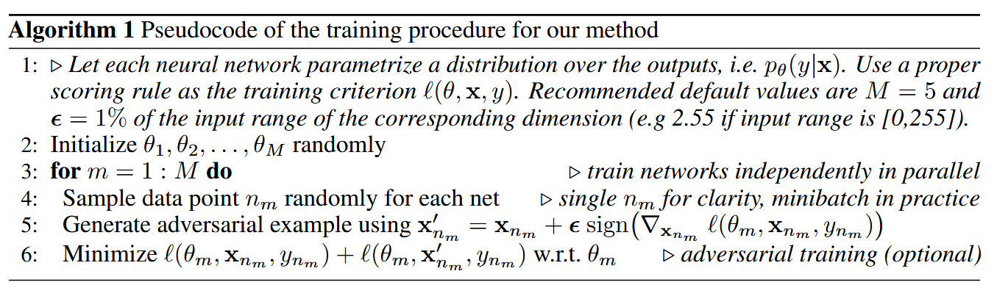
Mitigation: Ensembles
Authors propose ensembles as mitigation for overconfident coverage
They test:
  Bagging
  Deep ensembles

Slide 7
Demo: setup
Ran NRE, NPE and their relative ensembles against a new benchmark task.
4 and 6 dimensional d-vine gaussians exhibits a deterministic structure
  can be used as a prior but a black-box SBI-method can’t inherit this prior
Emperical convergence vs confidence level is compared against bayesian oracle and a MST-fitter.

Slide 8
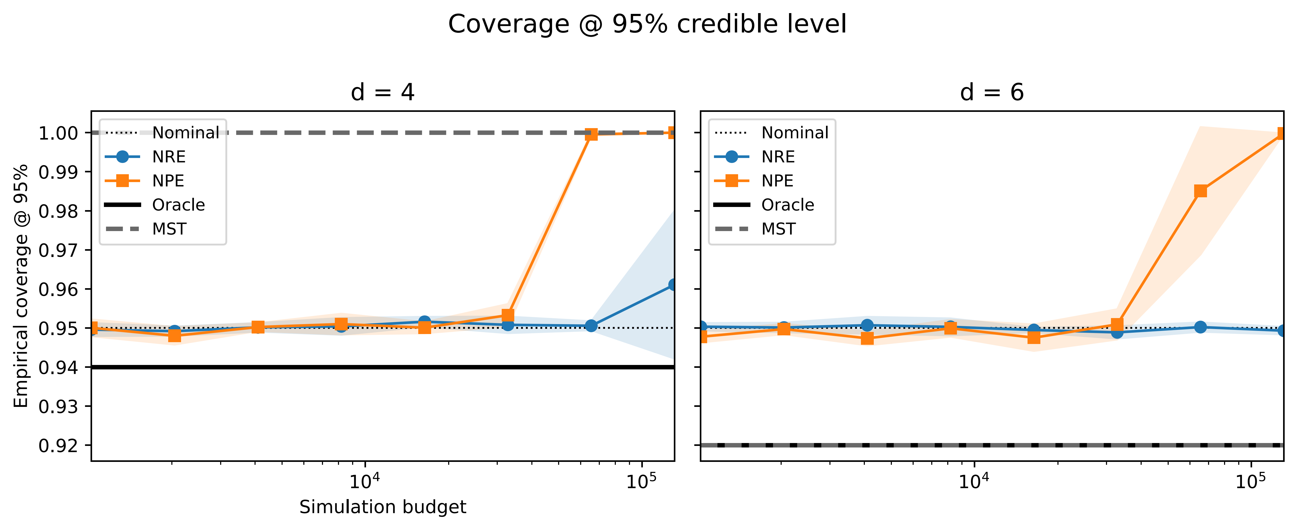
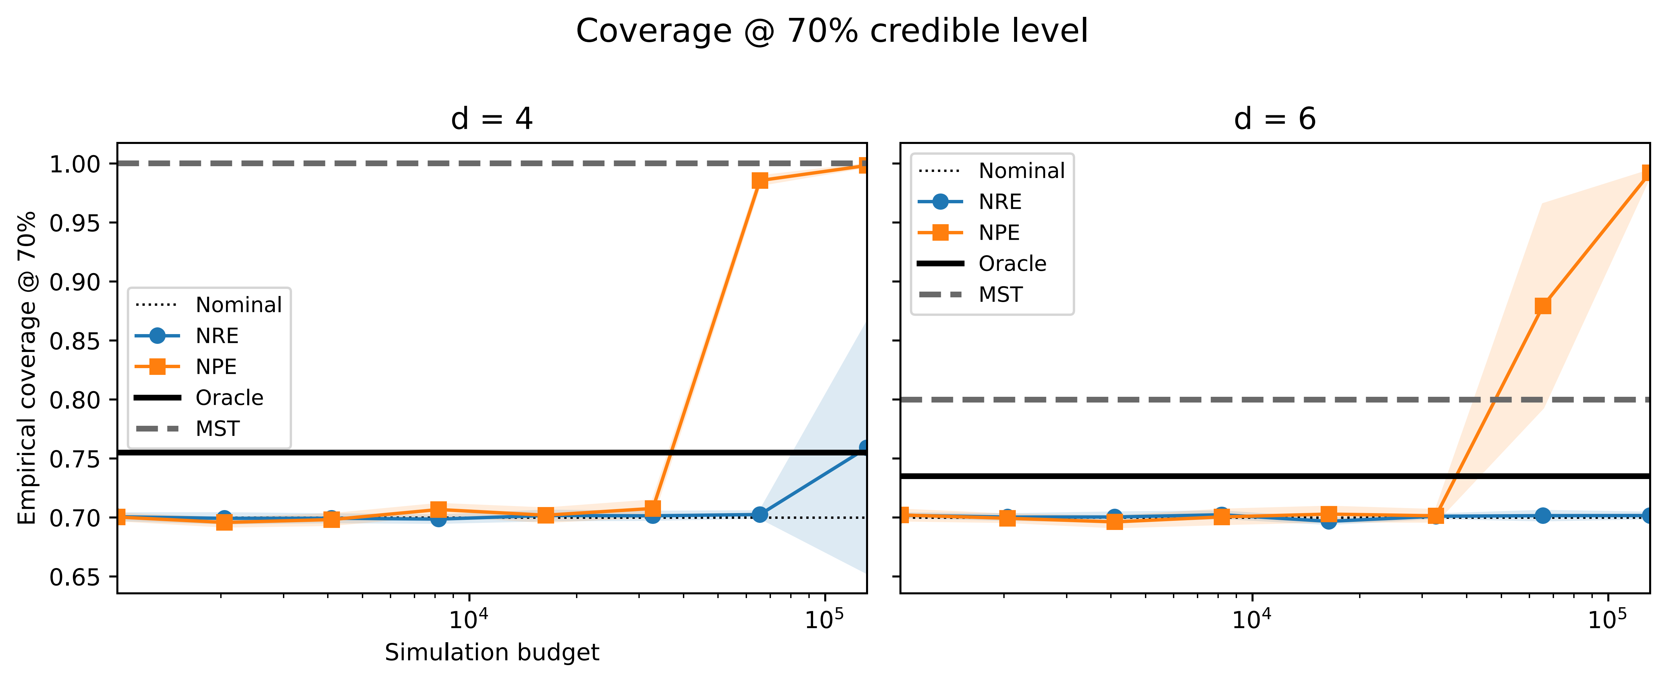
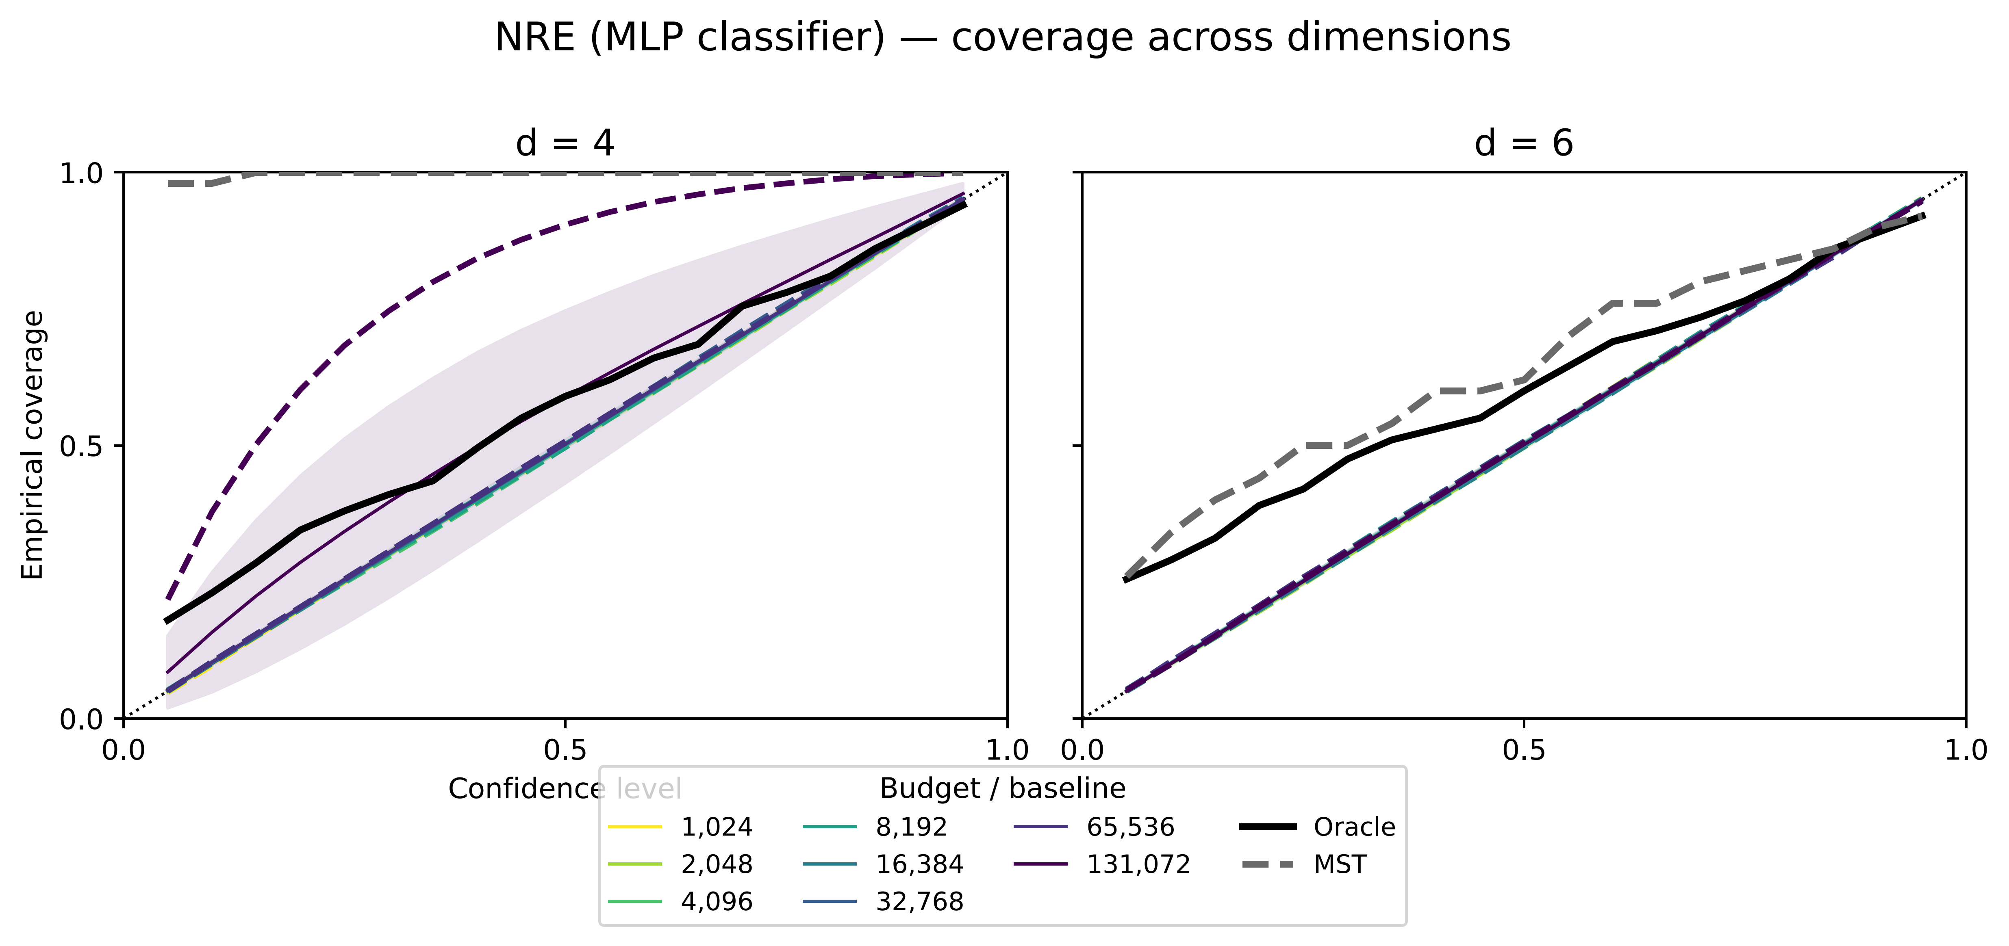
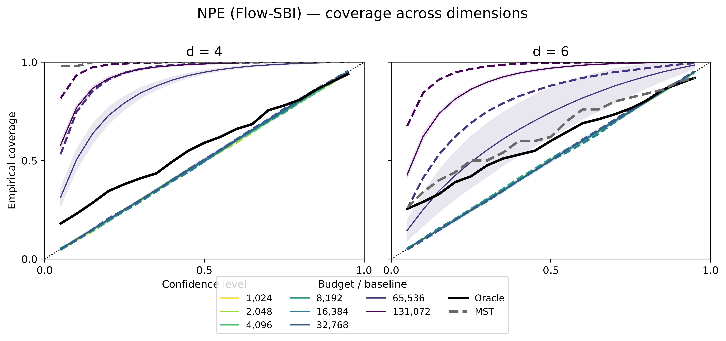
Demo findings & conclusion

Slide 9
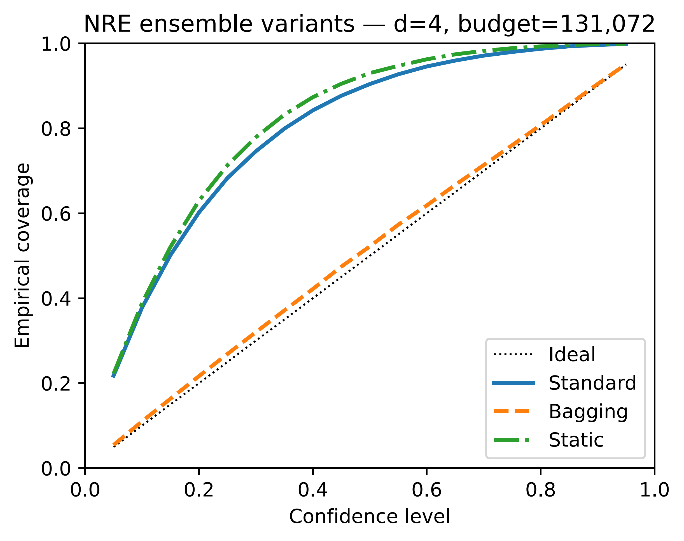
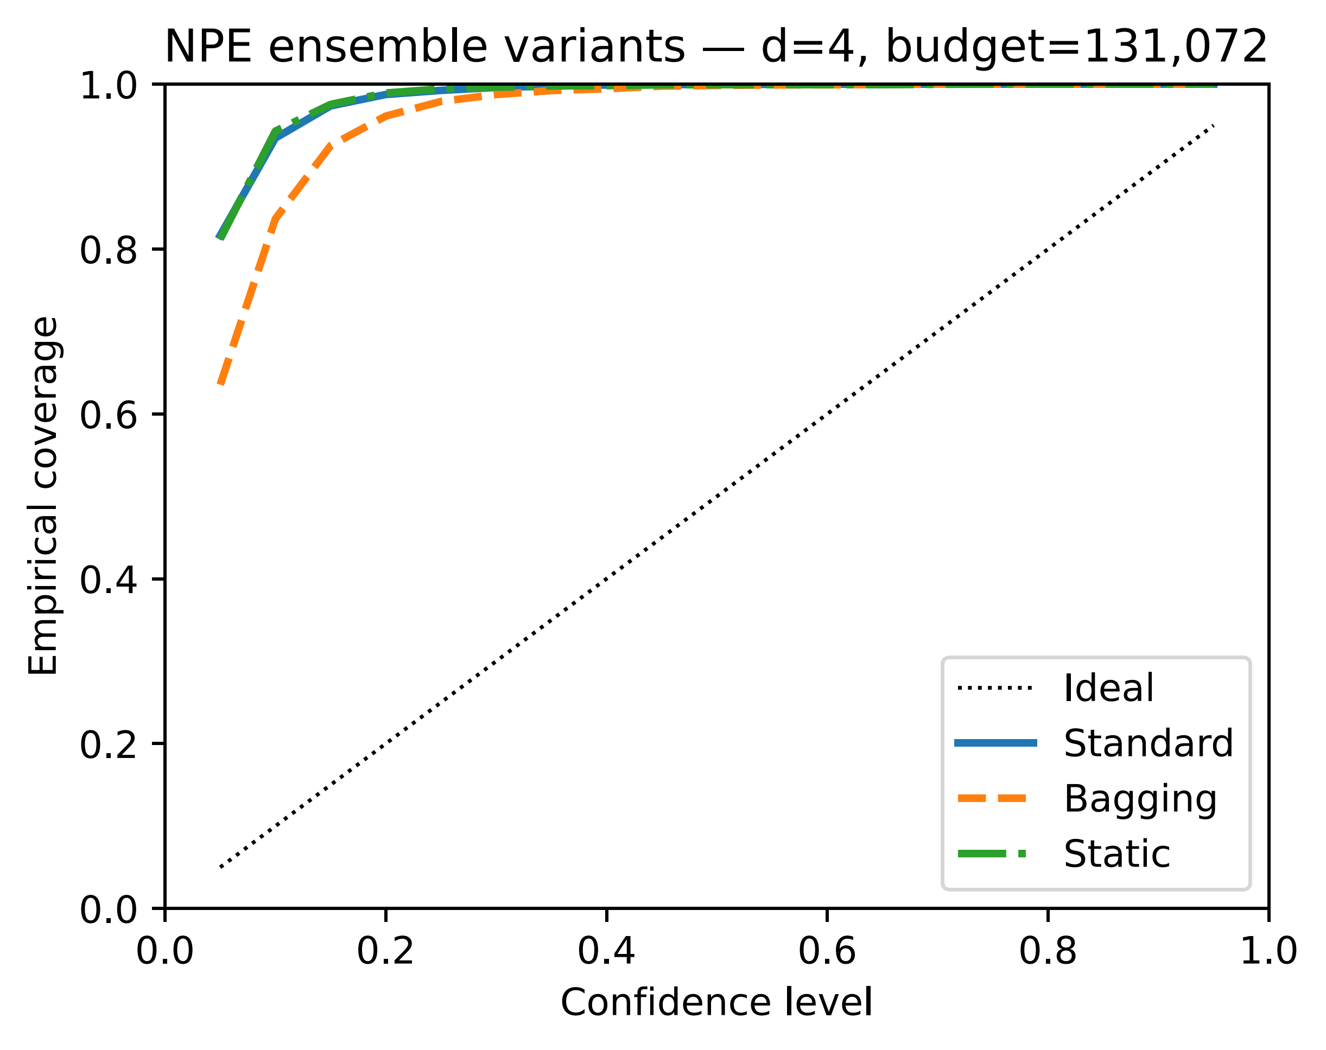
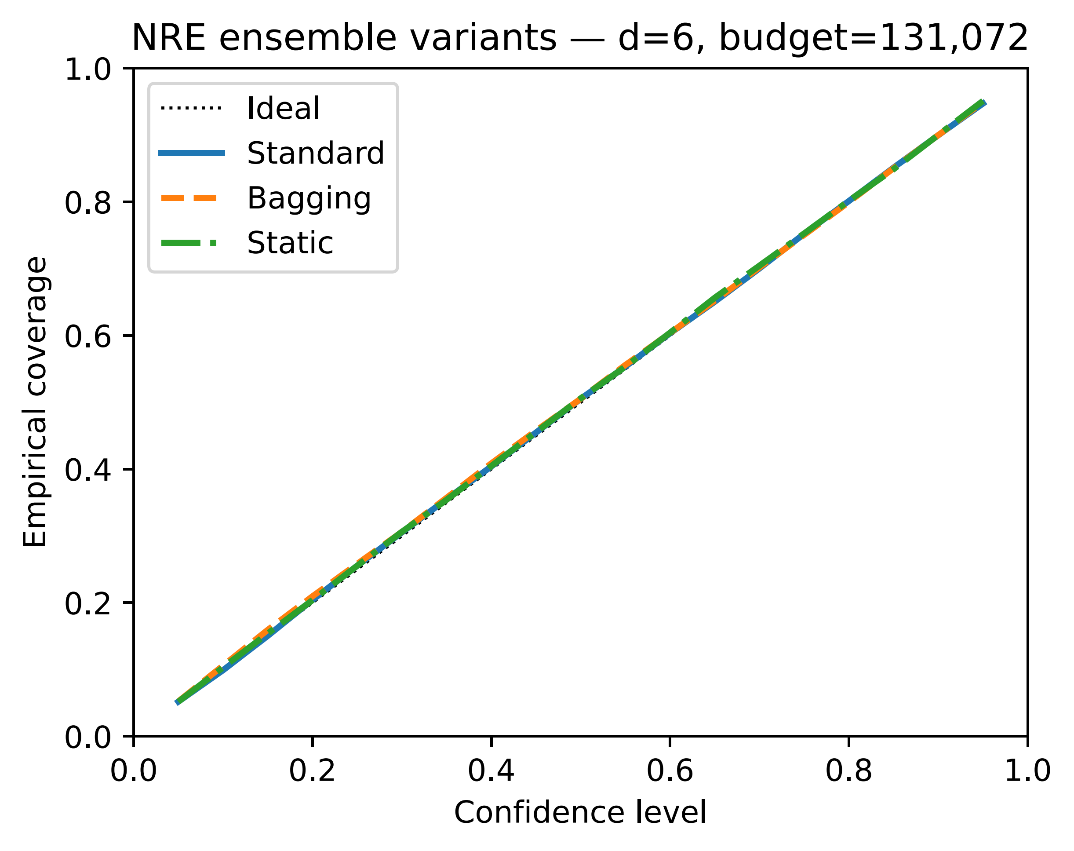
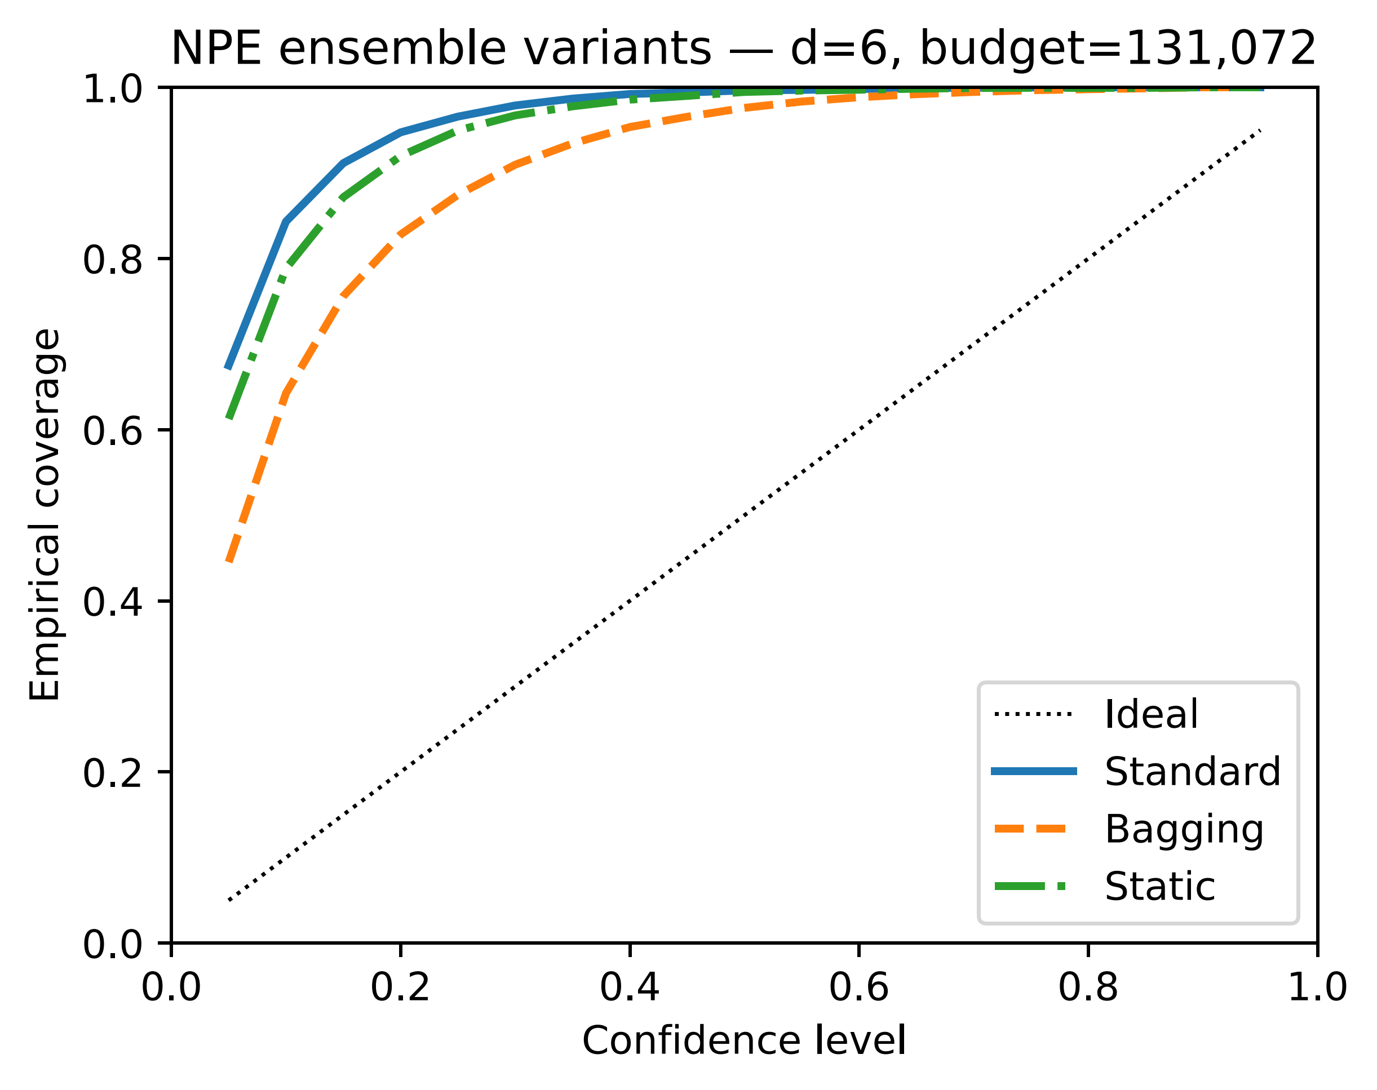
Demo: Ensembles

Slide 10
References
Hermans, J., Begy, V., & Louppe, G. (2022). A crisis in simulation-based inference? Beware, your posterior approximations can be unfaithful. Transactions on Machine Learning Research.
Alvaro Tejero-Cantero, Jan Boelts, Michael Deistler, Jan-Matthis Lueckmann, Conor Durkan, Pedro Gonçalves, David Greenberg, and Jakob Macke. sbi: A toolkit for simulation-based inference. The Journal of Open Source Software, 5(52):2505, 2020.
Balaji Lakshminarayanan, Alexander Pritzel, and Charles Blundell. Simple and scalable predictive uncertainty estimation using deep ensembles. Advances in neural information processing systems, 30, 2017.
Leo Breiman. Bagging predictors. Machine learning, 24(2):123–140, 1996.

Slide 11
Demo: setup
 | NRE, NPE, Ensemble | MST-fitter | Bayesian Oracle
Structural Prior | No | Yes | Yes
Tree Prior | No | No | Yes

Slide 12
Demo: setup
Task | D | Theta | X samples
D-vine 4d | 4 | 6 | 2000
D-vine 6d | 6 | 15 | 3000
X samples = N-OBS * D = 500 * D

Slide 13
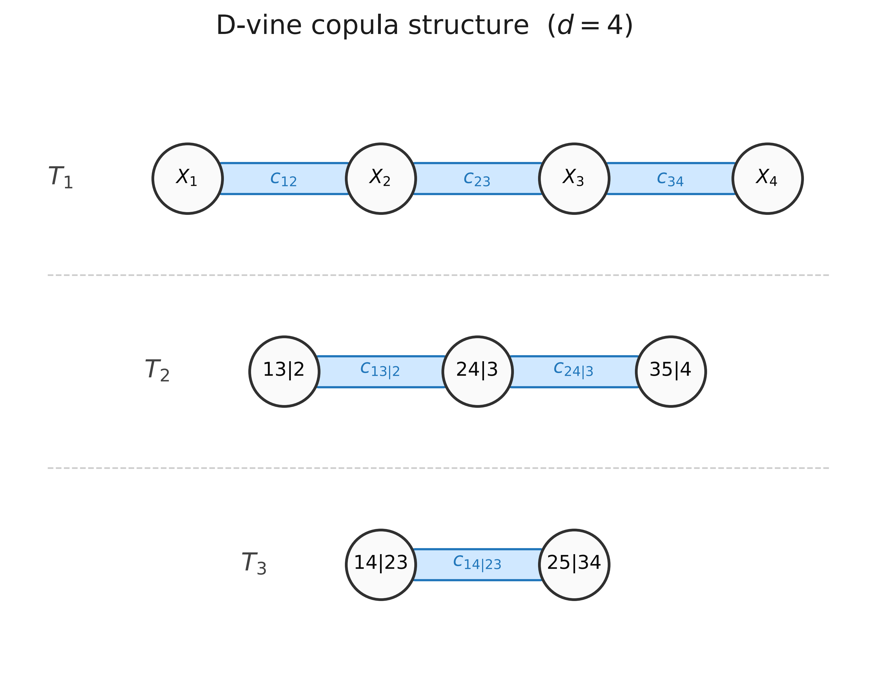
Demo: setup

Slide 14
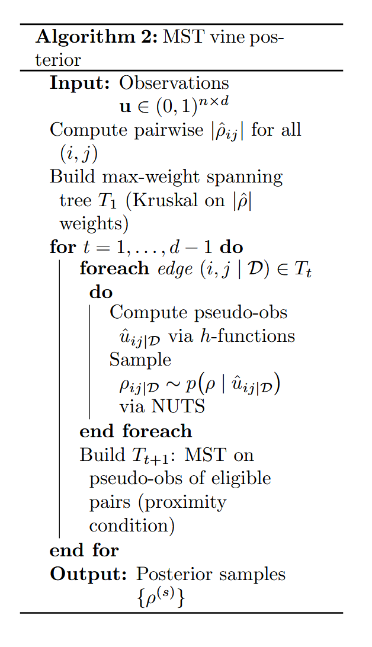
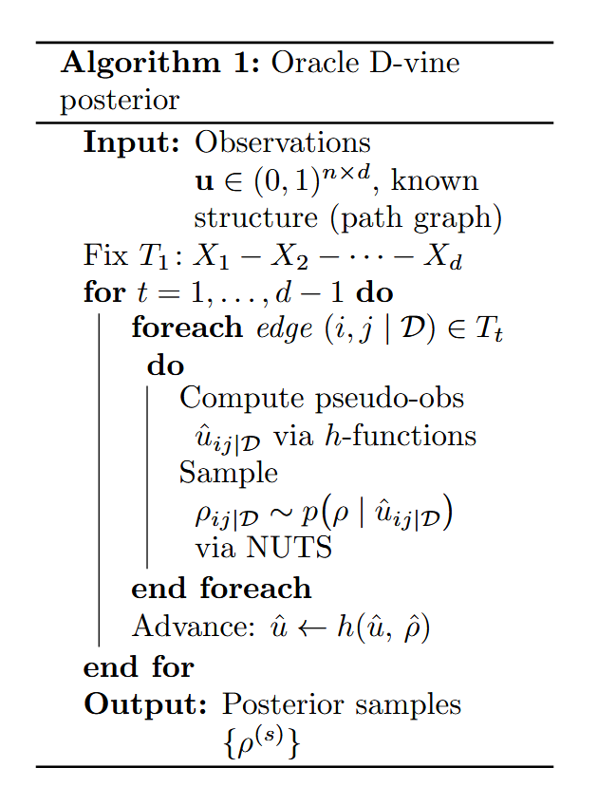
Demo: setup

Slide 15
Demo: setup
5 ensembles per method (normal, bagging bootstrap, static subset variants)
Batch size: 512, LR: 0.001 with plateau scheduler, 100 epochs
Criterion: BaseCriterion (binary cross-entropy for classifier NRE)

Slide 16
Demo: training details
Server specs
GPU: NVIDIA RTX 6000 Ada, 49 GB VRAM + NVIDIA H100, 80GB VRAM
CPU: 60 GB RAM, 16 CPU + 185 GB RAM, 32 CPU
OS: Ubuntu (Python 3.12.3 system, no conda)
CUDA: 13.0, driver 580.126.09

