Slide 1
How can we learn multidimensional joint-probability distributions?
Talk on copulas and computational methods
Konsta Kiirikki / 19.03.2026. / Nerd Out: New Hope II

Slide 2
Learning multidimensional joint-probability distributions

Slide 3
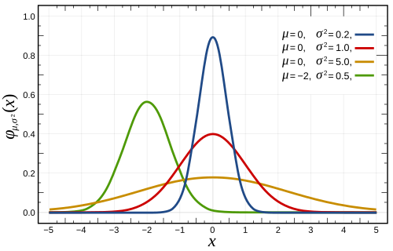
Learning multidimensional joint-probability distributions

Slide 4
Learning multidimensional joint-probability distributions

Slide 5
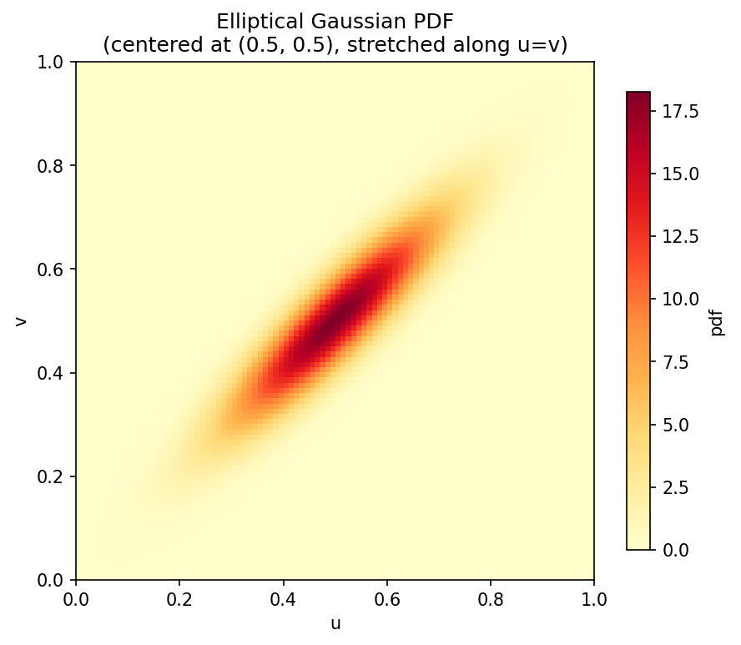

Slide 6
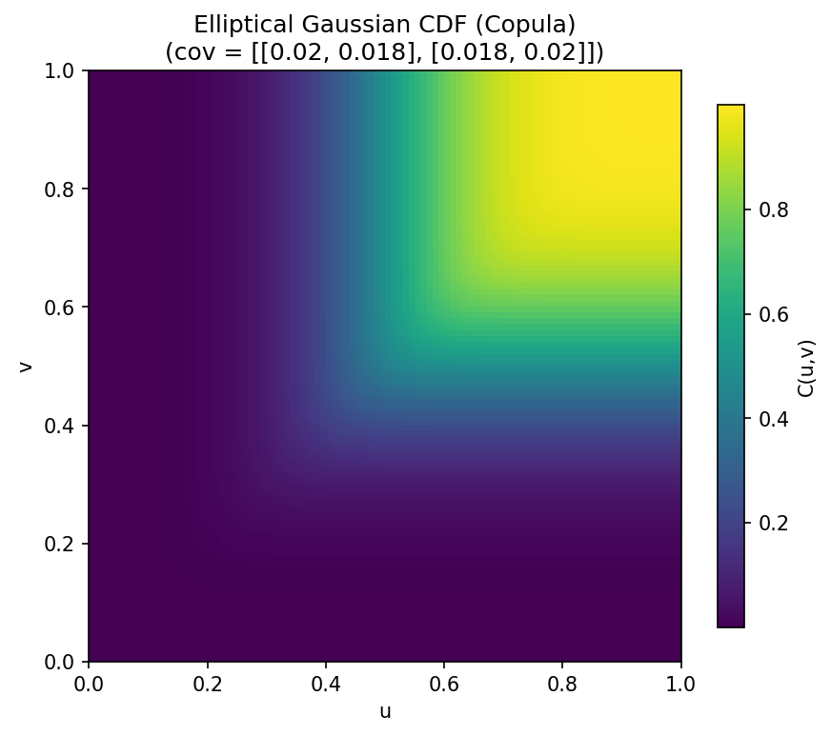

Slide 7
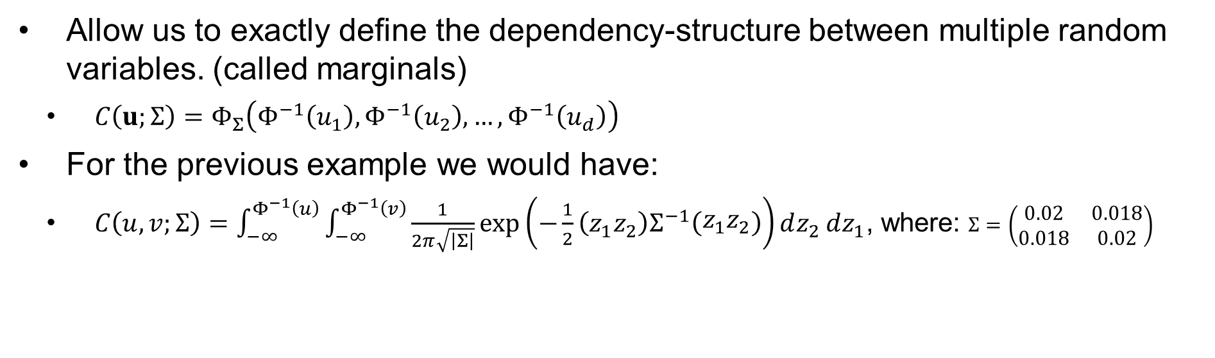
Copulas
Allow us to exactly define the dependency-structure between multiple random variables. (called marginals)
  $C\left(u;Σ\right)=Φ_{Σ}\left(Φ^{−1}\left(u_{1}\right),Φ^{−1}\left(u_{2}\right),…,Φ^{−1}\left(u_{d}\right)\right)$
For the previous example we would have:
  $C\left(u,v;Σ\right)=\int_{−∞}^{Φ^{−1}\left(u\right)}{\int_{−∞}^{Φ^{−1}\left(v\right)}{\frac{1}{2π\sqrt{\left|Σ\right|}}}}\exp\left(−\frac{1}{2}\left(z_{1}z_{2}\right)Σ^{−1}\left(\begin{matrix}z_{1}z_{2}\end{matrix}\right)\right)dz_{2} dz_{1}$, where: $Σ=\left(\begin{matrix}0.02 & 0.018 \\ 0.018 & 0.02\end{matrix}\right)$

Slide 8
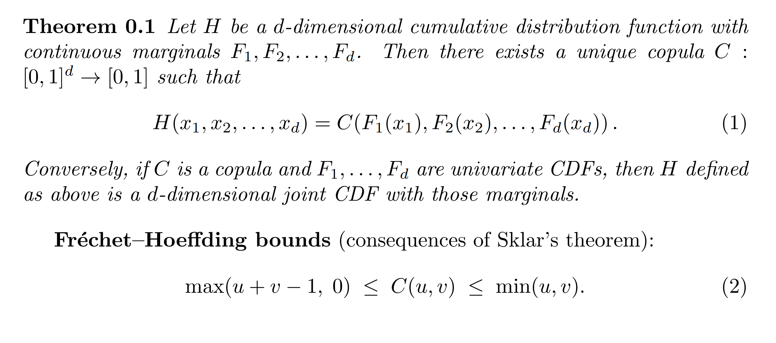
Sklar’s theorem

Slide 9
Learning multidimensional joint-probability distributions

Slide 10
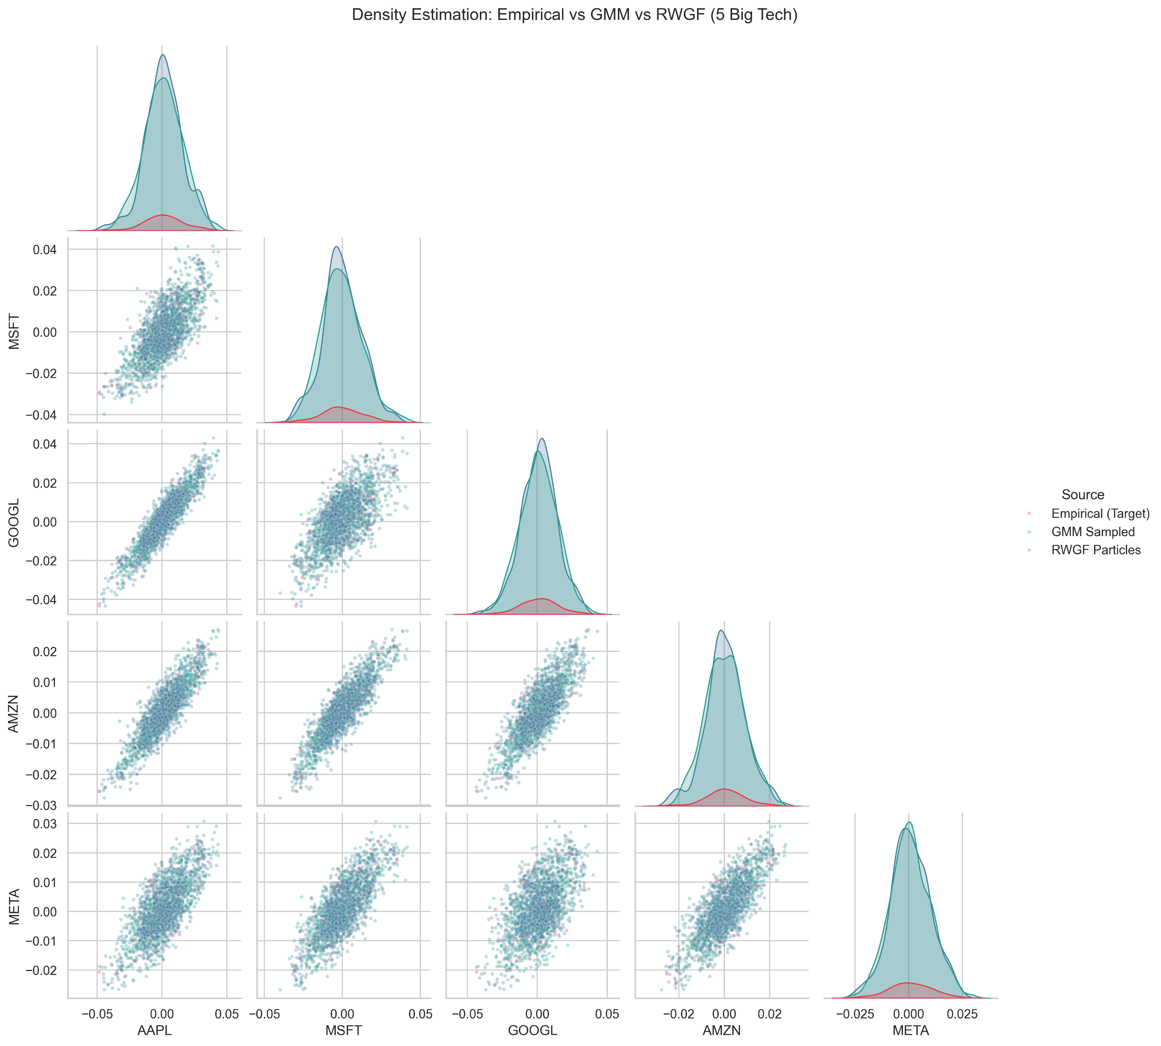

Slide 11
Learning multidimensional joint-probability distributions

Slide 12
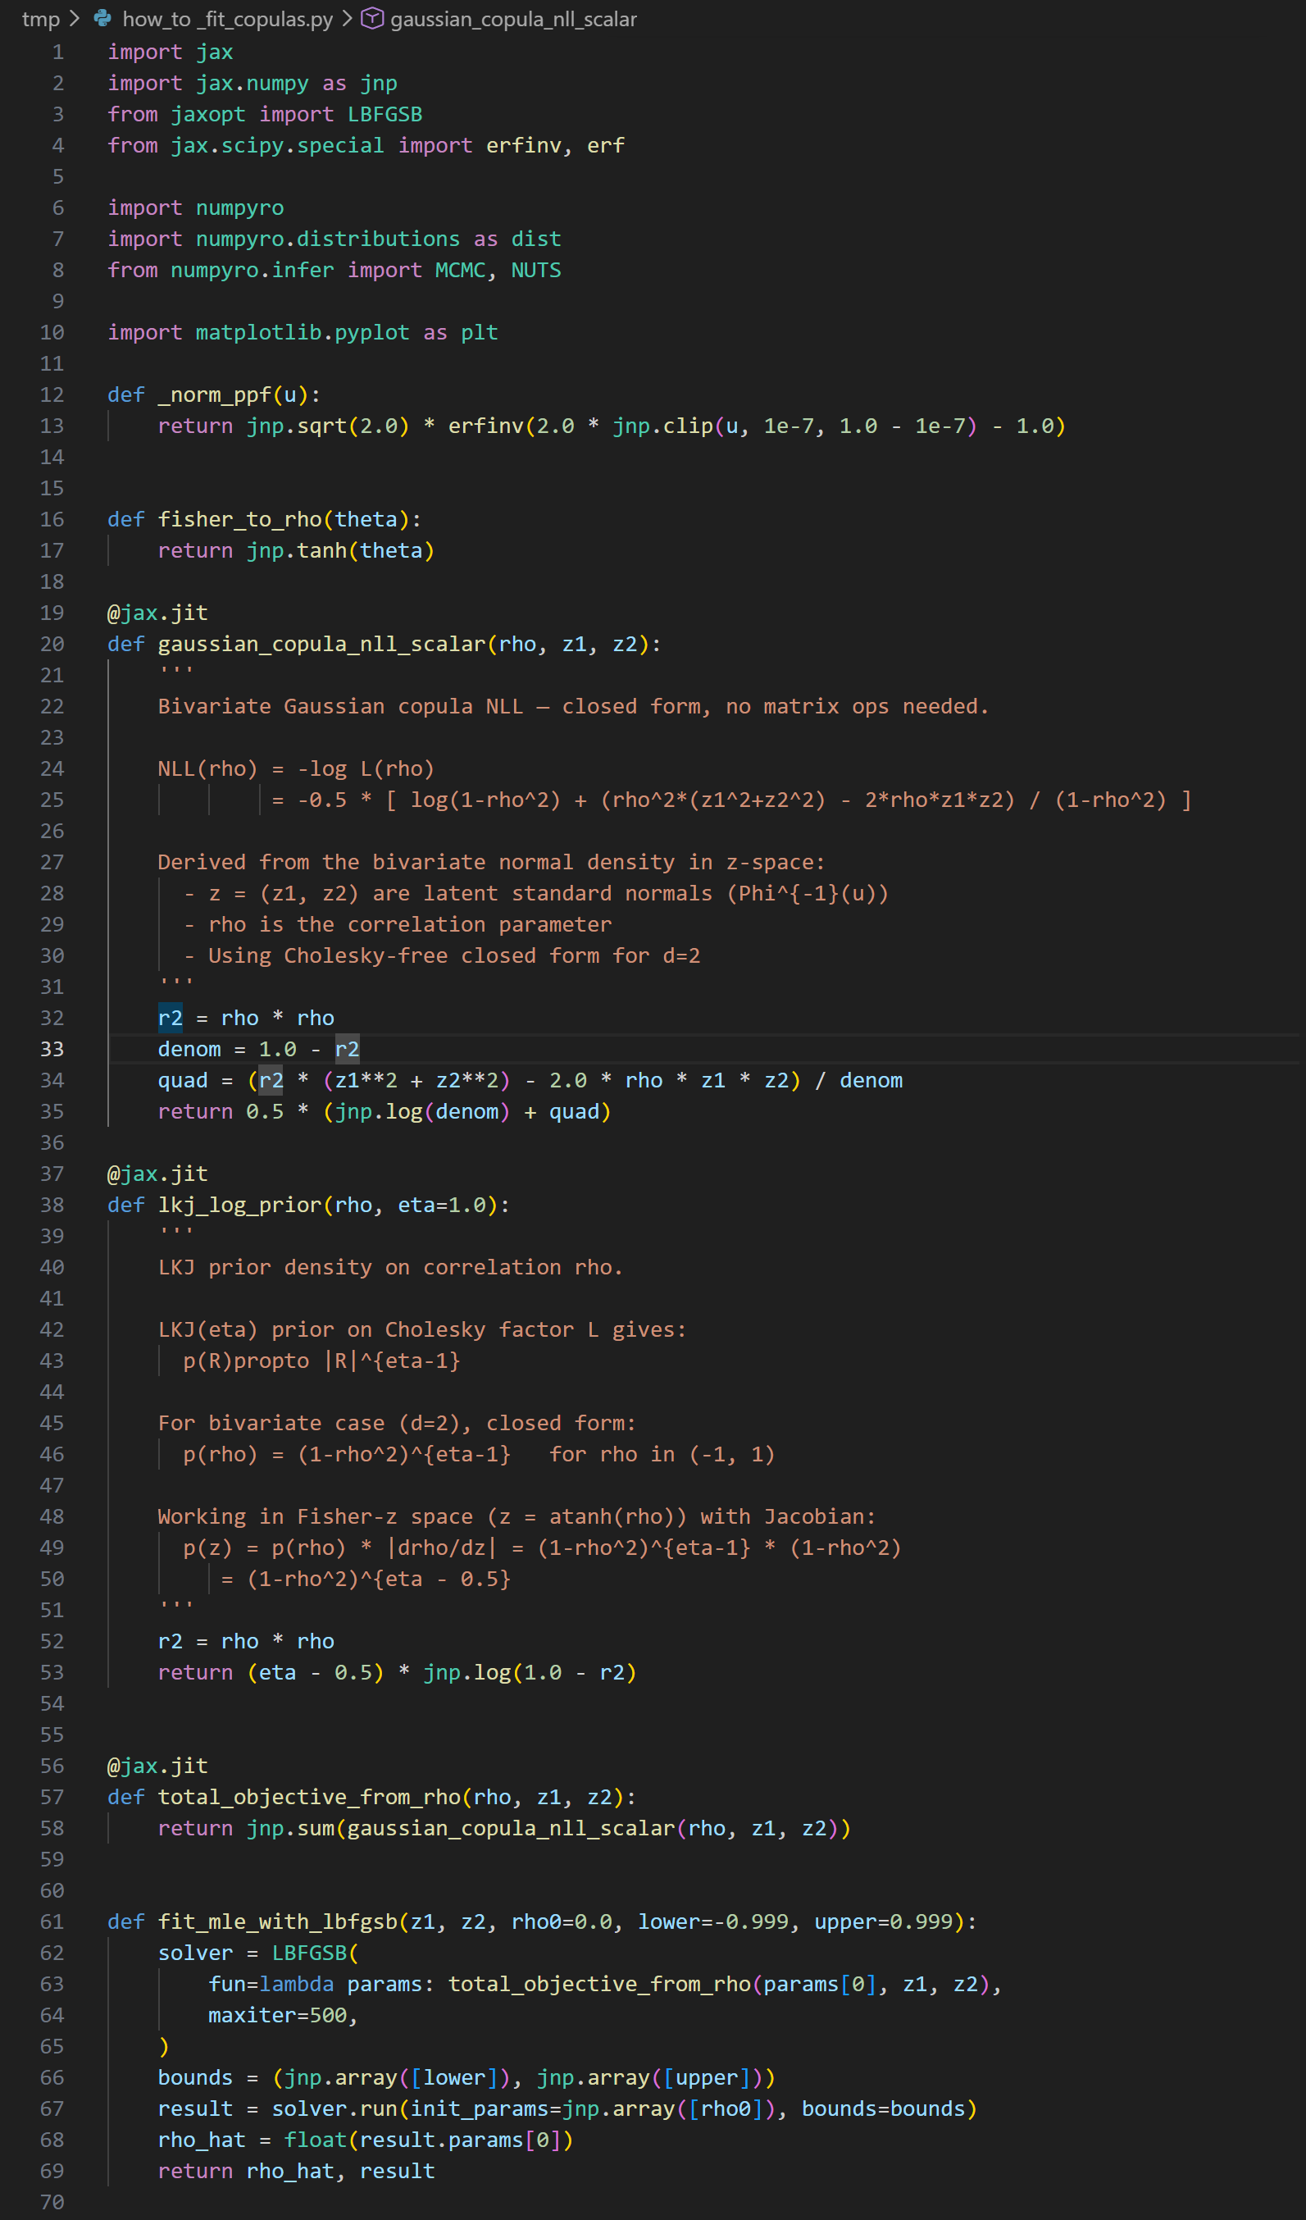

Slide 15
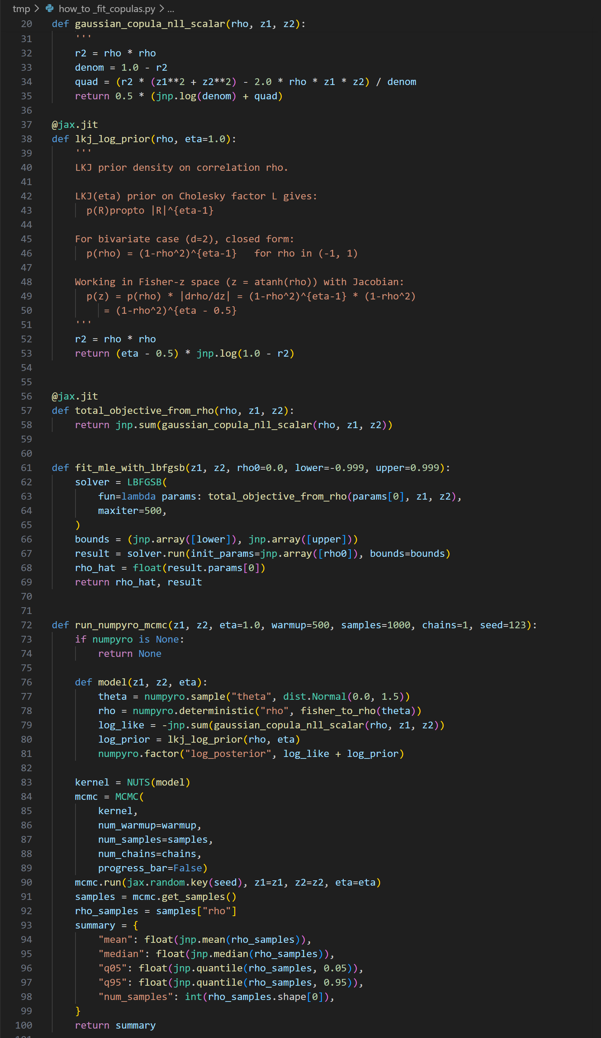

Slide 18
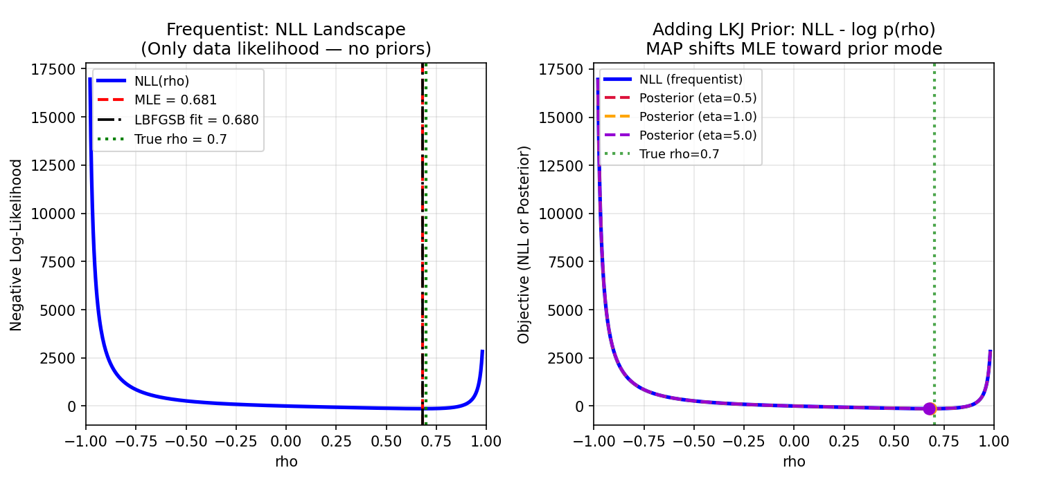
Result

Slide 19
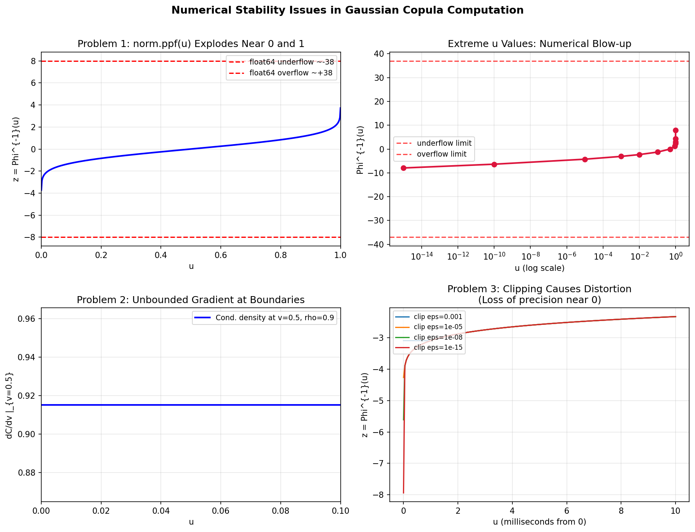
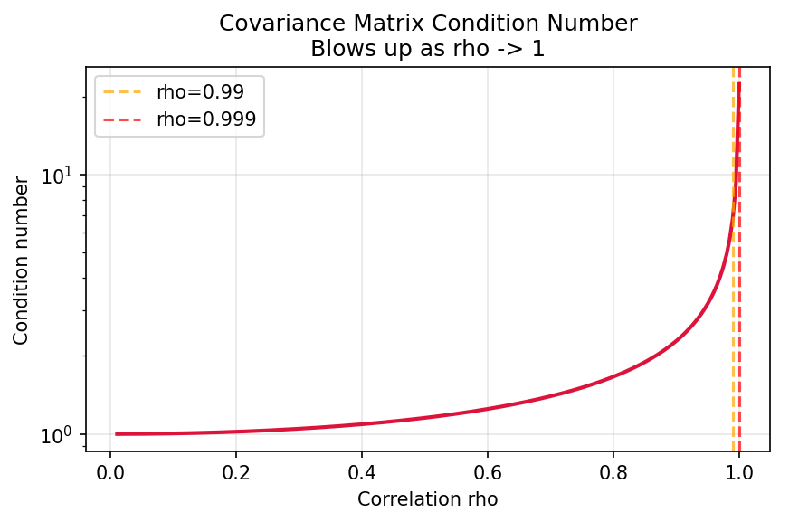
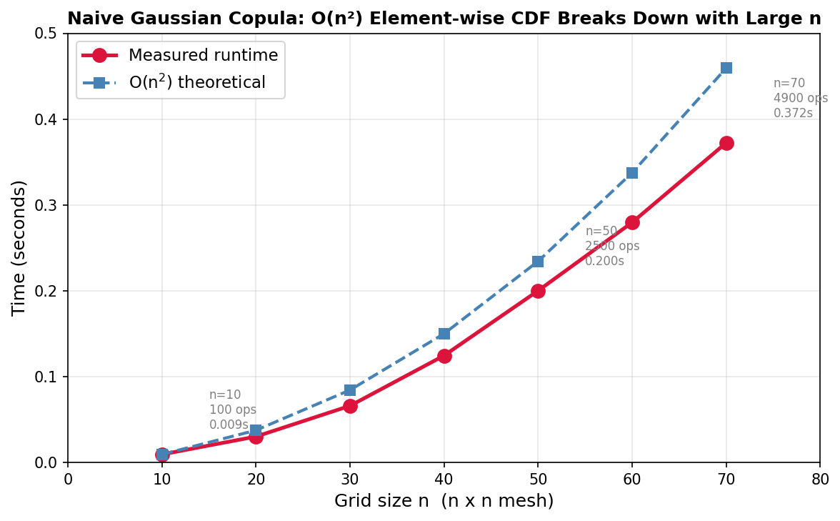
What happens when we let n>10?

Slide 20
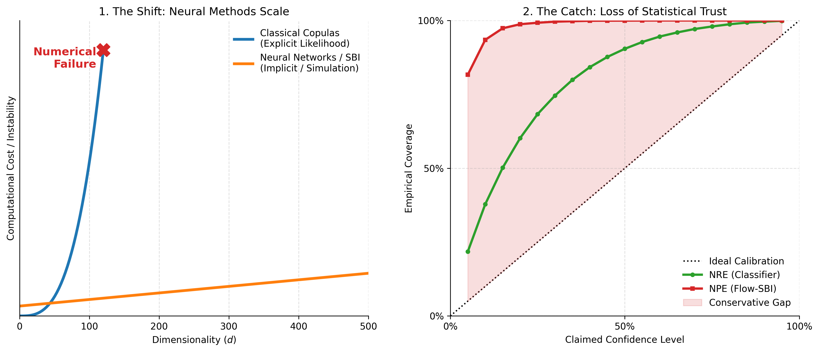
Neural networks for rescue?

Slide 21
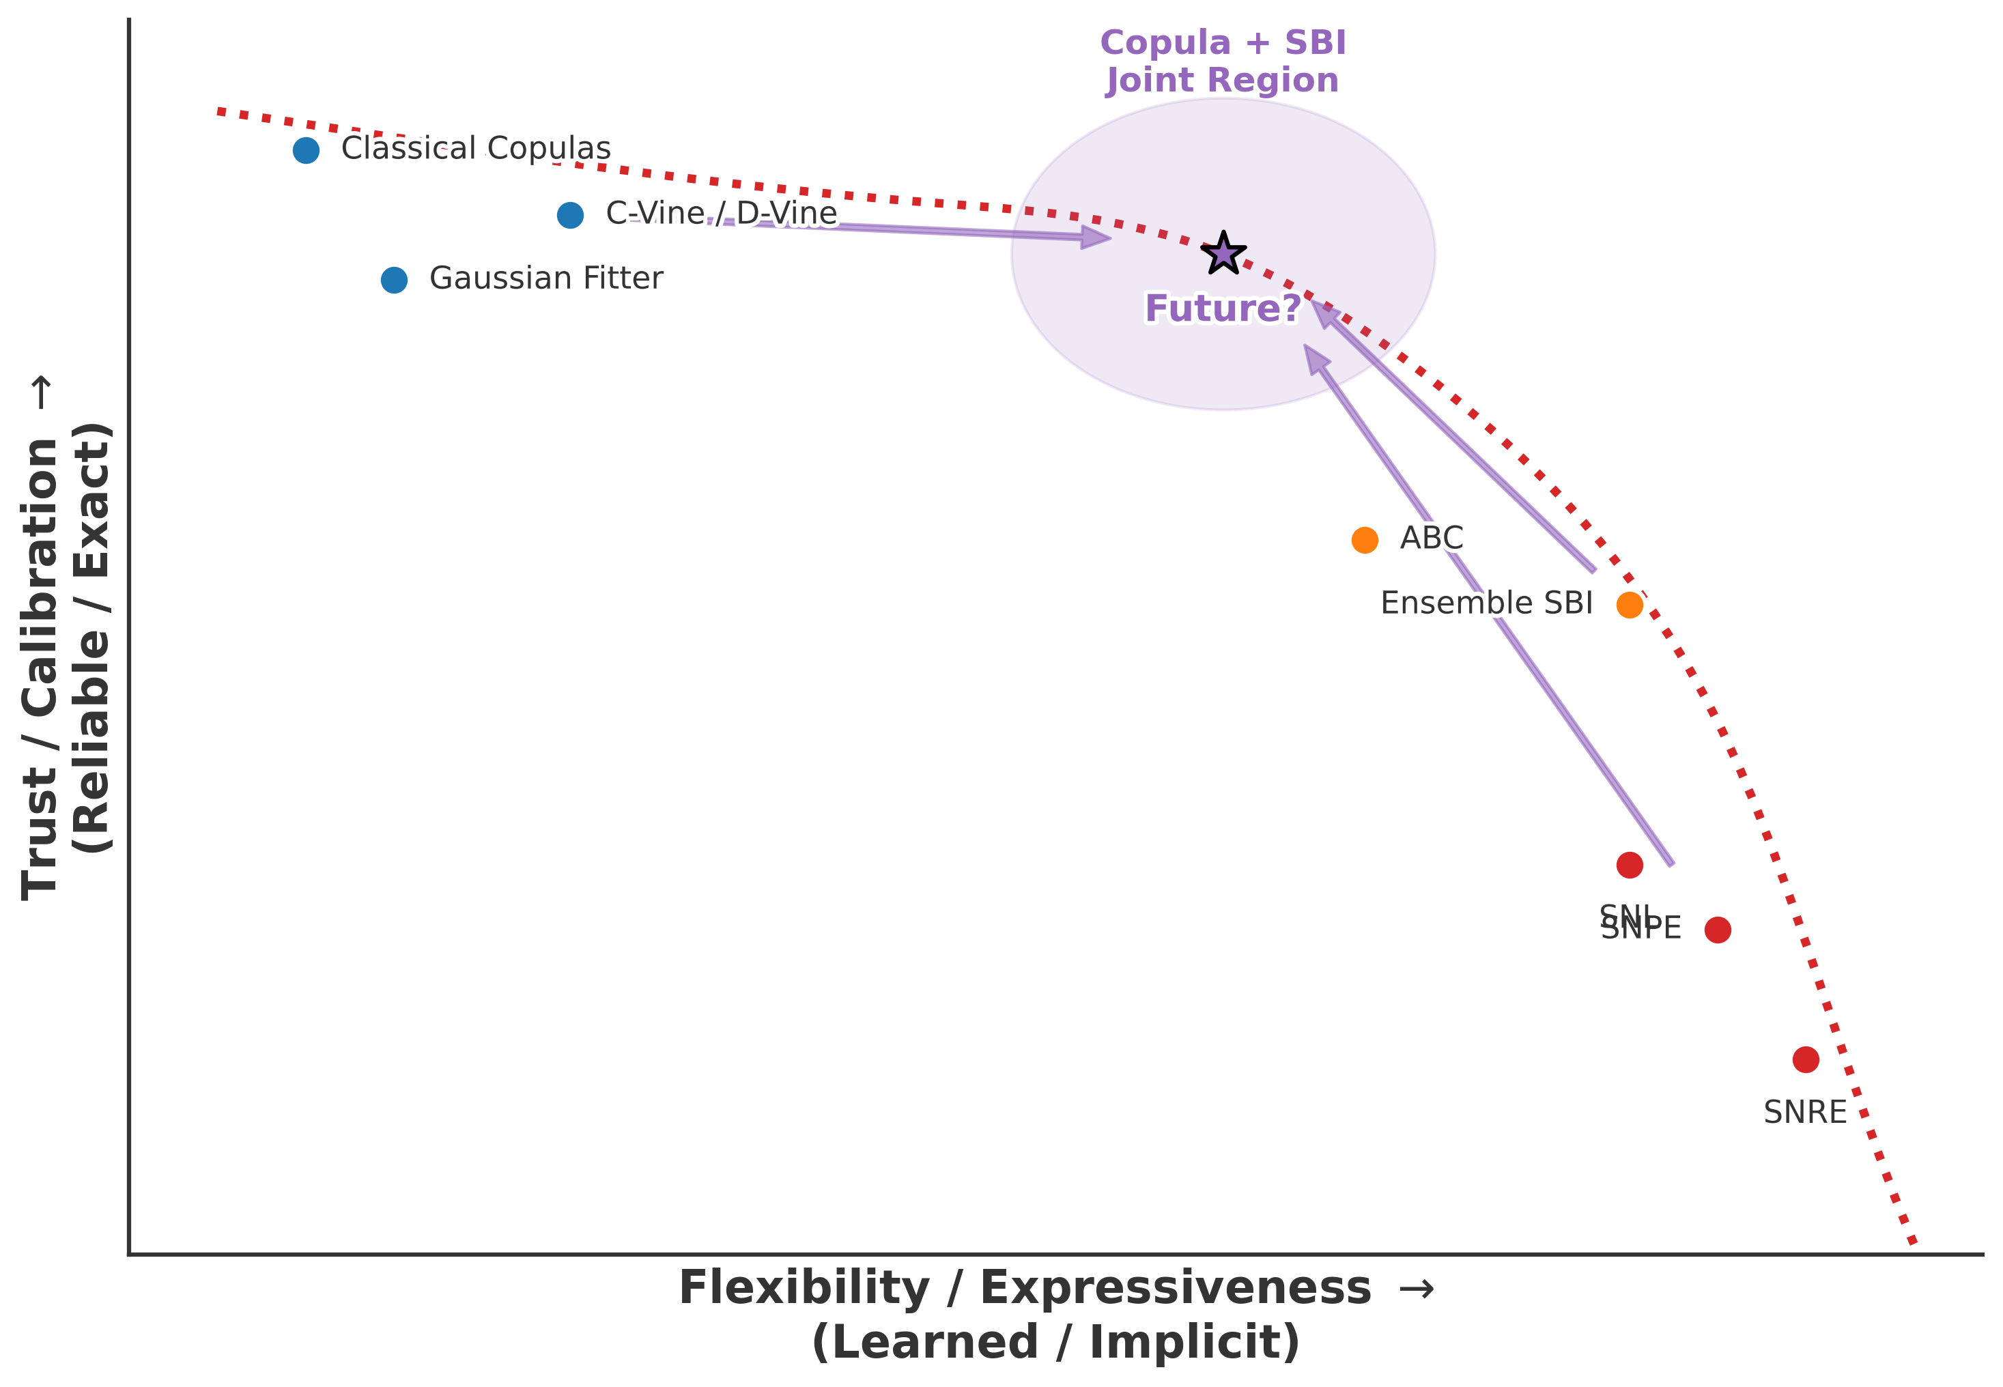
Frontier
Structured (explicit)
  Copulas, vines
    interpretable, decomposable
    scaling, model selection
Implicit (learned)
  Flows, SBI (NPE/NRE)
    flexible, high-dimensional
    calibration issues (coverage failures)
Bridging directions
  Copula-inspired flows
  Structured priors in SBI
  Bernstein-Yett uniform priors

