Slide 1
How to do machine learning research
by Bill Freeman, Andrej Karpathy, Eamonn Keogh
Summarised by
Markus Heinonen, Aalto University
March 2023

Slide 2
http://people.csail.mit.edu/billf/publications/How_To_Do_Research.pdf
Bill Freeman, MIT
~90,000 citations

Slide 3
Please don’t tell me “it doesn’t work”. Of course it doesn’t work
What I want to hear instead is something like, “I’ve narrowed down the problem to step B. Until step A, you can see that it works, because you put in X and you get Y out, as we expect. You can see how it fails here at B. I’ve ruled out W and Z as the cause.”
Take things slowly. Verify your assumptions. Understand the thing, whatever it is–the program, the algorithm, or the proof. As you do experiments, only change one thing at a time, so you know what the outcome of the experiment means.

Slide 4
Slow down to speed up
I love to hear about progress when I meet with students, but note that I have a very general notion of progress. Progress can include: “I’ve shown why this doesn’t work”, “I’ve simplified the task to get it to start working.”, or “I spent the whole time reading because I know I have to understand this before I can make any progress.”
The weak student does exactly what the advisor has asked. But the advisor’s solution fails, and the student reports that failure.
The strong student starts doing what the advisor has asked, sees that it doesn’t work, looks around within some epsilon ball of the original proposal to find what does work, and reports that solution.

Slide 5
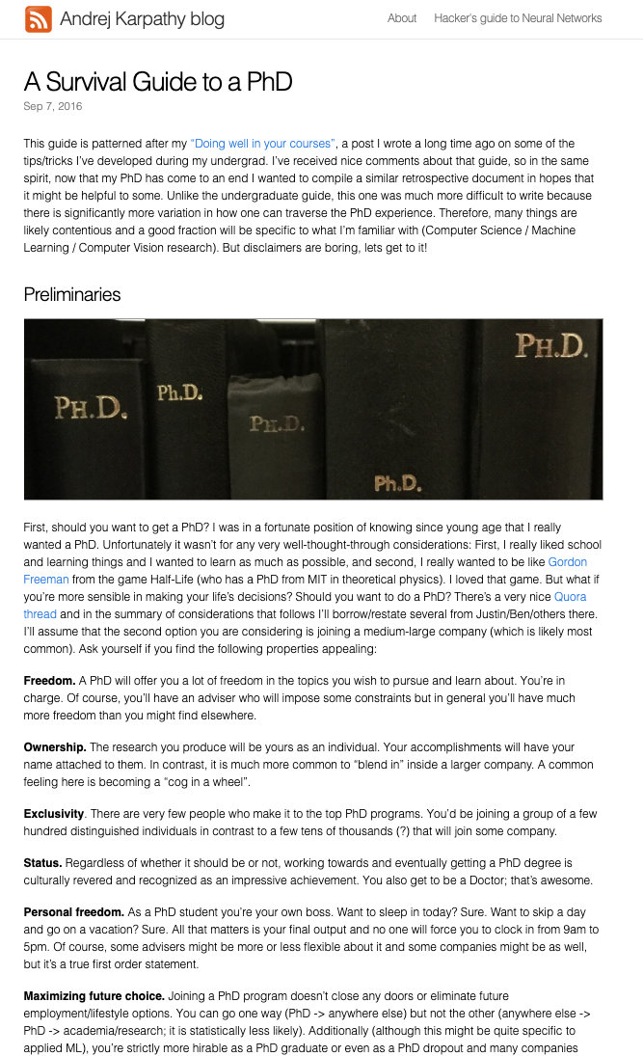
Andrej Karpathy, Tesla
~55,000 citations
http://karpathy.github.io/2016/09/07/phd/

Slide 6
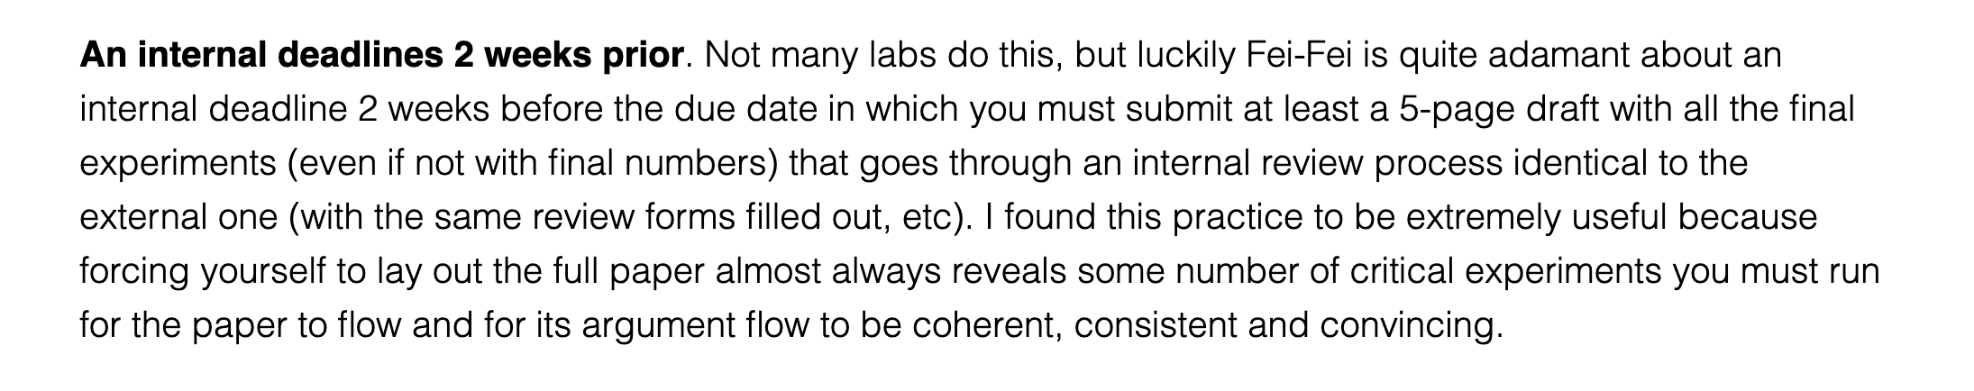
Finishing papers

Slide 7
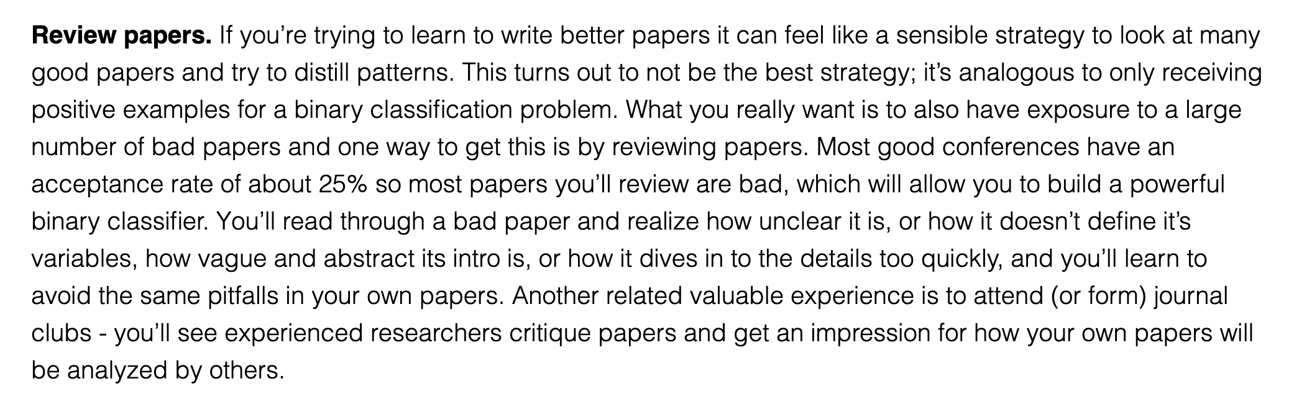
How to write good papers

Slide 8
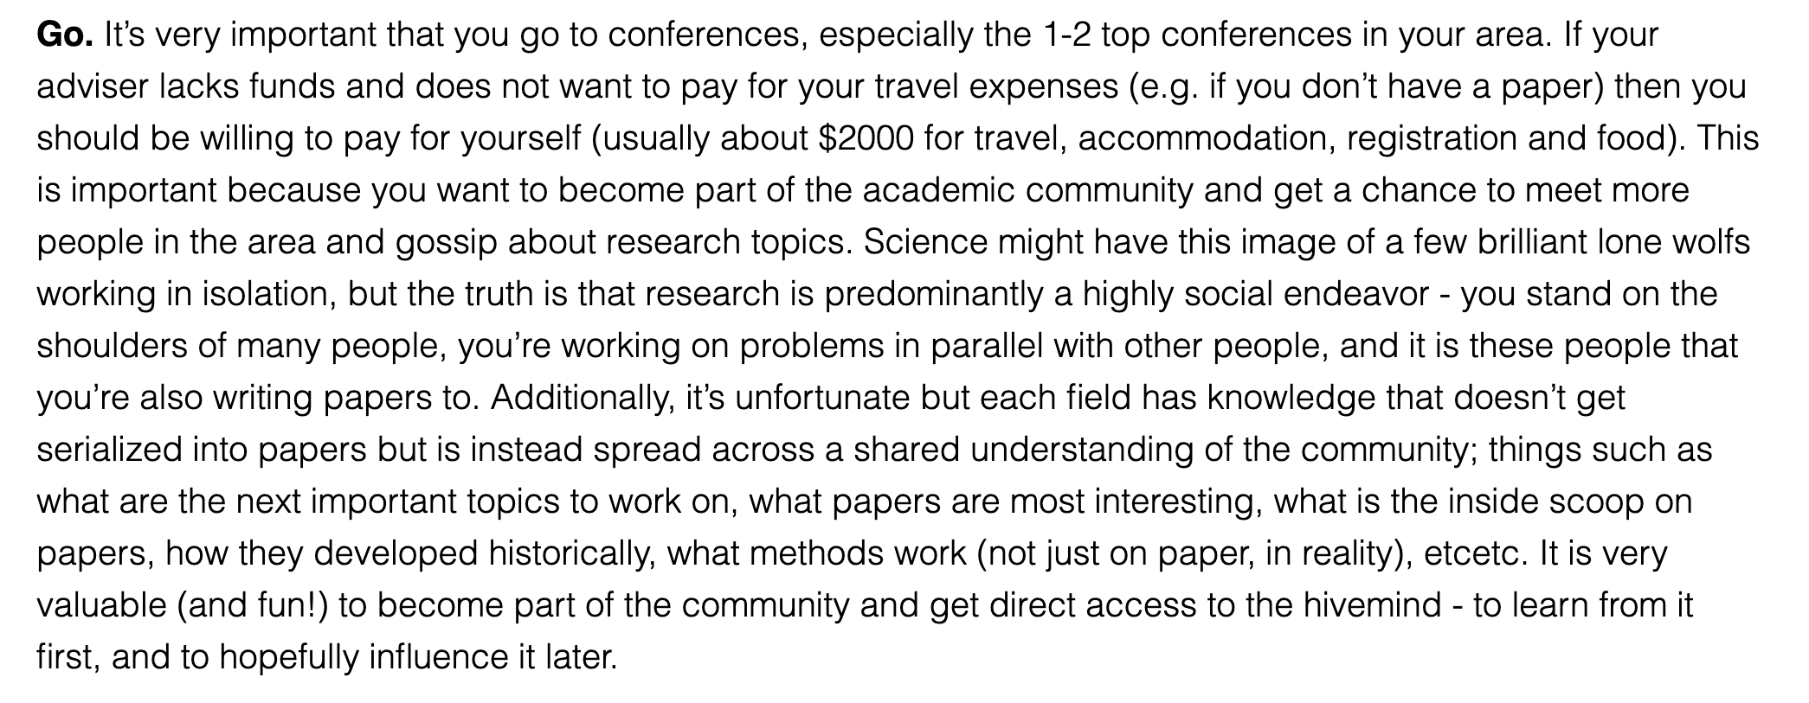
Conferences

Slide 9
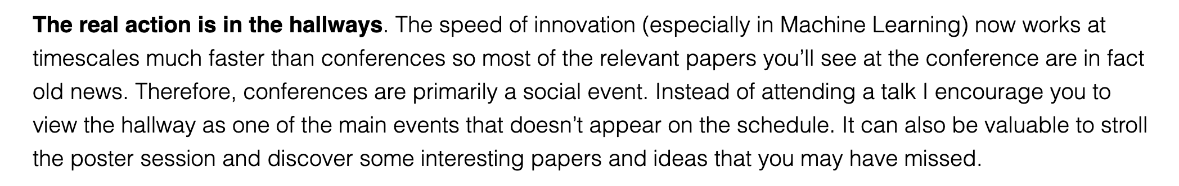
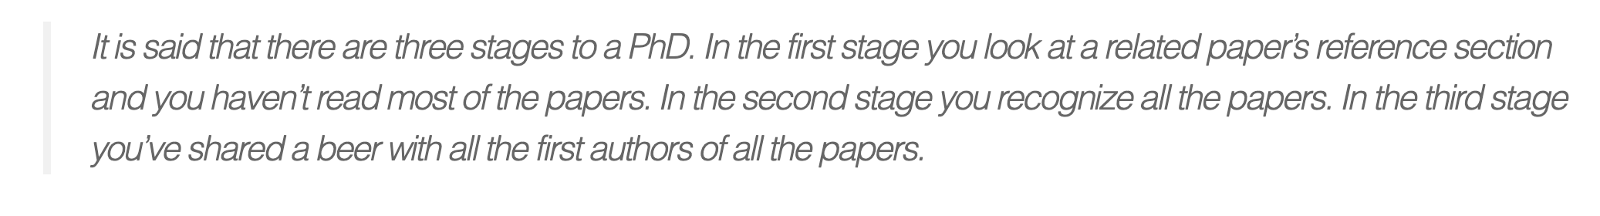
Conferences

Slide 10
http://www.cs.ucr.edu/~eamonn/Keogh_SIGKDD09_tutorial.pdf
Eamonn Keogh, UC
~55,000 citations

Slide 11
Finding research problems

Slide 12
Problem statement

Slide 13
First page as an anchor

Slide 14
Eliminate simple ideas first

Slide 15
Don’t make reviewers think!
👎
👍

Slide 16
👎
👍

Slide 17
Reproducibility

Slide 18
Use color

Slide 19
Too many digits

Slide 20
Be precise

Slide 21
Report performance distribution

Slide 22
Report performance distribution
👎
All of these hide information

Slide 23
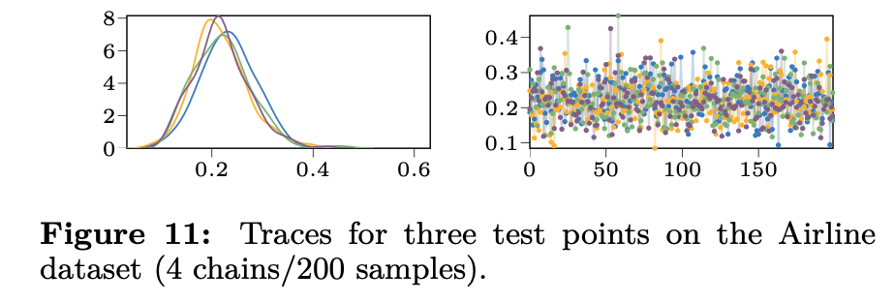
Show your distributions!
Show both of these
👍

Slide 24
My recommendations

Slide 25
Recognize sources of variability
Always give some variance of all quantities (eg. accuracy)
At least six sources of variability
Test distribution
Function stochasticity
Parameter posterior
Parameter initialisations
Hyperparameters
Training samples
Random seed
A good paper demonstrates how the model behaves wrt all sources
$$Ε_{x∼p\left(X_{test}\right)}f\left(x | θ,ε\right)p\left(θ | θ_{0}, γ, X_{train}, seed\right)$$

Slide 26
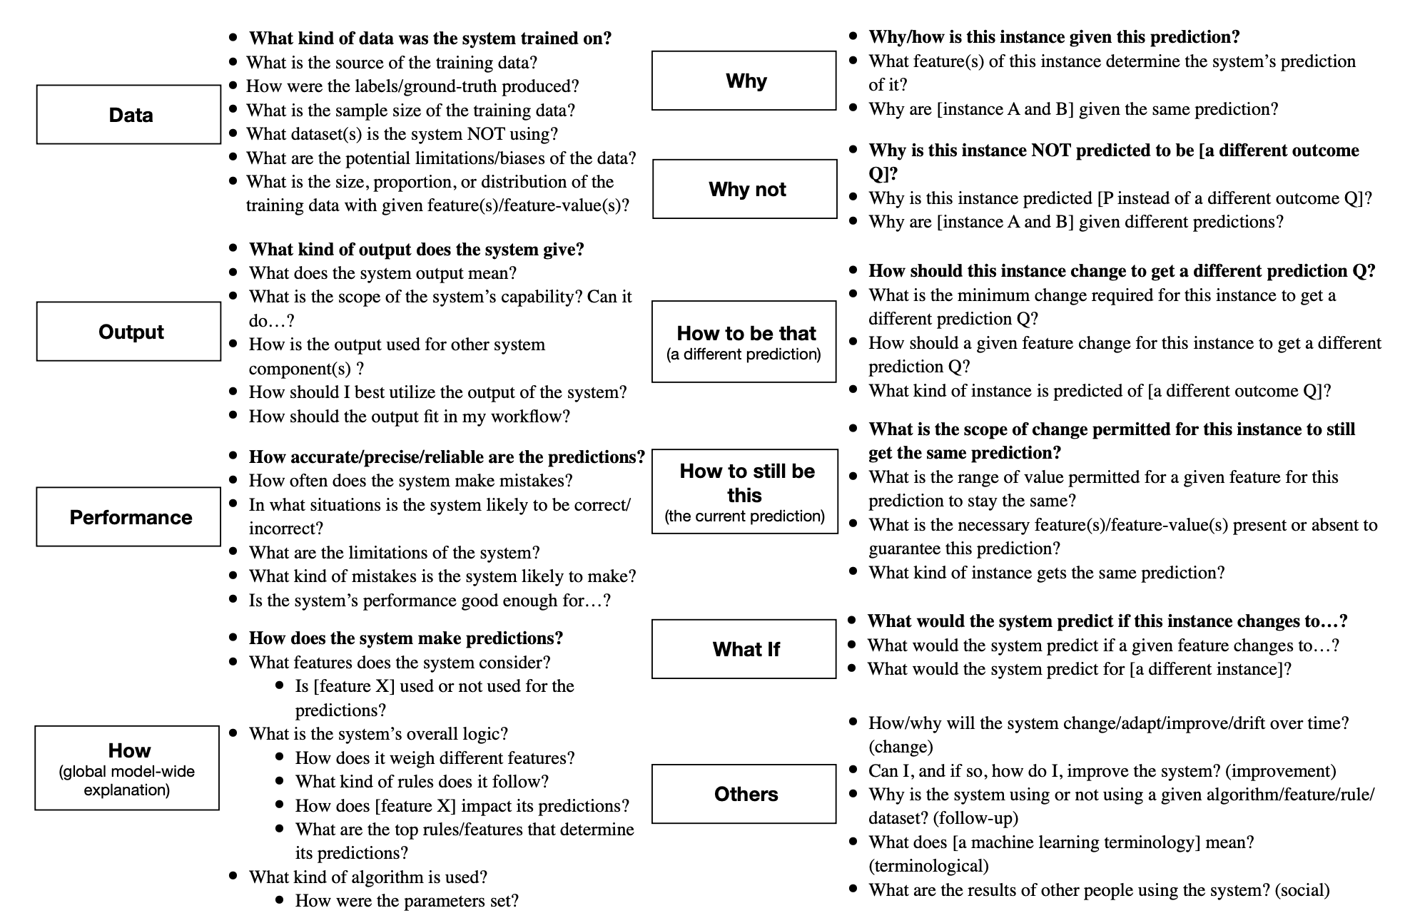
Do you understand your model? .. does your audience? .. do your reviewers?
🤔
Liao, Gruen, Miller. Questioning the AI: Informing Design Practices for Explainable AI User Experiences, 2020

Slide 27
Two scenarios
Students runs an experiment and gets great results, but doesn’t know why
Student runs an experiment and gets bad results, and doesn’t know why
Which one is better?
Both are bad!

Slide 28
Standard for publications is high!

Slide 29
On being precise
Sloppy presentation implies that you don’t care about your work
Typos, mistakes, poor illustrations, missing citations
Typos signal that you did not bother to proofread your paper
Fair enough, I won’t bother to read your paper either
There can not be any mistakes in math
If you don’t understand the equations, why should the reader bother?

Slide 30
Giving talks
Don’t target your talk to experts of your domain
They have already read your paper; they will cite you anyways
Target your talk to non-experts
Conferences are a place to hear about new things
The audience has a limited mental budget
The listener has to build a mental model of every equation
60% of people are visual learners
Visualise all math: If you can’t, can the audience?
Don’t make audience think
Color your math
After 5 equations or symbols half the people will stop listening
Is all of your math crucial for understanding?
Can you replace math with figures?

Slide 31
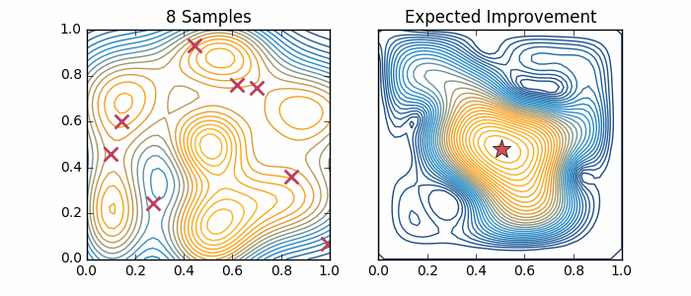
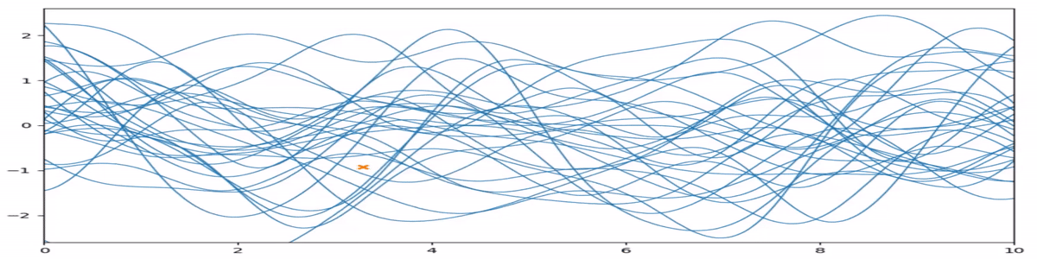
Animate your presentations! The math of this slide can be almost understood with no math!
👍

Slide 32
Wide aspect ratio looks nicer \documentclass[aspectratio=169]{beamer}
👍

Slide 33
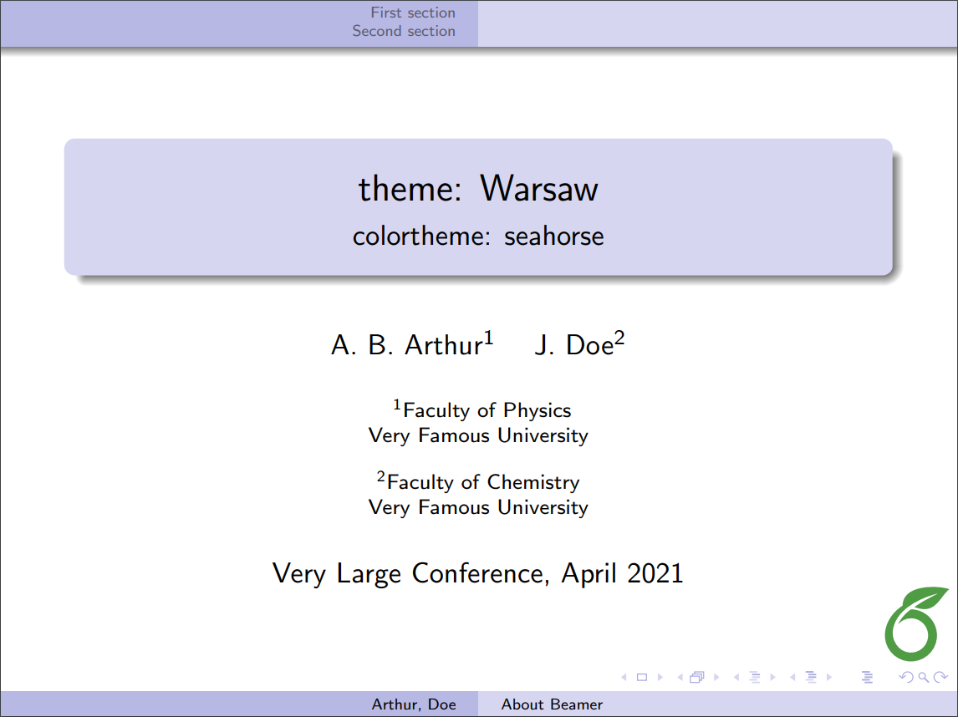
Remove unnecessary stuff

Slide 34
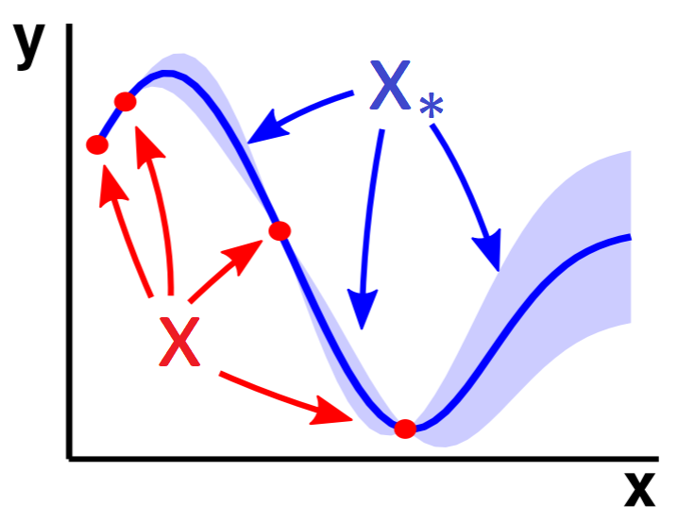
Annotate plots Help the reader!
👍

Slide 35
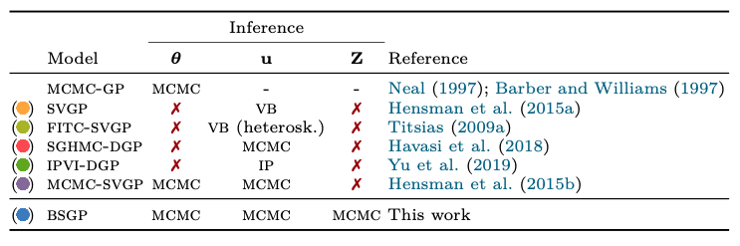
Include scope table Define the context!
👍
(colors help a lot!)

Slide 36
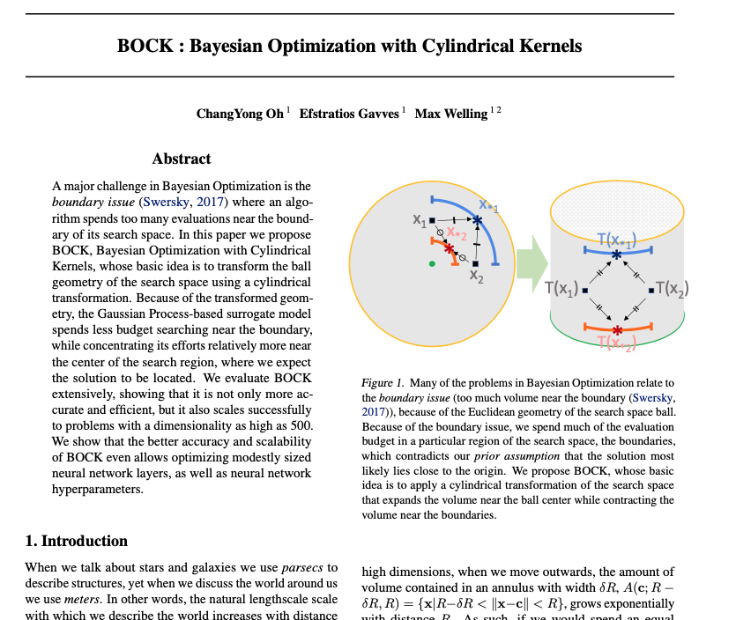
Use a first-page figure (but what kind…)
👍

Slide 37
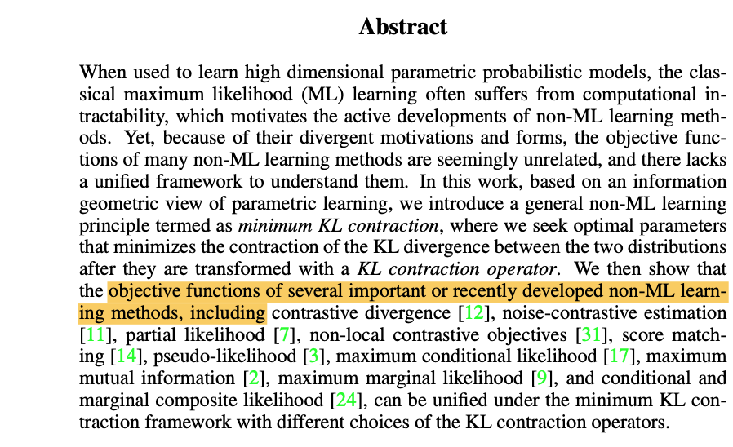
You can break article conventions
🤔
Citations in abstract, why not
Literature survey can come late
Math on second sentence is fine

Slide 38
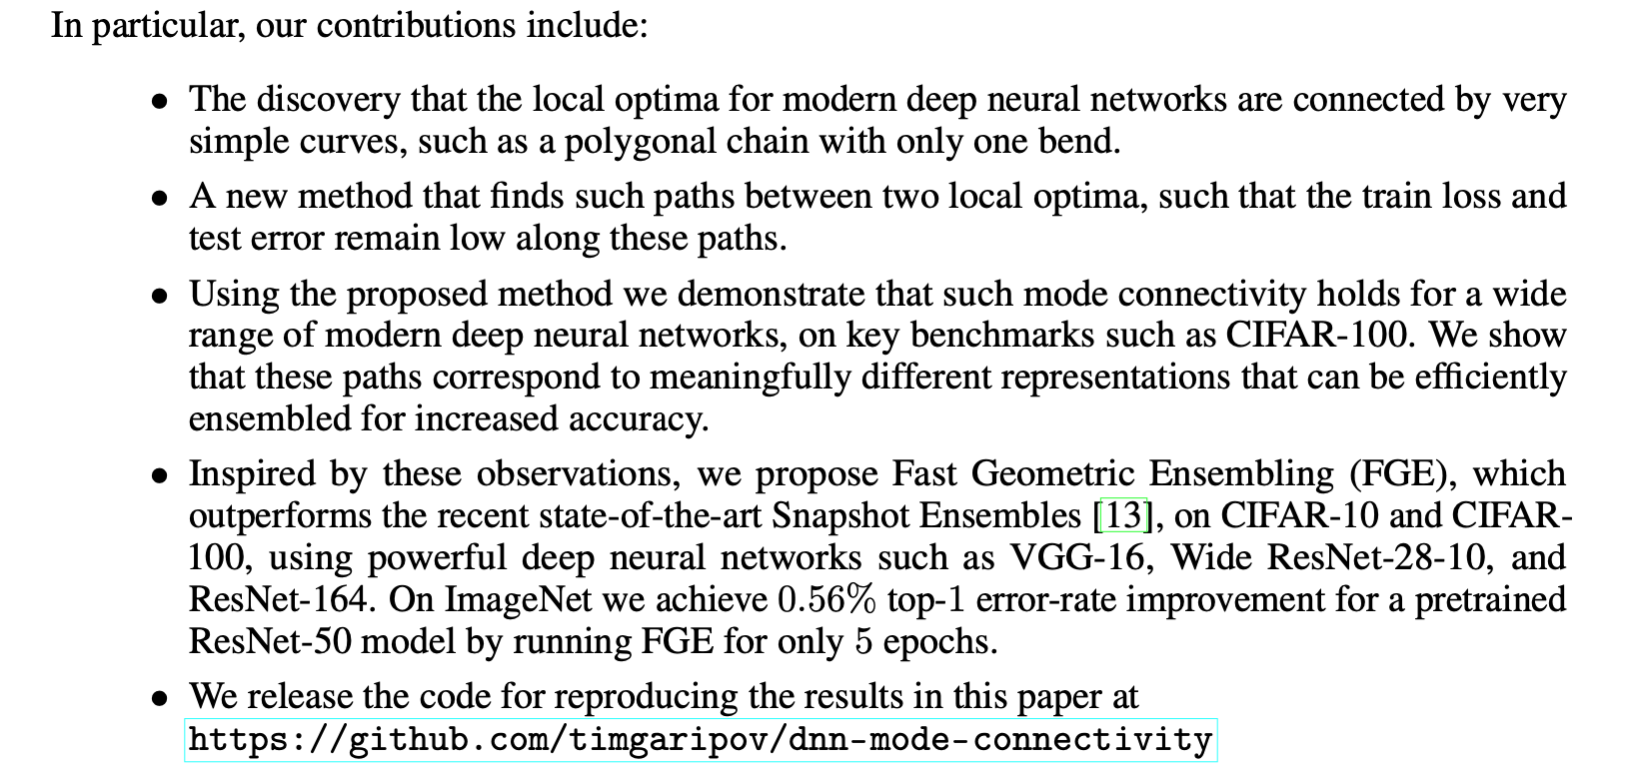
Bullet your contributions (reviewers are asked to list them, don’t make them think)
Don’t forget this

Slide 39
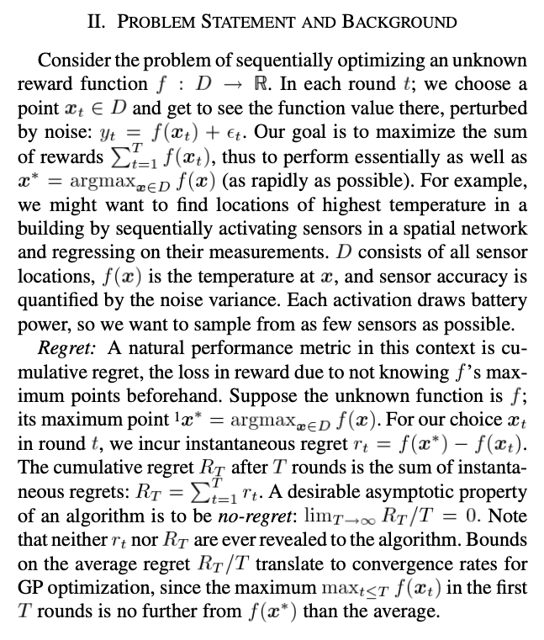
Define your problem
👍
Precise goal
Conceptualise
Define unknowns

Slide 40
Visualise the obvious
👍

Slide 41
High-level schematics
👍

Slide 42
Technical schematics: map your math (also separate how model use differs between train/test)
👍

Slide 43
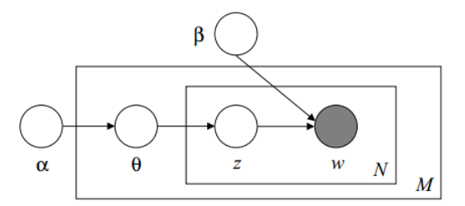
Are you probabilistic? Then do a plate diagram
👍

Slide 44
Clear result tables \includepackage{booktabs}
👍
Eyes naturally compare things vertically, but can’t compare horizontally
Use color
(but be consistent)
(don’t forget variances!)

Slide 45
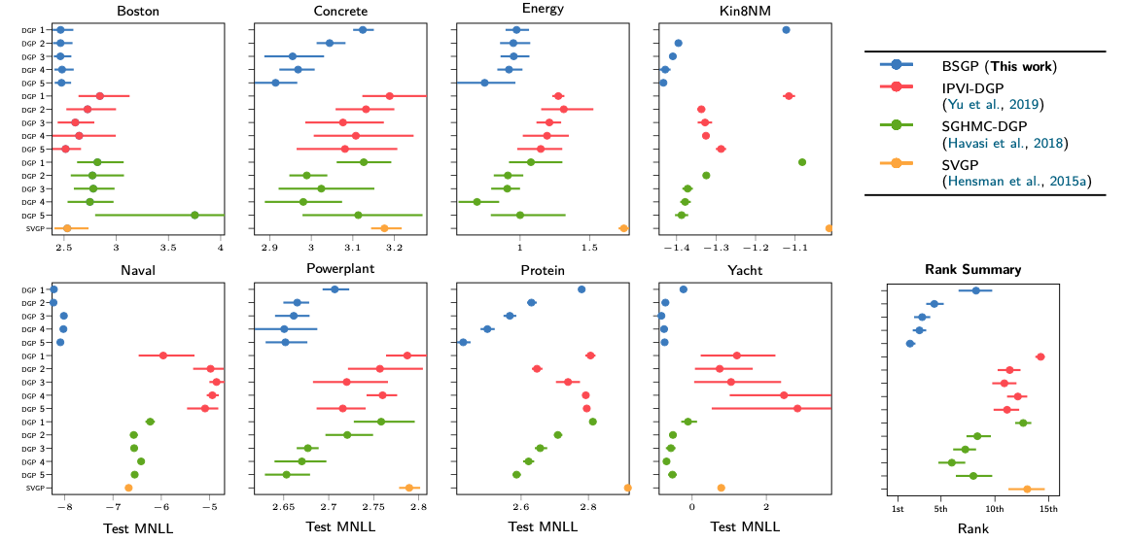
Presenting large comparisons
👍
Summarise!

Slide 46
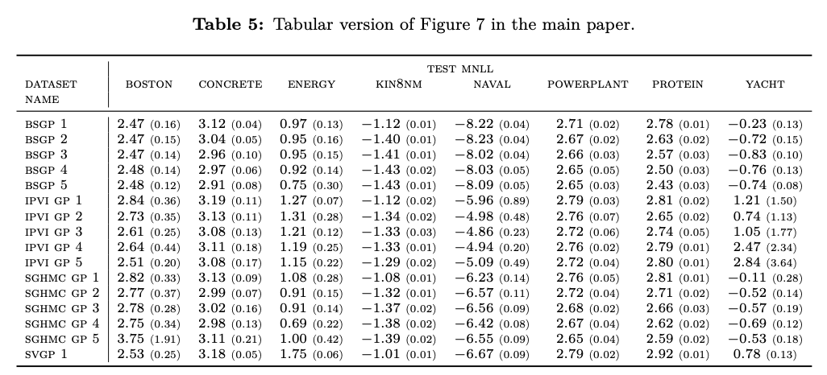
Presenting large comparisons
👍
Put tabular copy to appendix!
Std with smaller font 👍

Slide 47
Visualise intermediate fits
👍

Slide 48
Ablation studies
👍

Slide 49
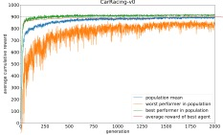
Learning curves over data / folds / ensembles / terms
👍

Slide 50
Include “dummy” baselines
👍
( too many digits! )

Slide 51
Parameter & feature tables
👍

Slide 52
Start every project with PCA / T-SNE / UMAP
👍

Slide 53
Visualise loss landscapes or posteriors
👍
https://arxiv.org/abs/1712.09913

Slide 54
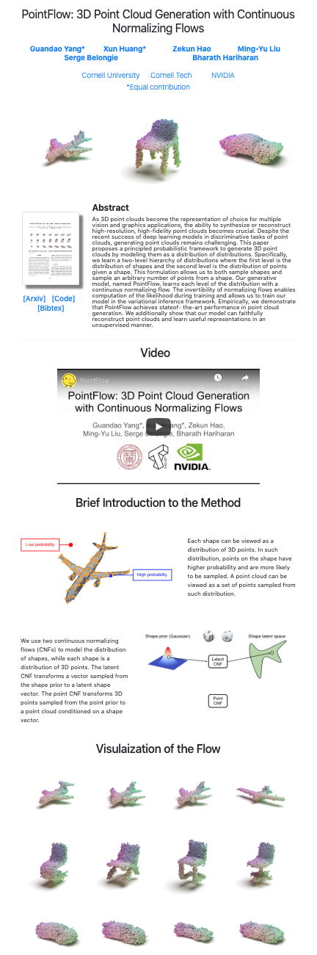
Build your brand
Have a twitter/blog/github/scholar/website
Make sure collegues/journals/conferences/bigshots can find you online
Build a website for each paper
Include code / examples / visualisations
Arxiv is not enough
Include a “1-click” demo
Website increases impact and reach

Slide 55
On plotting
Seaborn and matplotlib are good libraries
Use modern “soft” color palettes (the “CN” colors in matplotlib)
Never use “r/b/g/c/k” colors
Save images as .png with high dpi 600
Vector formats .pdf/.eps are a headache
Trim all whitespace with imagemagick -trim
Scale figures to be readable with poor eyesight
Decrease ‘figsize’ to scale the figure (use smallest figsize that looks good)
Don’t adjust fonts manually
All figure fonts need to be as big as caption font
Figures need to be self-contained and self-explanatory
Does the figure work without caption? If not, simplify!
Caption: give conclusion

Slide 56
On captions
🤔
Is the plot self-explanatory without the caption?
description
conclusion
Is the plot fully labelled?
👎

Slide 57
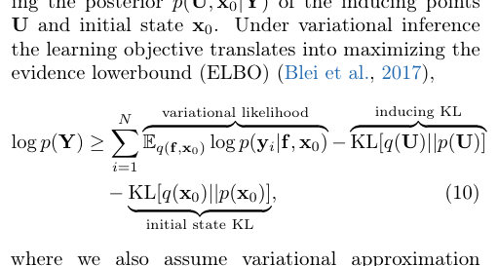
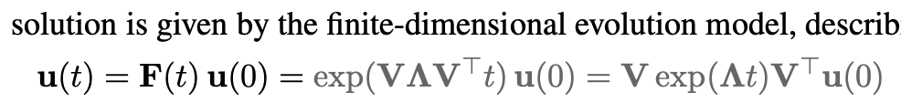
On Latex
👍
Try to keep to classic latex style
Basics
Use booktabs for tables
Use \resizebox to make tables exactly 1-column wide or 2-column wide
Use natbib with \citep and \citet
Color citations blue, eqrefs red
\usepackage[usenames,dvipsnames]{xcolor}
\usepackage[colorlinks=true,citecolor=MidnightBlue]{hyperref}
Use wide aspect ratio, remove Beamer bottom buttons, remove beamer footer bar
Math
Use \align
Don’t place line breaks around equations
Don’t place whitespace around parenthesis (don’t use \left( if not needed)
Use \underbrace a lot!
Use macros, eg. \def\N{\mathcal{N}}
Use color
Math presentation
Prioritize readability and understandability
Include full math and intermediate derivations in appendix

Slide 58
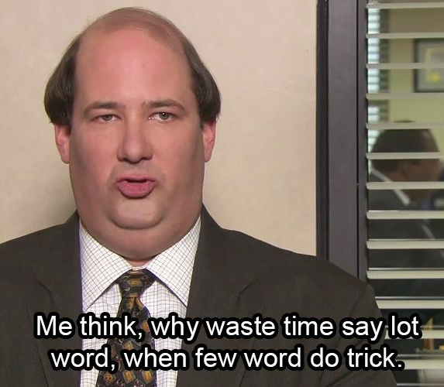
Remove unnecessary words that you don’t need in sentences.
because based on the fact that
for the purpose of
there were several subjects who completed
it is suggested that a relationship may exist
a total of n subjects
four different groups
the reason is because
The results showed that
https://www.sportsci.org/jour/9901/wghstyle.html

Slide 59
Go to the point: abstract case-study
Triviality: do we need this?
More background: is this needed?
Hamiltonian mechanics is one of the cornerstones of natural sciences. Recently there has been significant interest in learning Hamiltonian systems in a free-form way directly from trajectory data. Previous methods have tackled the problem of learning from many short, low-noise trajectories, but learning from a small number of long, noisy trajectories, whilst accounting for model uncertainty has not been addressed. In this work, we present a Gaussian process model for Hamiltonian systems with efficient decoupled parameterisation, and introduce an energy-conserving shooting method that allows robust inference from both short and long trajectories. We demonstrate the method’s success in learning Hamiltonian systems in various data settings.
The actual problem definition, can we start directly from this?

Slide 60
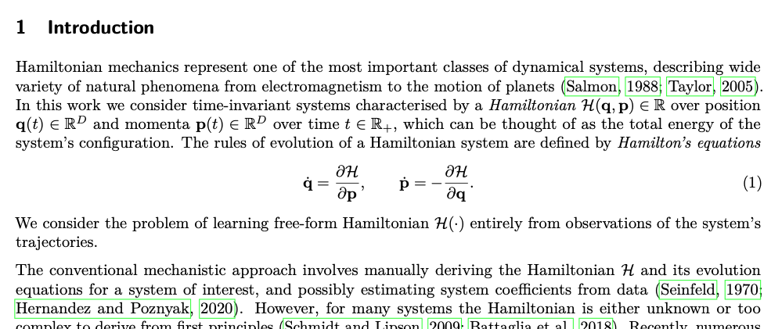
Go to the point: Introduction case-study

Slide 61
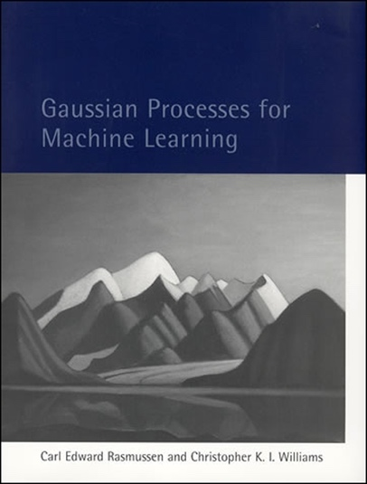
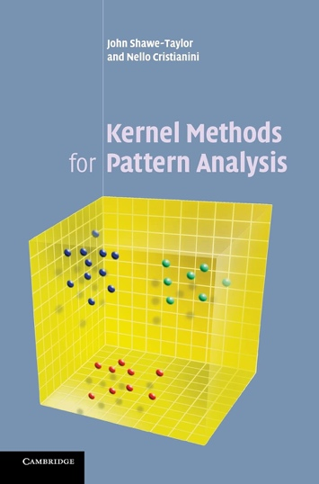
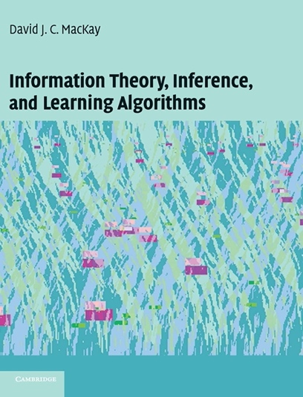
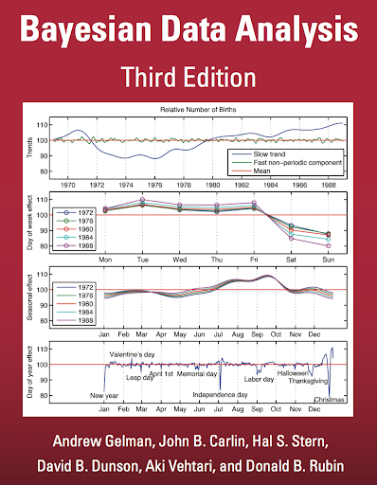
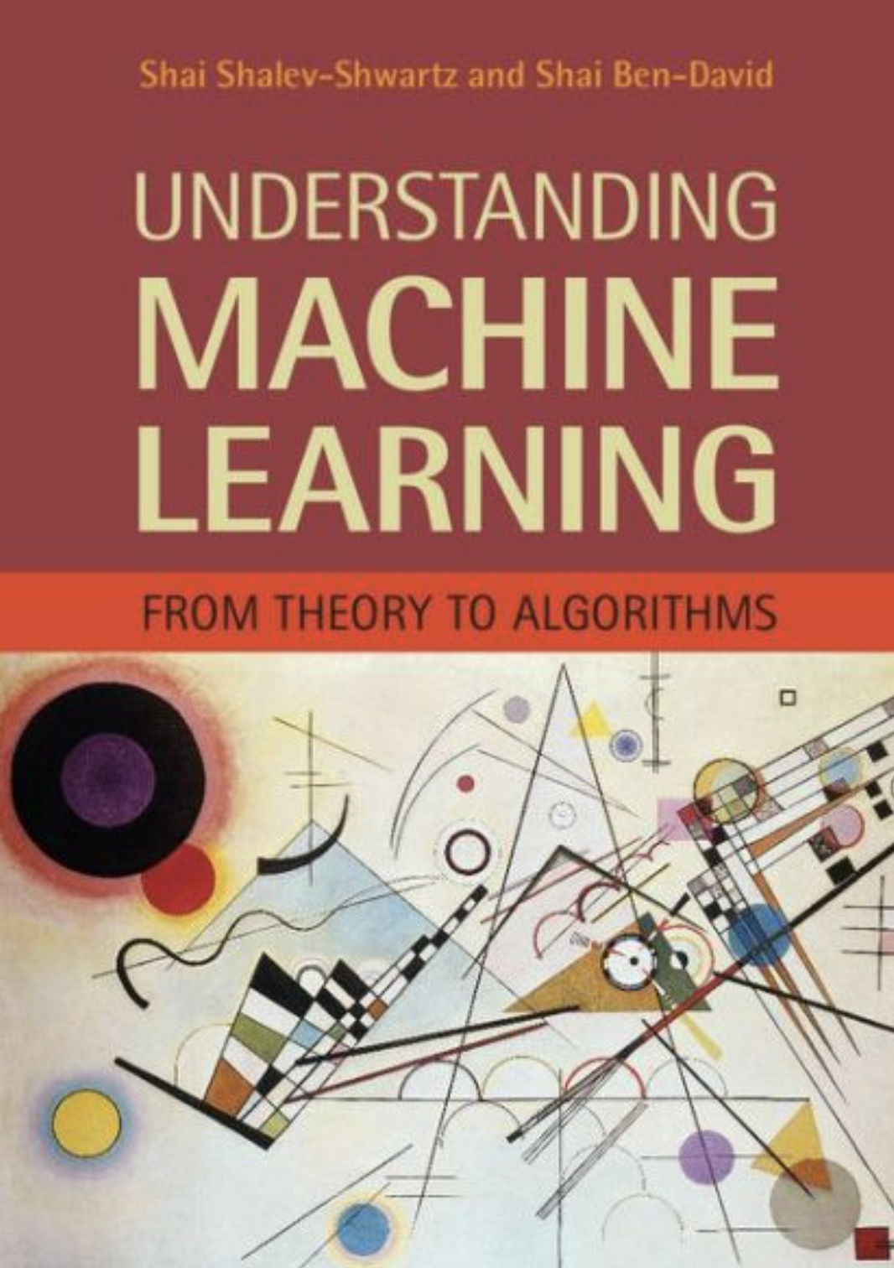
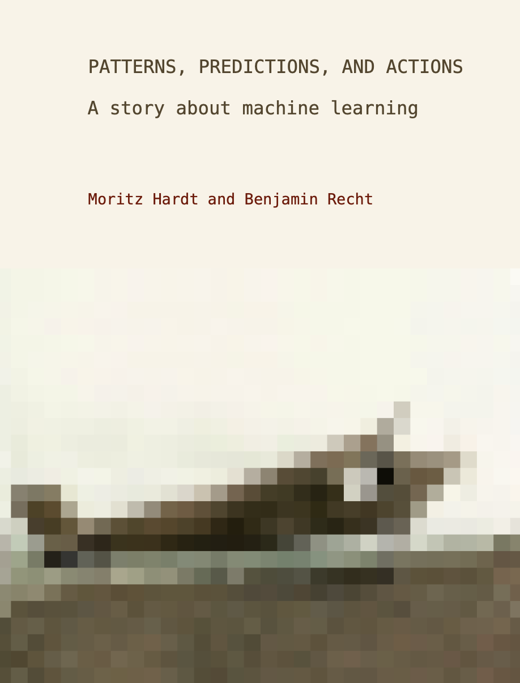
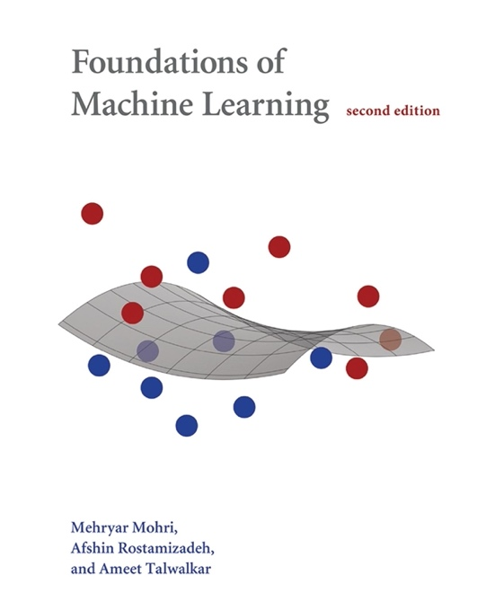
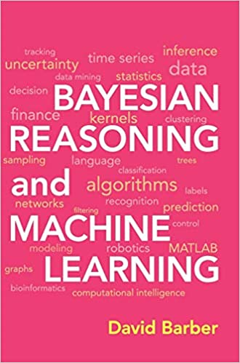
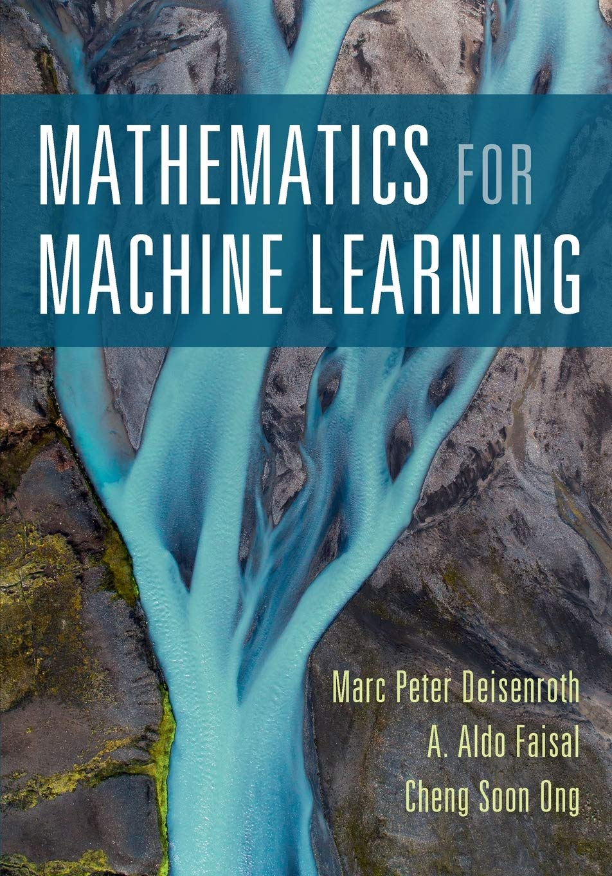
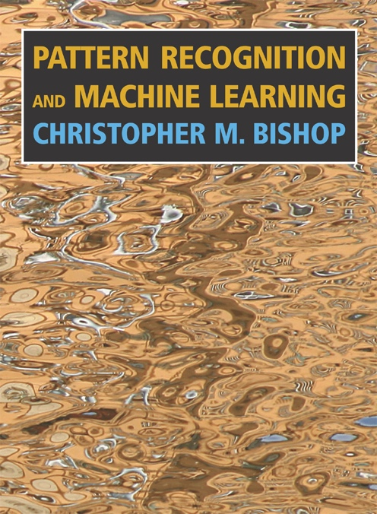
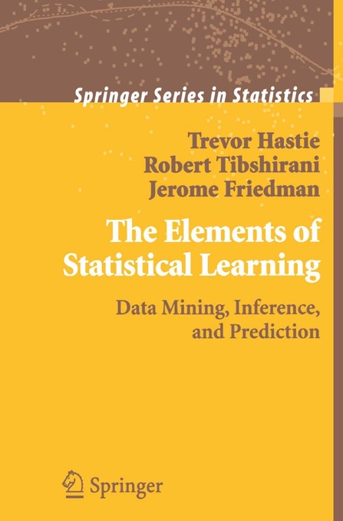
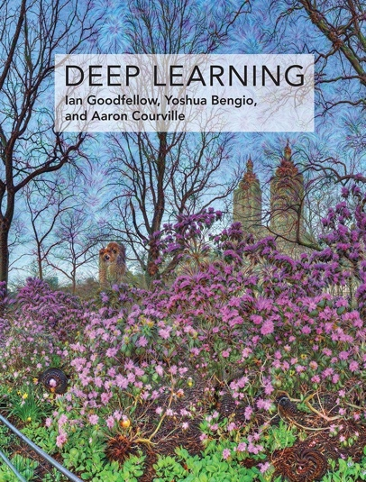
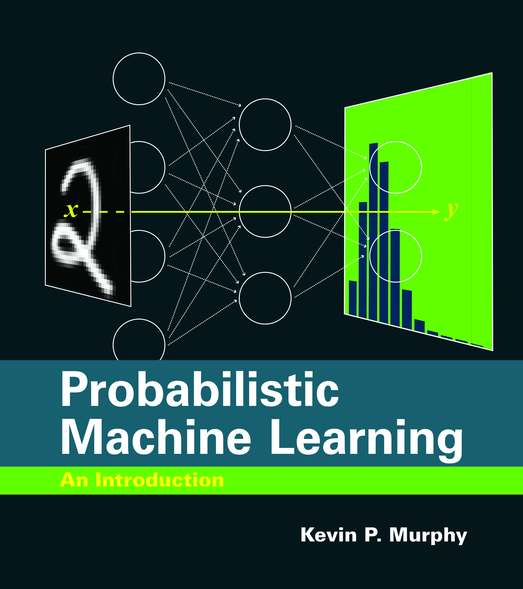
On reading
Only an ML expert can create new ML
Be an expert
In the first 12 months of your phd
Read Math for ML
Read PRML or ESL
Read Deep Learning or PML
(Lots of overlap!)
Use 1 weekday to reading
If you get stuck, read more (not less!)
Main result of phd is you, not your research!
1st year

Slide 62
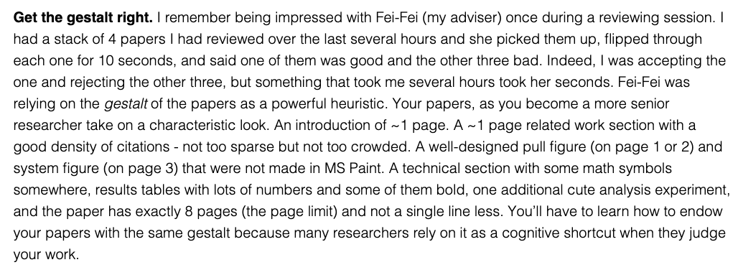
How to read a paper?
Phd is 1000 work days
Reading paper every two days gives you a mental library of 500 papers
Most papers need only 10 minutes to read: what is the gist?

