Slide 1
Megakernels Considered Harmful: Wavefront Path Tracing on GPUs
Samuli Laine
Tero Karras
Timo Aila

Slide 2
Path Tracing Overview
Cast a ray from the camera through the pixel
At hit point, evaluate material
  Determine new incoming direction
  Update path throughput
Cast a shadow ray towards a light source
Cast the extension ray and repeat
At some depth, start using Russian roulette to terminate path probabilistically
  Avoids infinitely long paths

Slide 3
Problems in Megakernel Path Tracer
You can put all code in one kernel, even on a GPU
  Ray casts, evaluators and samplers for all materials, evaluators and samplers for all light source types, path tracing logic, MIS, new path generation, etc.
BUT:
Lots of code
  Bad for instruction cache
Lots of registers used (based on hottest spot)
  Bad for latency hiding capacity
Lots of execution divergence
  Bad for SIMT execution model (warps of 32 threads)

Slide 4
Problems in Megakernel Path Tracer
You can put all code in one kernel, even on a GPU
  Ray casts, evaluators and samplers for all materials, evaluators and samplers for all light source types, path tracing logic, MIS, new path generation, etc.
BUT:
Lots of code
  Bad for instruction cache
Lots of registers used (based on hottest spot)
  Bad for latency hiding capacity
Lots of execution divergence
  Bad for SIMT execution model (warps of 32 threads)

Slide 5
Execution Divergence in Path Tracing
Paths may hit different materials
  Each material has its own code
Paths may terminate at different lengths
  Various reasons
  This issue has been investigated before
    Solutions, e.g., path regeneration are known, but they are not very effective
Not all materials produce a shadow ray
  BSDFs with Dirac distribution (mirror, glass)

Slide 6
Execution Divergence in Path Tracing
Paths may hit different materials
  Each material has its own code
Paths may terminate at different lengths
  Various reasons
  This issue has been investigated before
    Solutions, e.g., path regeneration are known, but they are not very effective
Not all materials produce a shadow ray
  BSDFs with Dirac distribution (mirror, glass)

Slide 7
Real-World Materials or
How Bad Can It Be?

Slide 8
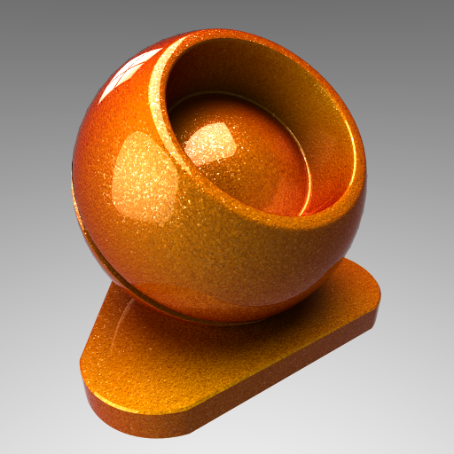
Materials Are Expensive
Composed of
multiple BSDF
layers
Non-trivial BSDFs
Procedural
noise everywhere
Huge textures*
* Not addressed in this work

Slide 9
Example: Car Paint
Four layers
  Fresnel coat
  Glossy flakes 1 & 2
  Diffuse base
Coat is a simple dielectric
BSDF with Fresnel weight
Flakes are Blinn-Phong
BSDFs with procedural
colors and normals
Base is a diffuse BSDF
with angle-dependent color

Slide 10
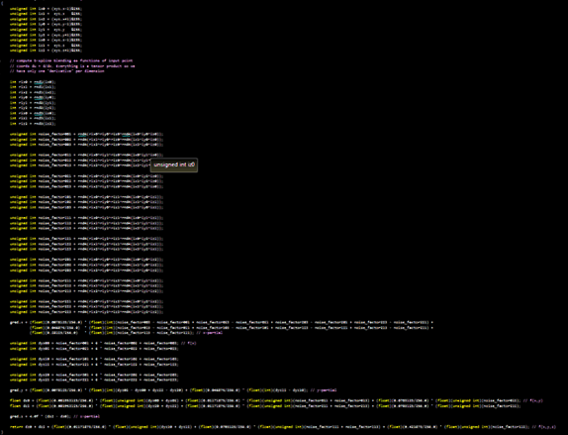
Example: Noise Evaluator

Slide 11
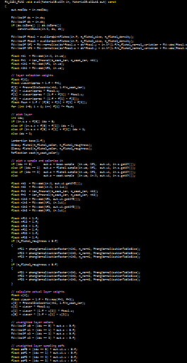
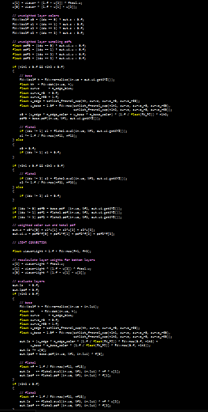
Example: The Entire Car Paint

Slide 12
And This Isn’t Even a Difficult Case
Only four layers
No textures
  No procedural texcoords
  No filtering
  No out-of-core
No iterative stuff
Still ~2x as expensive to evaluate as a ray cast
  In this scene, probably closer to 10x

Slide 13
Problem: How to Evaluate Materials Efficiently?
Worst case: Every thread hits a different, expensive material
Megakernel runs each sequentially with abysmal SIMD utilization
We really need to do better than that
  Otherwise the materials will dominate

Slide 14
Let’s Solve Everything

Slide 15
It’s Business Time
The recipe to reorganize path tracing to be more GPU-friendly:
1. Remove the loop around path tracer
  Avoid consequences of variable path length
  Also enables the two other optimizations
2. Place requests for operations into queues
  Ray casts, material evaluations, etc.
  Avoids threads idling when executing conditional code
3. Execute operations in separate kernels
  Minimize register pressure and instruction cache usage
    Avoid losing latency hiding capacity unnecessarily

Slide 16
Step 1: Remove the Loop
Keep a pool of paths alive all the time
  E.g., one million paths
At each iteration, advance each of them by one segment
  Cast rays, evaluate materials and lights, accumulate radiance, update throughput, run the roulette, etc.
If path terminates, generate a new one in its place
  Ensure there’s always paths to work on
Similar to previous work
[e.g. Wald 2011, Van Antwerpen 2011, etc.]

Slide 17
Pros and Cons
+ Variable path length is not an issue anymore
    As previously noted
+ Allows further optimizations
    Collecting requests in operation-specific queues and scheduling them individually
    This is the big one! Really hard to do in the megakernel approach
– Path state must reside in memory
    A simple loop-based method can keep it in registers
    Not as bad as it sounds if we use a good memory layout (SOA)
– Less “natural” to implement
    But only until you get used to it
– Doesn’t buy you much performance alone

Slide 18
Step 2: Per-Operation Queues
Allocate a queue for each primitive operation request
  Extension ray casts
  Shadow ray casts
  New path generation
  Material evaluations
    With separate queues for individual materials
Place requests compactly (i.e., no gaps) into queues
When executing, use one thread per request
  Every thread will have an item to work on
  Every thread will be doing the same thing, so there’s very little execution divergence!

Slide 19
Step 3: Individual Kernels for Each Operation
We already have well-optimized kernels for ray casts from previous research
  Now we can use them directly
  Optimized for low register count and high perf
Let each material have its own kernel
  Some are simple and need few registers
    Combining these into one kernel is sometimes a good idea
  Some are complex and need many registers
Smaller code → Won’t overrun instruction caches

Slide 20
Implementation

Slide 21
Schematic
Logic
Always operates on
all paths in pool
New Path
Material 1
Material 2
Each kernel has its
own queue
Ext Ray Cast
Shadow Ray Cast
Each type of ray has
its own queue

Slide 22
The Logic Kernel
Logic
Does not need a queue, operates on all paths
Does “everything except rays and materials”
  If shadow ray was unblocked, add light contribution
  Find material and/or light source that ext ray hits
  Apply Russian roulette if limit depth exceeded
  If path terminated, accumulate to image
  Apply depth-dependent extinction for translucent materials
  Generate light sample by sampling light sources
  Place path in proper queue according to material at hit
    Or in “new path” queue if path terminated

Slide 23
New Path Kernel
New Path
Generate a new image-space sample
  Based on a global path index
Generate camera ray
  Place it into extension ray queue
Initialize path state
  Init radiance, throughput, pixel position, etc.
  intialize low-discrepancy sequence for the path, used when generating random numbers in samplers

Slide 24
Material Kernels
Material n
Generate incoming direction
Evaluate light contribution based on light sample generated in the logic kernel
  Even though we haven’t cast the shadow ray yet
Get the probability of acquiring the light sample from the sampling of incoming direction
  Needed for MIS weights
By evaluating all of these in one go, we can discard the BSDF stack immediately afterwards
Generate extension ray and potential shadow ray
  Place in respective queues

Slide 25
Ray Cast Kernels
Ext Ray Cast
Shadow Ray Cast
Extension rays
  Find first intersection against scene geometry
  Utilize optimized kernels from previous research
  Store hit data into path state
Shadow rays
  We only need to know if the shadow ray is blocked or not
  Cheaper than finding the first intersection

Slide 26
Results

Slide 27

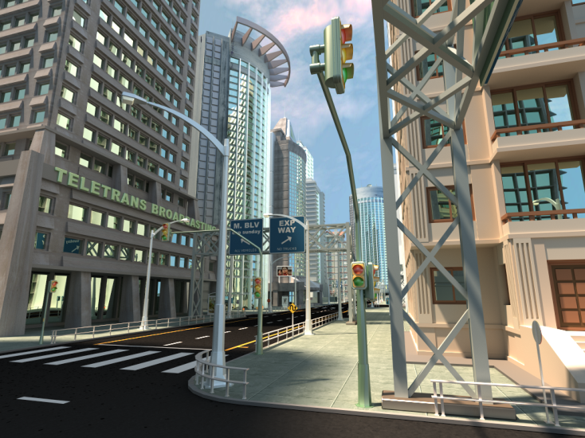
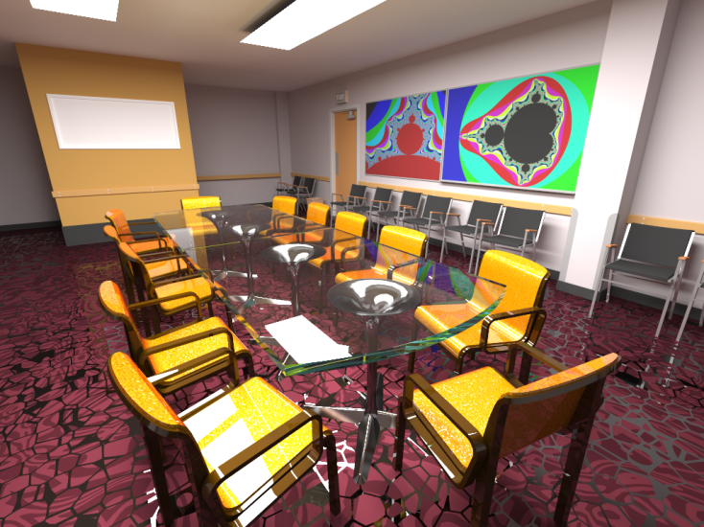
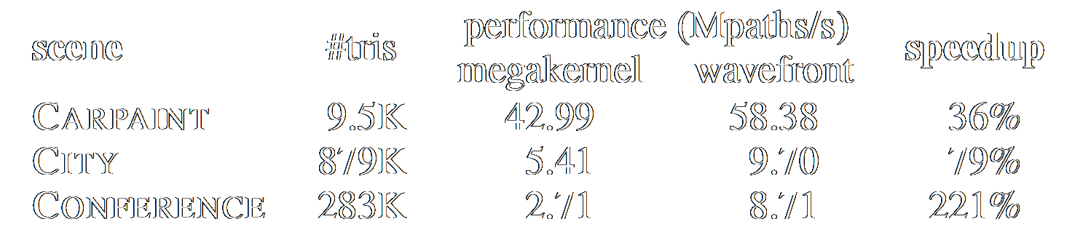
Test Scenes and Performance
Carpaint
City
Conference
Note: Megakernel has path regeneration

Slide 28
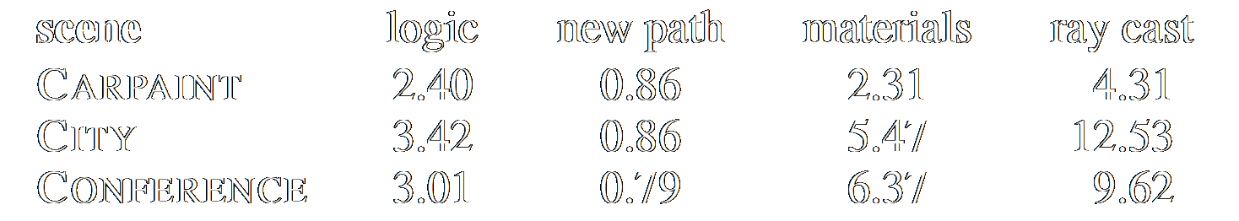
Execution Time Breakdown
(times in milliseconds / 1M path segments)
The most important takeaway: Ray casts are not the only expensive part!
  Optimizations yield diminishing returns already

Slide 29
Conclusions
Path tracing can be reorganized to suit GPUs better
  Bonus: Also works in practice
Going to the future, there is no limit on the number and complexity of materials
  Divergence will only get worse
  Megakernels will only get bigger
  → The proposed approach becomes even more appealing
Time to look beyond accelerating ray casts?

Slide 30
Future Work
Look at other rendering algorithms
  Bidir path tracing, MLT, etc.
  There is already good work in this direction
  [Van Antwerpen, Davidovič et al.]
  Should add complex materials in the mix!
What to do about gigantic textures?
  Run materials that have their textures resident while transferring missing textures on the GPU simultaneously?
  Put paths “on hold” while their textures are being loaded, and let other paths continue?
  Always run everything you can, try to make everything else runnable at the same time by async transfers?

Slide 31
Thanks!
Questions

