Slide 1

Clipless Dual-Space Bounds for Faster Stochastic Rasterization
Samuli Laine Timo Aila Tero Karras Jaakko Lehtinen
NVIDIA Research

Slide 2
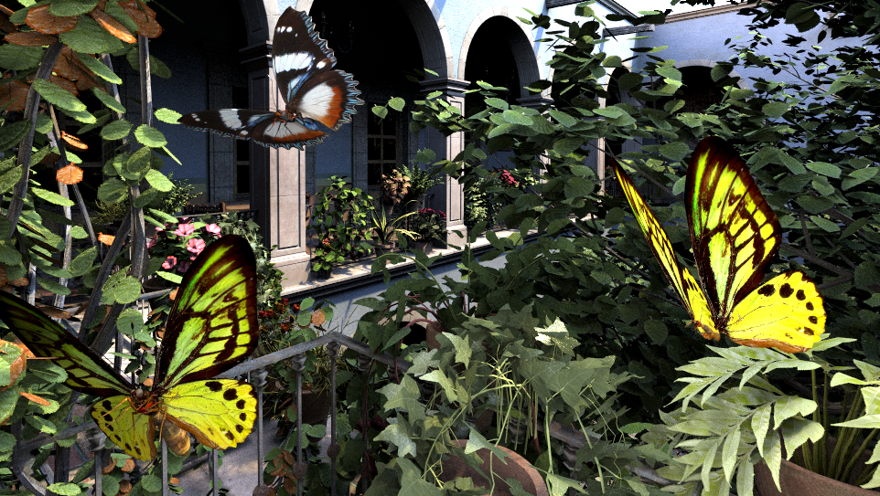
Notes:
This is an image produced by a pinhole camera model, meaning that the lens of the virtual camera is a point.
In addition, the shutter speed is infinitely fast, meaning that there’s no motion during the exposure.

Slide 3
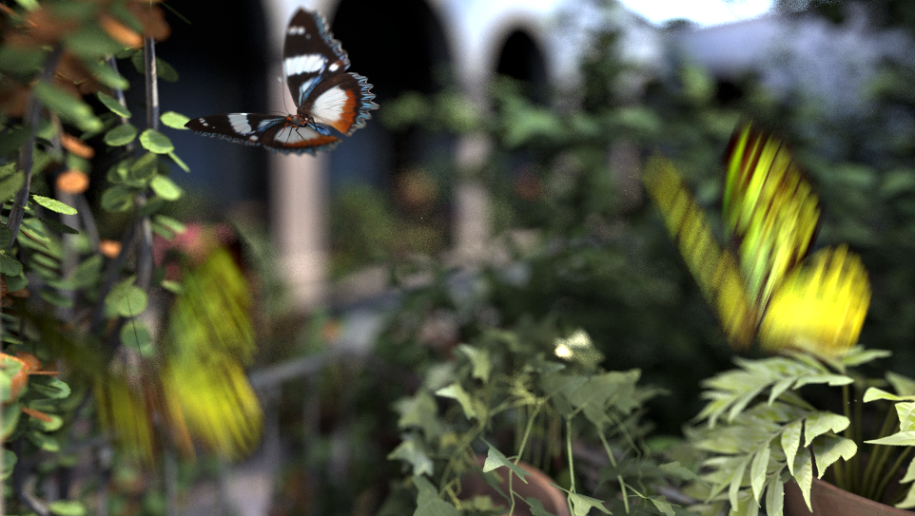
Notes:
Now here’s that same scene rendered with a more realistic camera model.
The camera lens now has a definite area, which causes defocus blur to objects outside the focal plane.
Also, the yellow butterflies are moving during the exposure, causing motion blur.
Stochastic rasterization extends traditional rasterization so that we can produce images with these effects.

Slide 4
Notes:
So let’s see how this extension works by first looking at traditional rasterization.

Slide 5
(x,y)
Notes:
Here, we have highlighted a pixel in the pinhole image and zoomed in a bit. As usual, we take multiple samples per pixel for antialiasing. Each sample has its own x and y coordinates within the pixel and therefore the samples can end up having different colors.
When the pixel is resolved by averaging the sample colors, the result is an antialiased pinhole image. More sophisticated resolving methods are also possible.

Slide 6
(x,y,u,v,t)
Notes:
In stochastic rasterization, each sample has three more coordinates, u, v, and t.
The u and v coordinates specify a location on camera lens, and the t coordinate specifies the time during exposure.
For different uv positions, the samples effectively see the scene from a slightly different angle, and similarly for different t values, the samples see the scene at slightly different times. These are the causes for defocus and motion blur.
As in traditional rasterization, resolving the pixels gives the final image.
The question now is how to obtain the sample colors, and there’s many approaches for doing that. So let’s take a look at some of those. For simplicity I will discuss only motion blur, but everything here applies to defocus blur as well.

Slide 7
Motion Blur
Notes:
Let’s work on this very simple (*) scene, where a triangle moves from left to right during the exposure time.

Slide 8
Motion Blur
t=0
t=1
Notes:
The input is the position of the triangle at the start of frame, or t equals zero, and at the end of frame, t equals one.
Again, to simplify things, the triangle doesn’t rotate or change its shape during the frame, or even move in perspective, but all of those can of course happen in a real setting.
We make the assumption that the motion of vertices is affine in world space. This is the most common way of describing motion.

Slide 9
Motion Blur
Notes:
Here’s what kind of result we would expect from this input.

Slide 10
Accumulation Buffer [Haeberli ‘90]
t
Notes:
The only hardware-supported technique that can be used for rendering motion blur is the accumulation buffer that allows merging multiple images together efficiently. It was introduced by Haeberli and Akeley in 1990.
To use accumulation buffer, we must pick a few dicrete time instants, and use those for all pixels in the image. In this example I’m using four samples per pixel, and therefore have only four individual values for t.
(* .. * .. * .. *) Now we can render the image at these four instants of time, and obtain this image. It’s not that close to what we wanted.
And this is why accumulation buffer is practically useless for rendering defocus or motion blur. You need way too many samples to produce a smooth result.

Slide 11
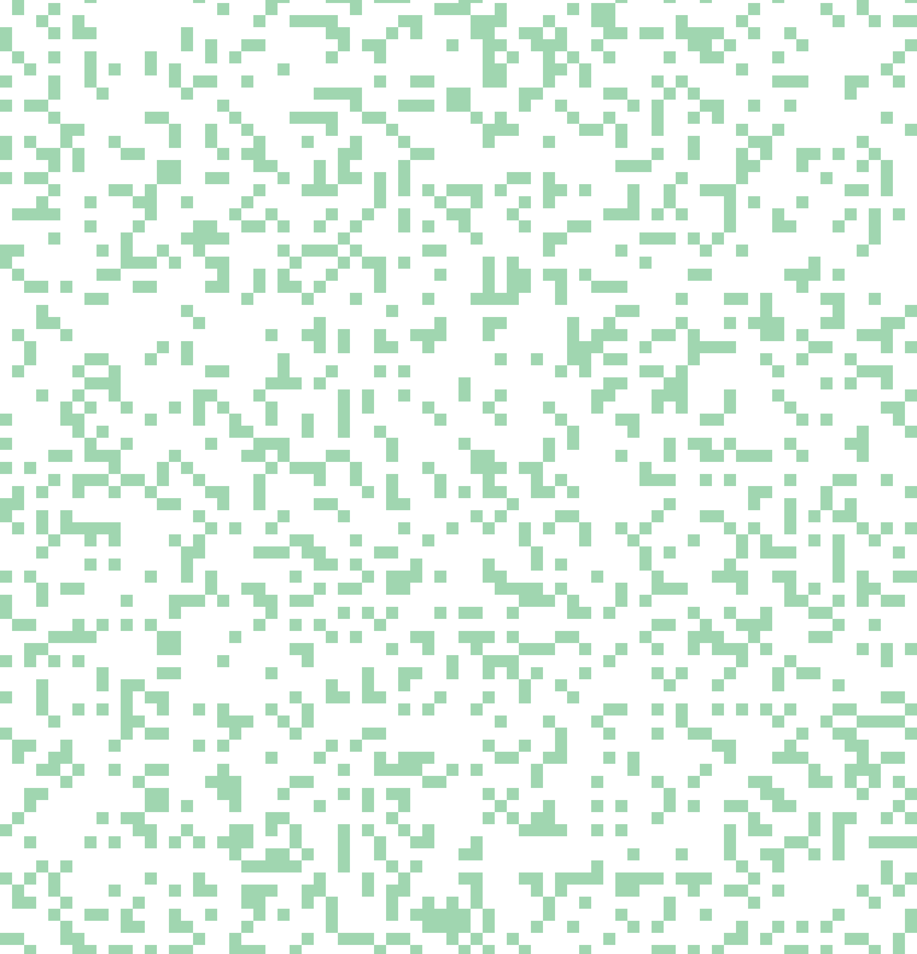
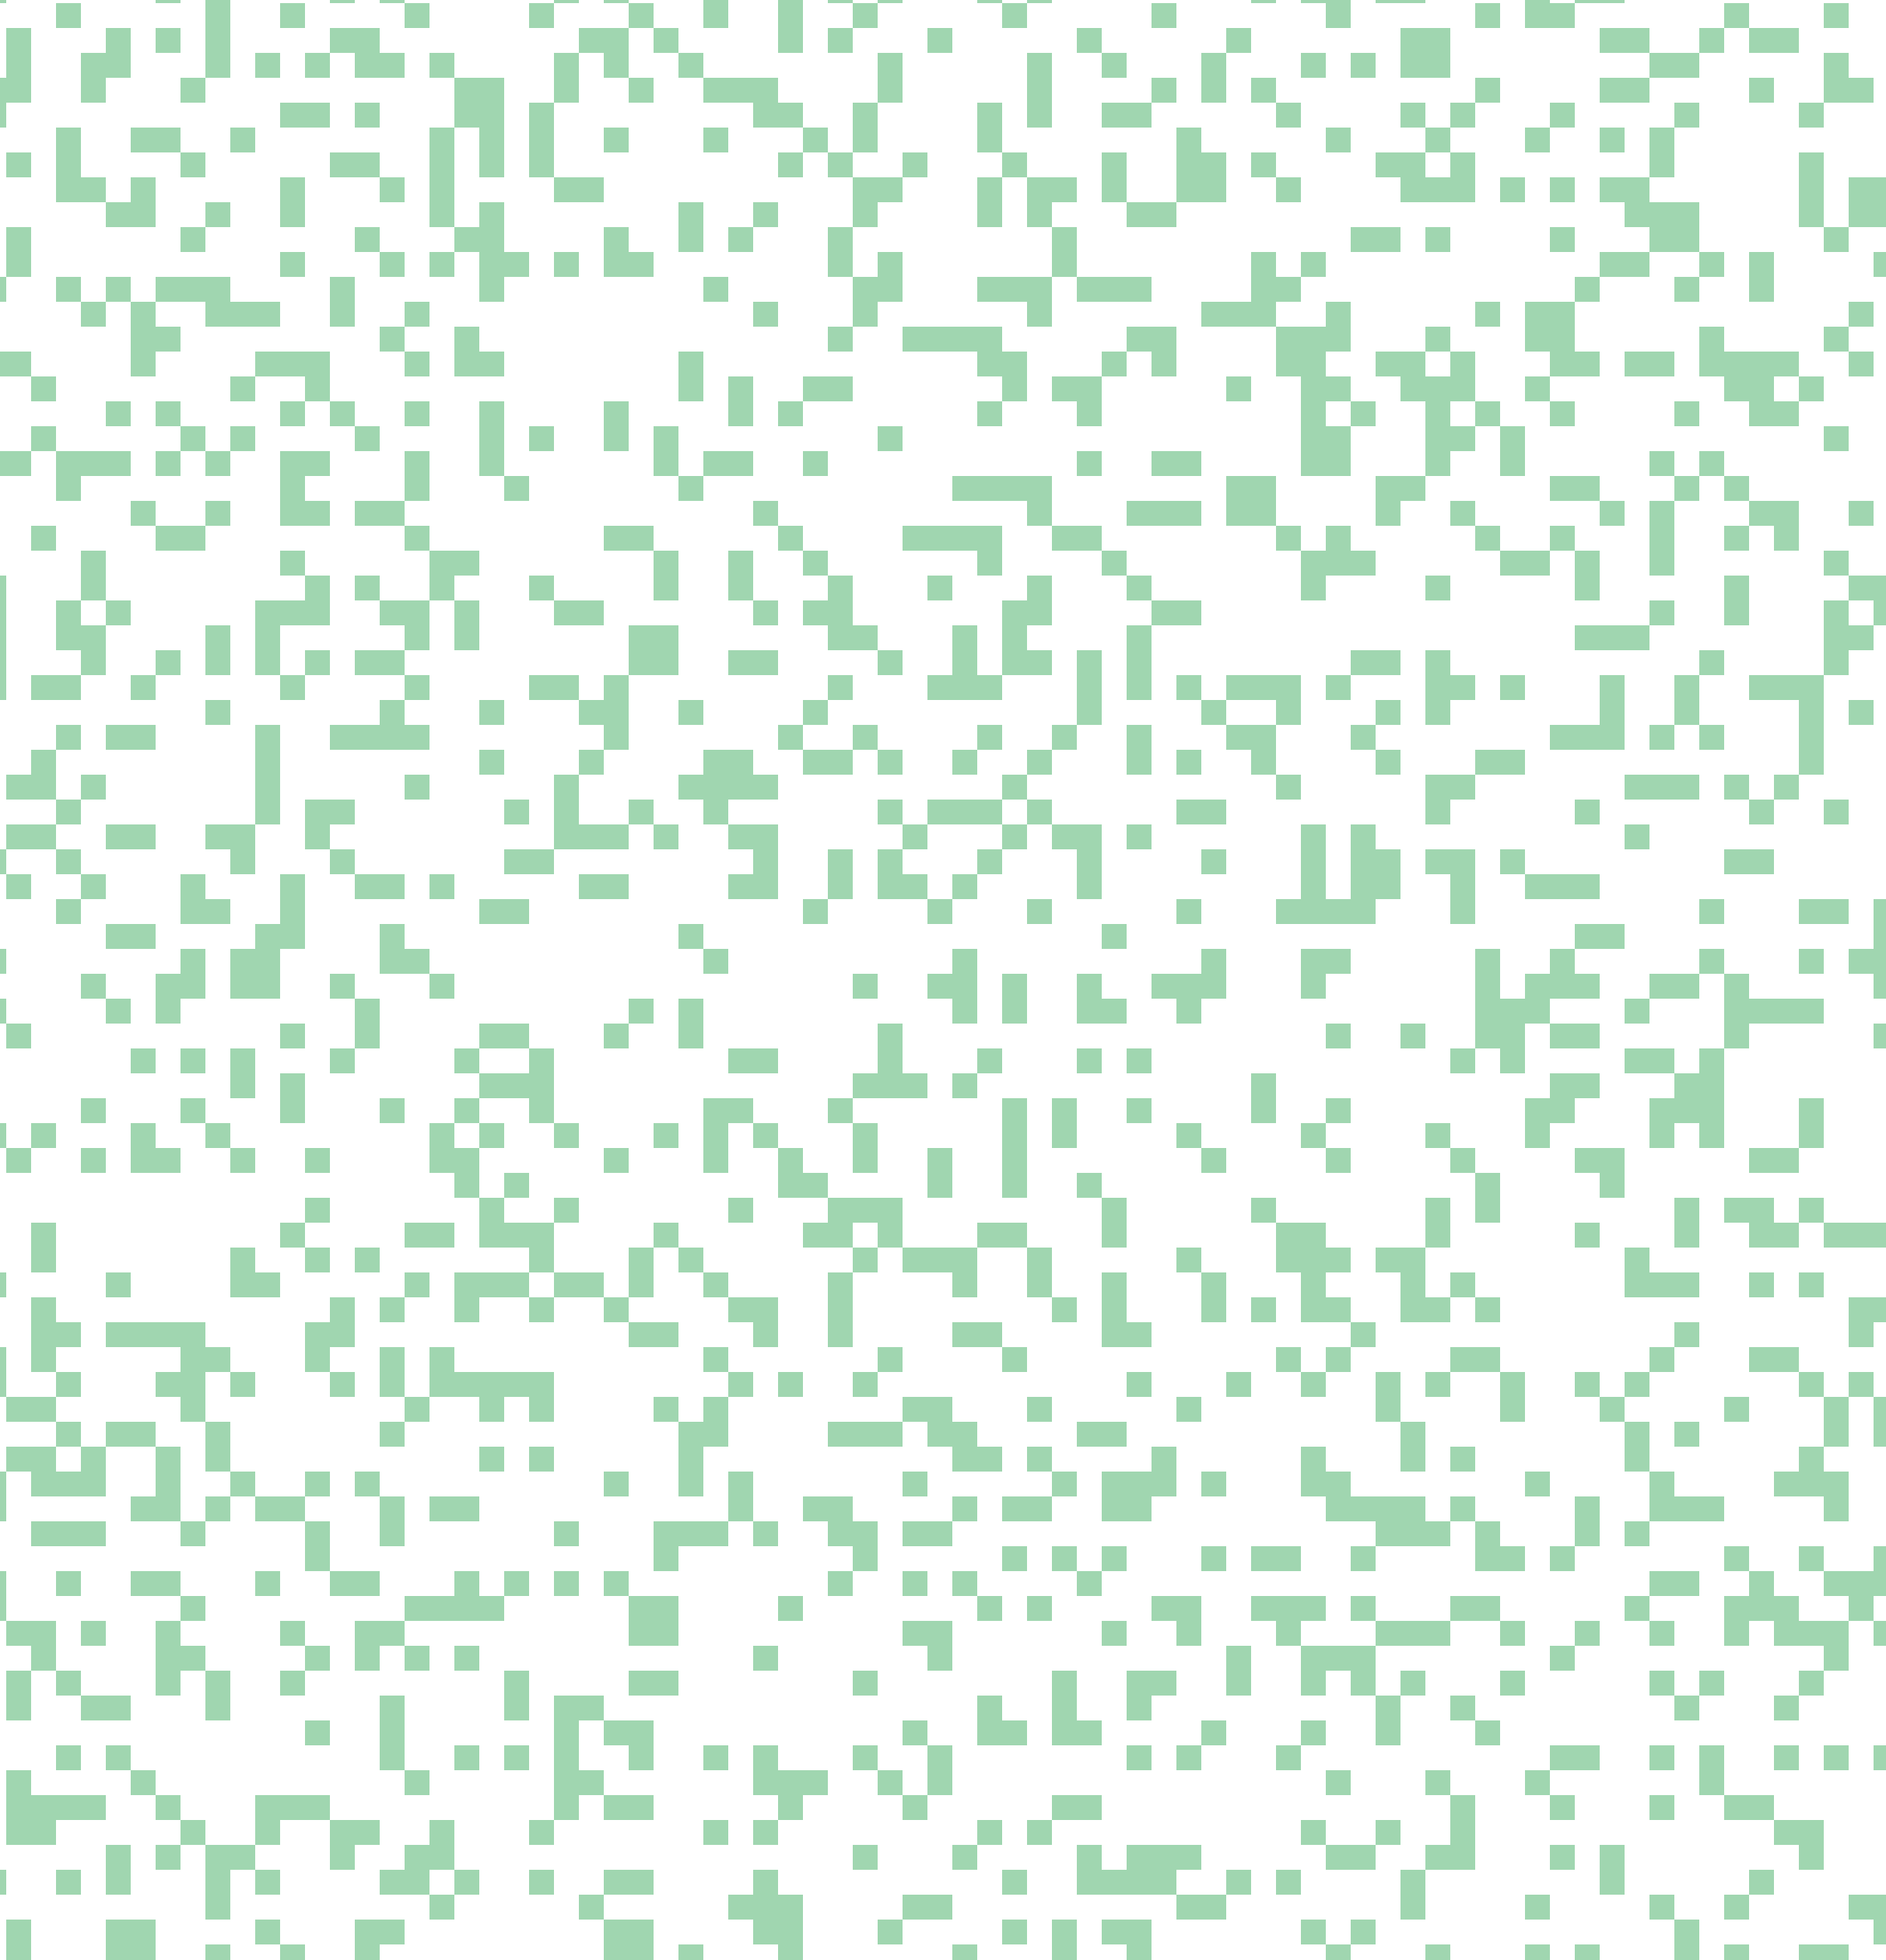
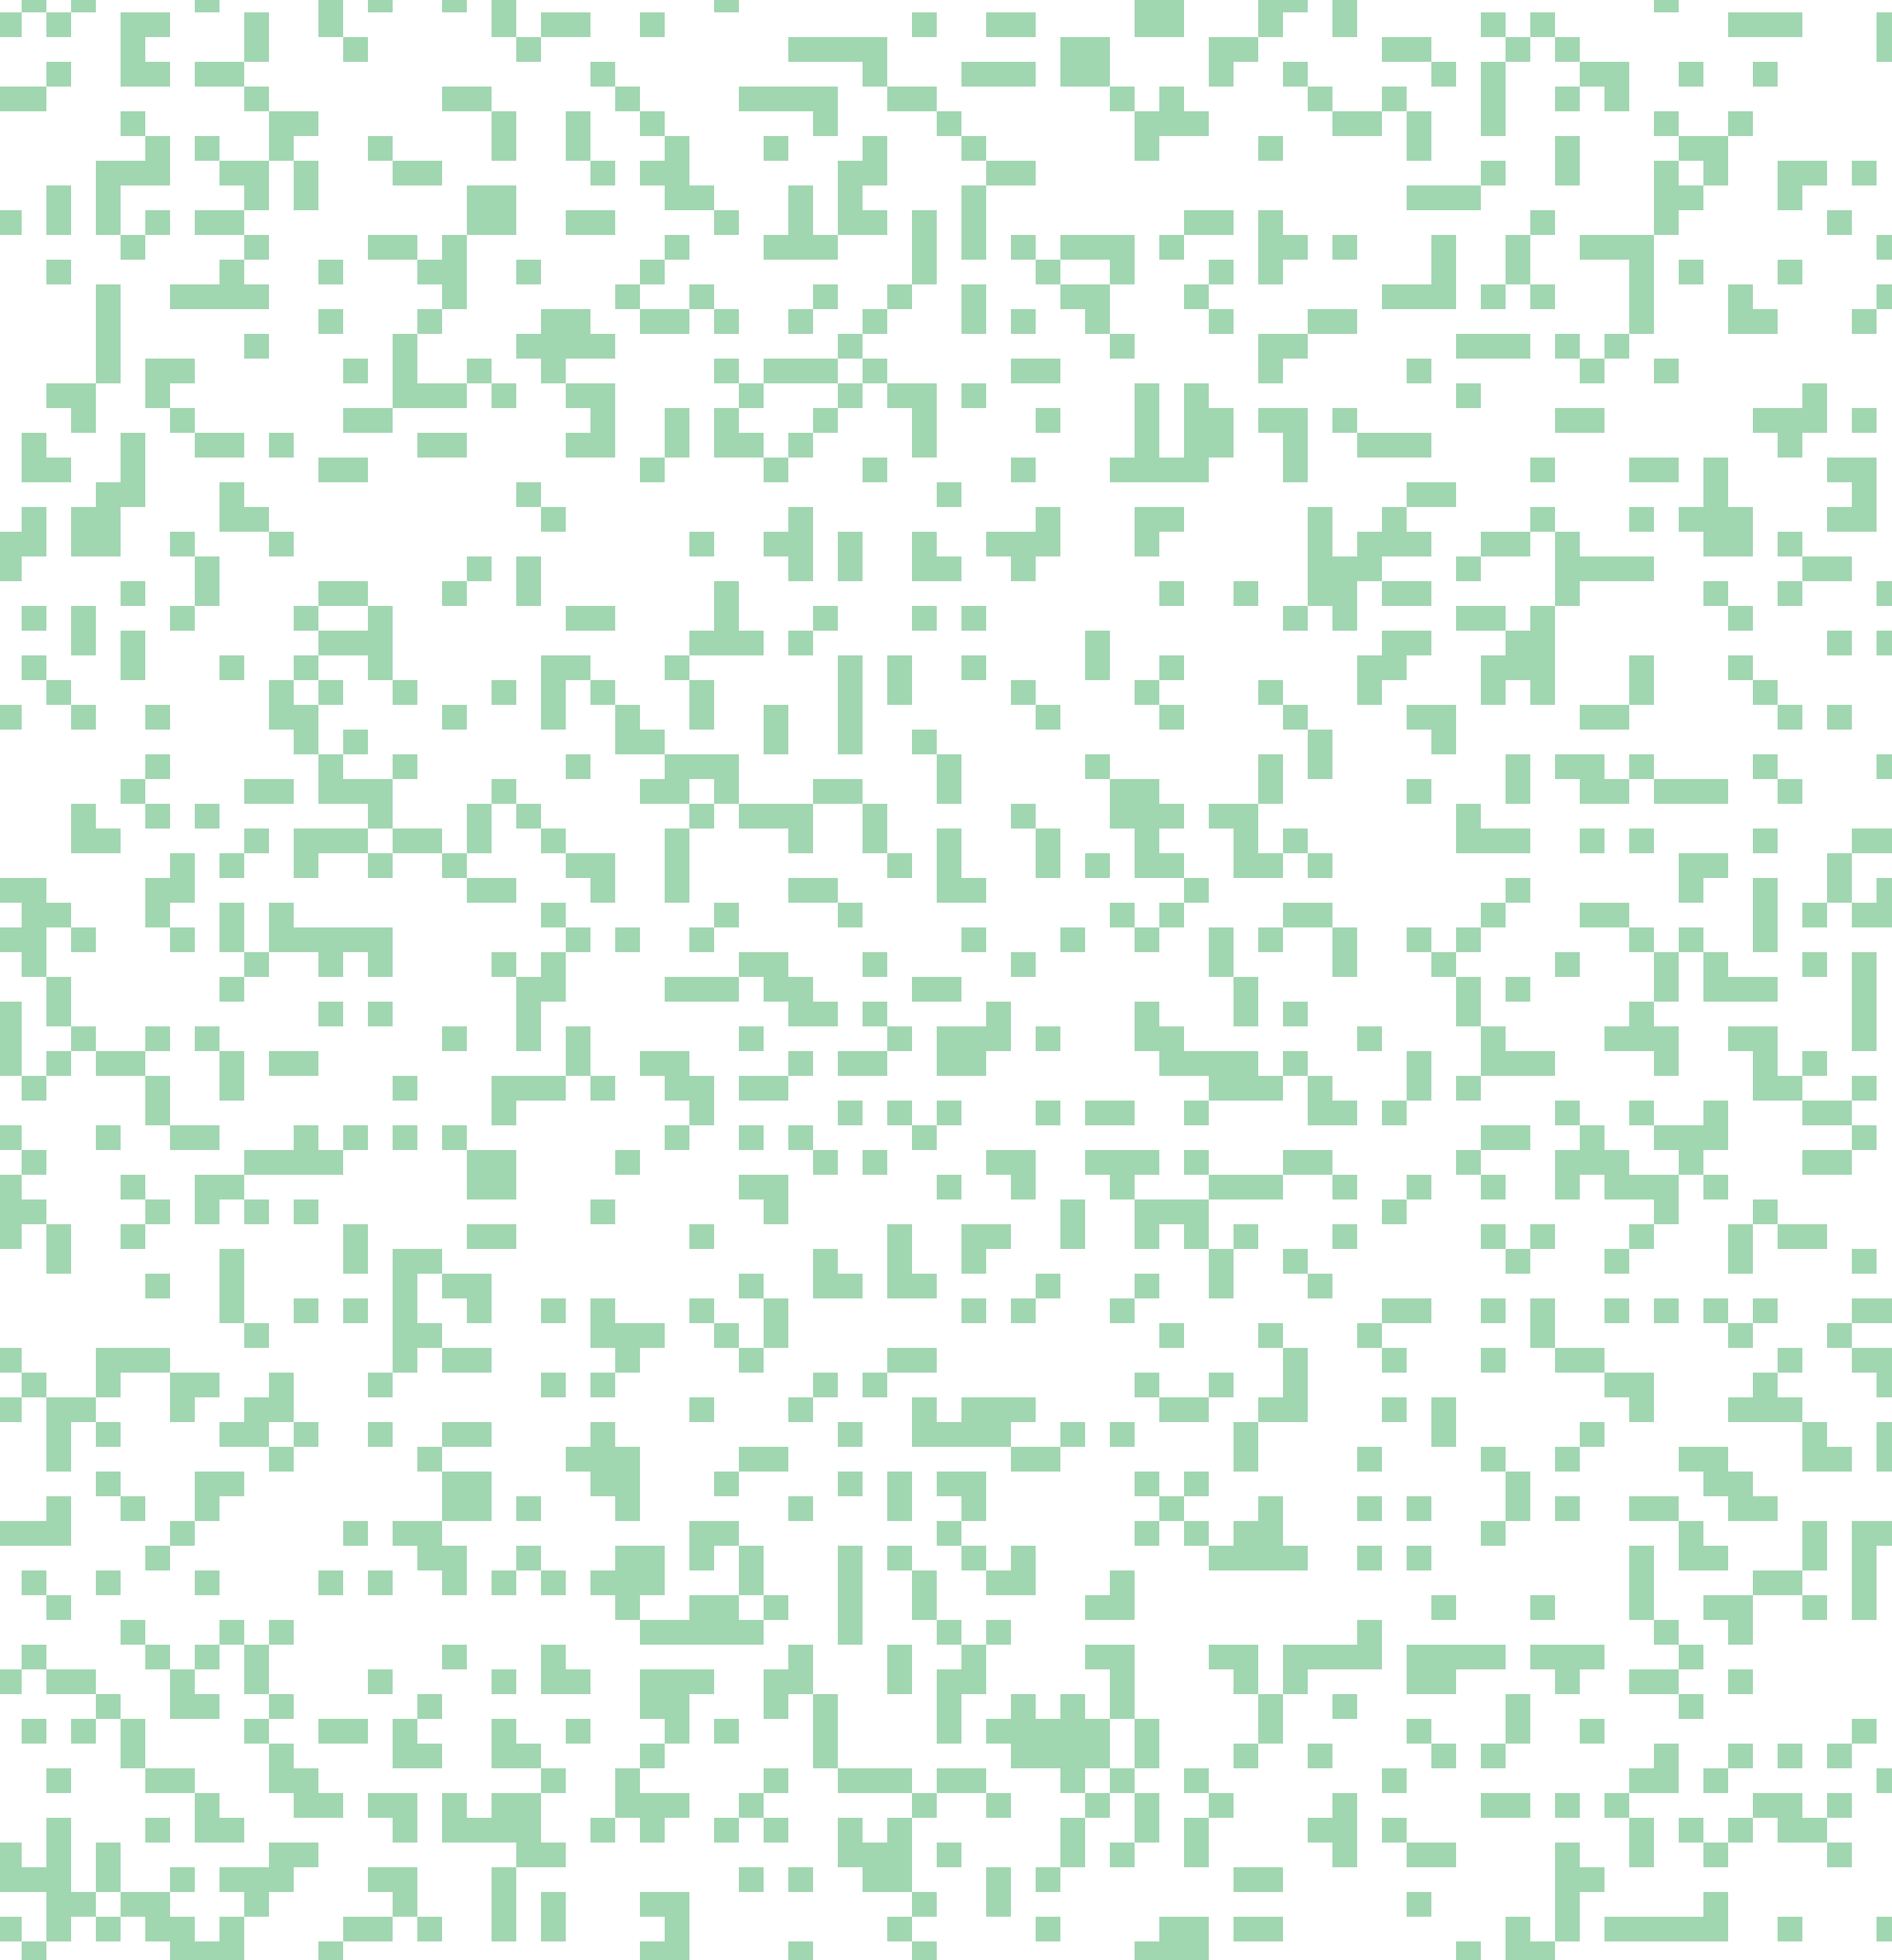
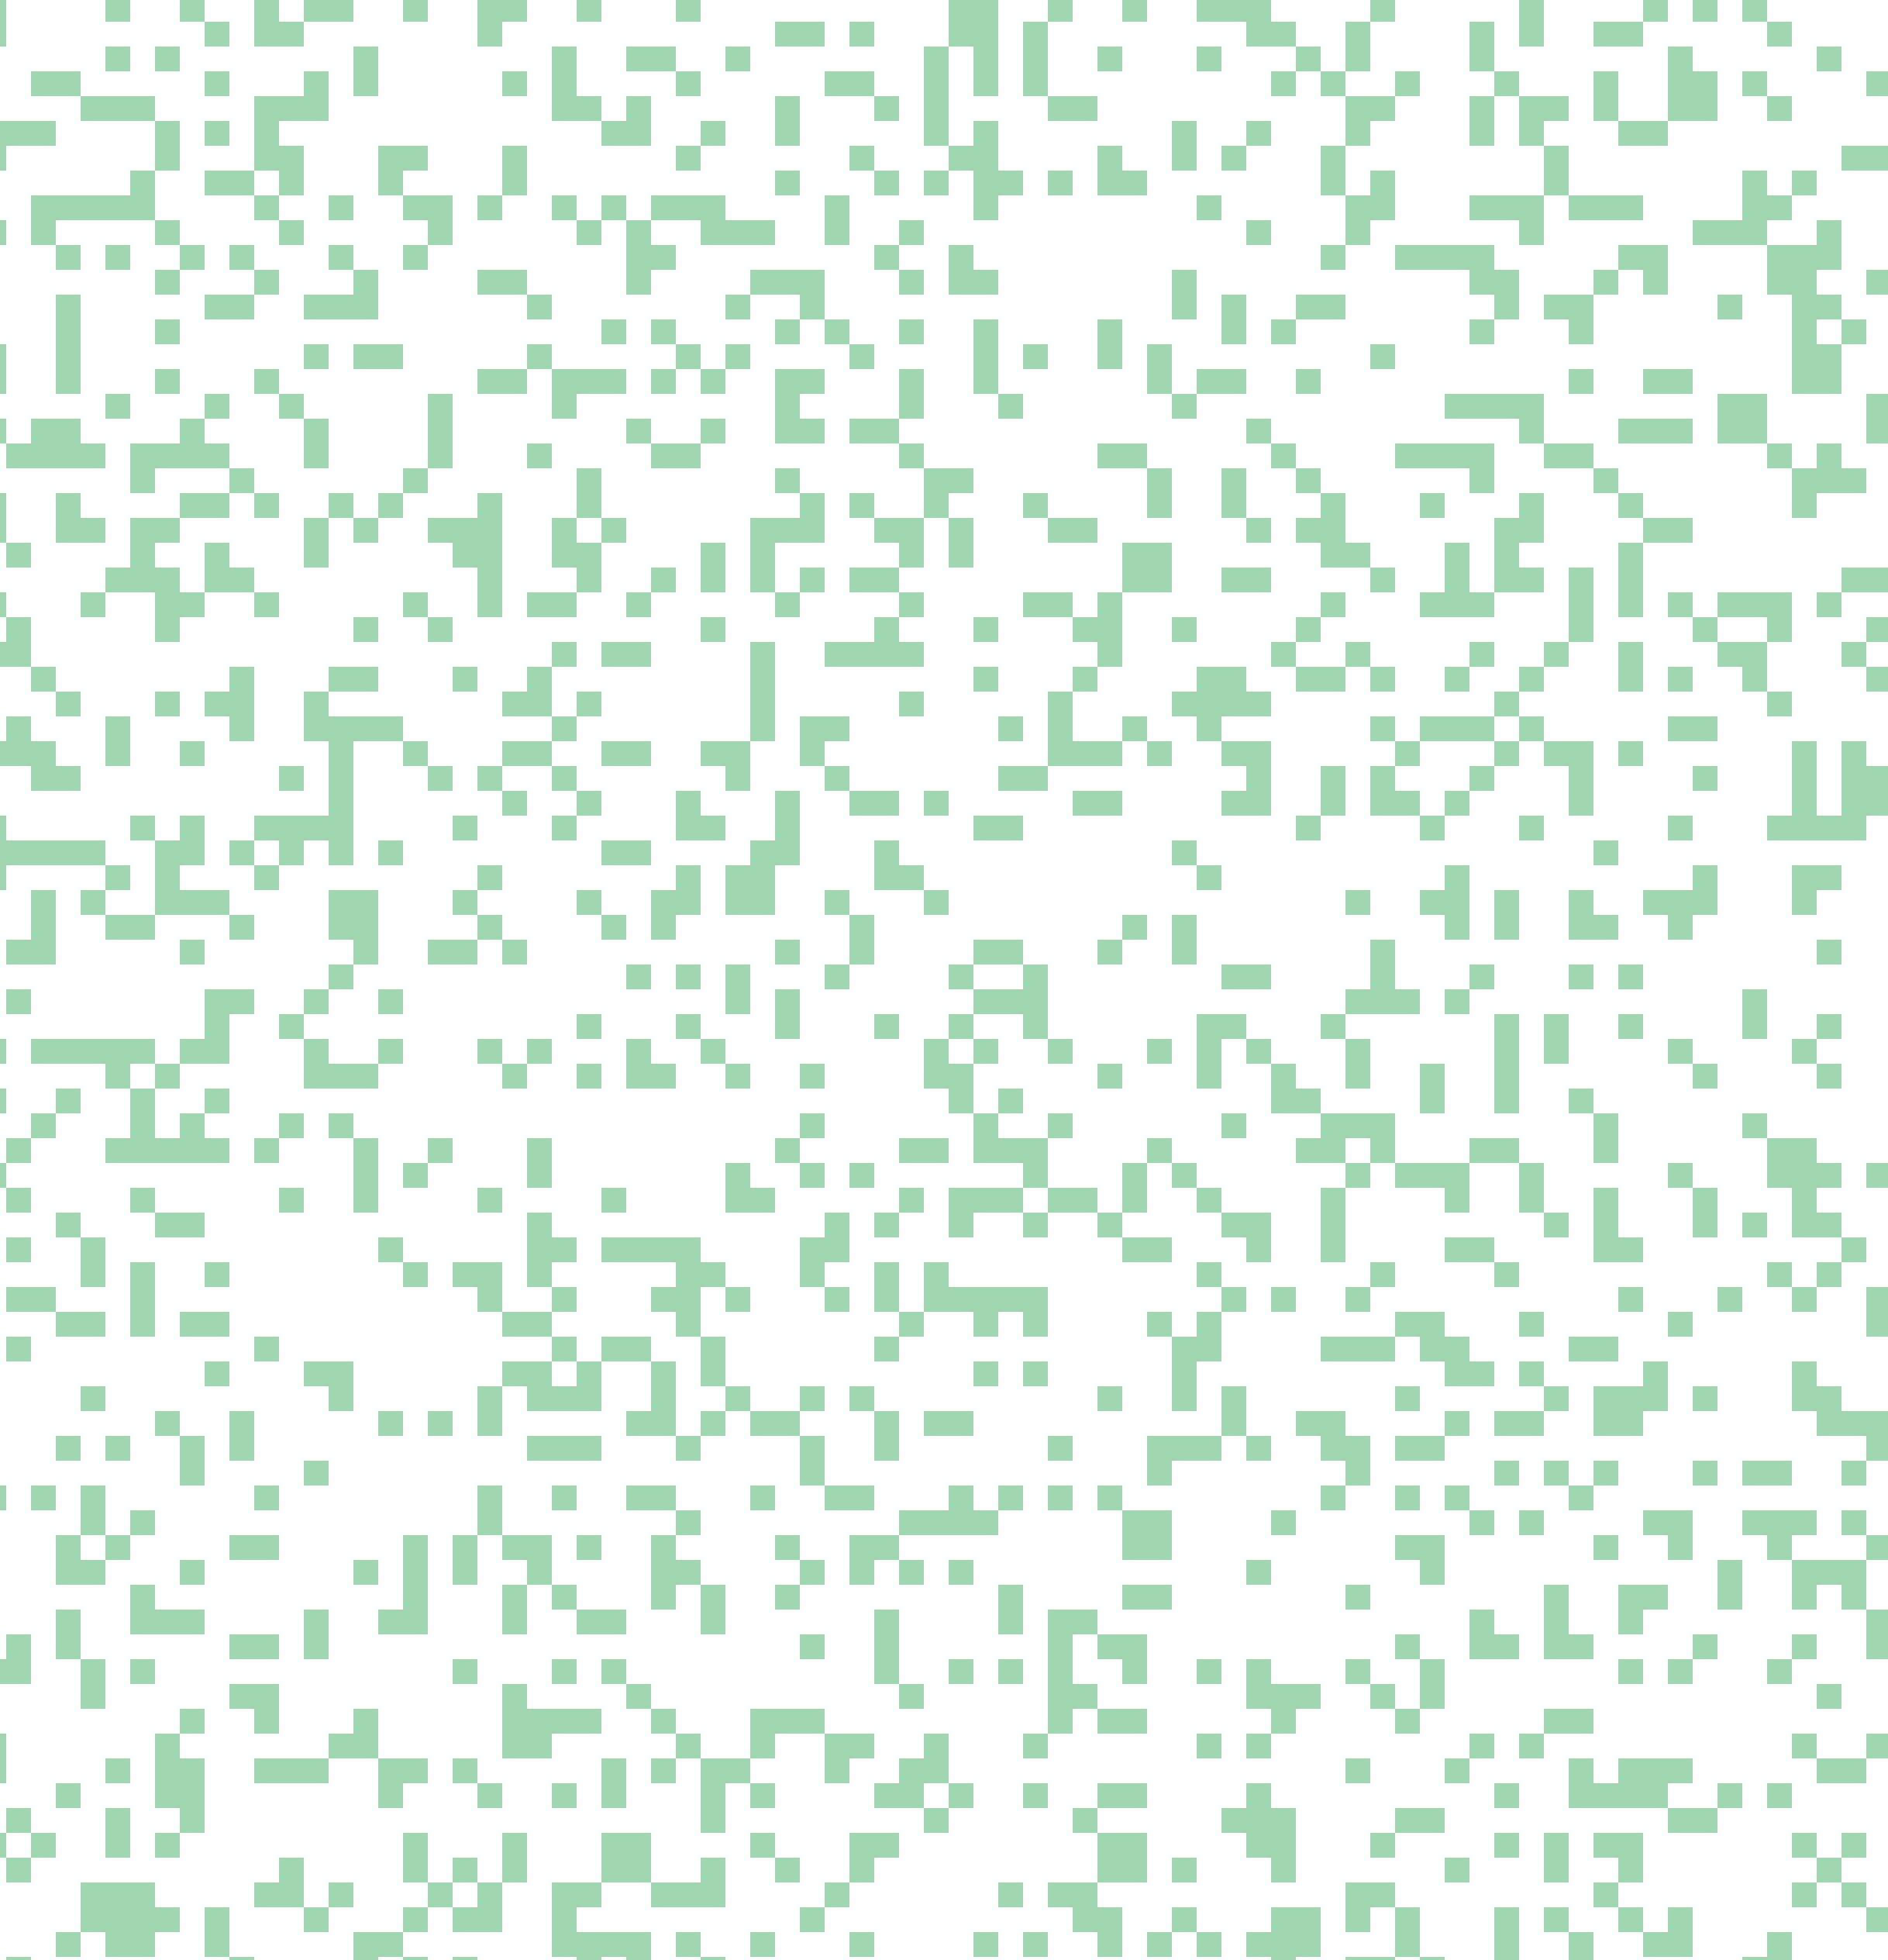
InterleaveUVT [Fatahalian ‘09]
t
Notes:
Recently, Fatahalian and others presented the InterleaveUVT algorithm, which can be seen as an extension to accumulation buffer.
In this example, we want to spend only as much effort as in the previous case, but would like to use more than four discrete t values.
The idea is to pick, let’s say 16 values for t, but only use four of those for any individual pixel.
(* .. * .. * .. * .. *) The triangle is now rasterized sixteen times, each time with a different t. To keep rendering cost and memory consumption low, we on each round touch only every fourth pixel.
(*) As a result, we get more individual t values at the expense of introducing noise.

Slide 12
InterleaveUVT [Fatahalian ‘09]
t
Notes:
Here it’s illustrated how a given pixel has only four of the sixteen possible t values.

Slide 13
InterleaveUVT [Fatahalian ‘09]
t
Notes:
The next pixel has a different subset,

Slide 14
InterleaveUVT [Fatahalian ‘09]
t
Notes:
And yet a different subset for the next pixel.

Slide 15
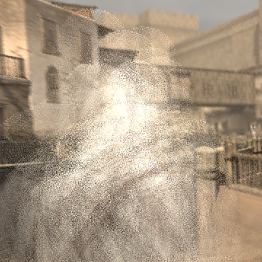
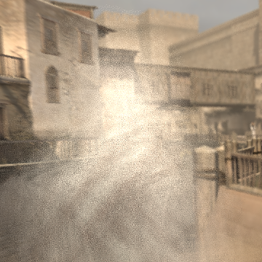
InterleaveUVT [Fatahalian ‘09]
Scene: Assassin’s Creed, courtesy of Ubisoft
4 samples/pixel (16 UVT triples)
16 samples/pixel (64 UVT triples)
Notes:
So InterleaveUVT is a big improvement over accumulation buffer, but the quality is still lacking somewhat. The main reason is that only a discrete set of individual t values can be used, which causes banding. With more dimensions, adding u and v, the problem is even worse.
Here are renderings from a game scene where we have added motion and defocus. On left we use four samples per pixel, meaning that we have 16 individual UVT triples. There’s severe banding artifacts in this image.
On the right we’re using 16 samples per pixel and 64 UVT triples, which is already quite a lot, but there’s still significant banding visible.
To get rid of this artifact we need to let each and every sample in the image to have its own UVT coordinates so that they are not picked from any discrete set.

Slide 16
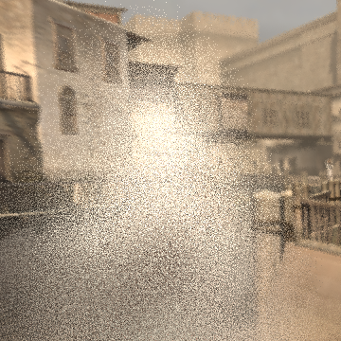

Unique UVTs
Scene: Assassin’s Creed, courtesy of Ubisoft
4 samples/pixel, unique UVTs
16 samples/pixel, unique UVTs
Notes:
Here’s the result if each sample can have its own UVT coordinates generated using a quasi Monte Carlo sequence. As you can see, there is no more banding visible.

Slide 17
5D Rasterization
t
t=0
t=1
Notes:
To enable these individual UVT coordinates we need to abandon accumulation buffer and its relatives, and do per-pixel 5D rasterization.
The concept is simple. From the input geometry, we first generate some sort of bounding shape (*), in this example just a rectangle.

Slide 18
5D Rasterization
t
t=0
t=1
Notes:
Then we loop over all pixels in this bounding shape, and for each sample in every pixel we either look up or generate the u, v, and t coordinate—I’m again only looking at t here.
We then use these to do a 5D coverage test for each sample.
The 5D coverage test essentially moves the triangle to the time t, adjusts it according to lens position uv, and then tests for overlap in x and y.

Slide 19
5D Rasterization
t
t=0
t=1
Notes:
Now each sample can have any u, v, and t coordinates it likes.

Slide 20
5D Rasterization
t
Notes:
In the limit, we sample the entire t range illustrated by the solid yellow box instead of individual ticks.
Thanks to this, the image contains no structured artifacts such as banding, but only noise due to the limited number of samples per pixel.
The only downside is that the 5D coverage test is very expensive, and there’s a lot of pixels to process.

Slide 21
5D Rasterization
t
?
t=0
t=1
Notes:
As a first remedy, it’s possible to use a smarter bounding shape than a rectangle. This avoids the processing of some unnecessary pixels.

Slide 22
5D Rasterization
t
t=0
t=1
Notes:
For example, McGuire and others suggested using screen-space convex hull, as in here, but as you can see the total area is not necessarily reduced much.
So if we cannot get rid of the pixels, maybe we can get rid of some samples within those pixels.

Slide 23
5D Rasterization
?
t
t=0
t=1
Notes:
Indeed, if we look at a pixel near the t zero triangle, it doesn’t seem possible that the samples with high t values could be covered, because when t is large the triangle is far away to the right.

Slide 24
5D Rasterization
?
t
t=0
t=1
Notes:
Also near the t one triangle, samples with low t values cannot be covered.

Slide 25
Pixar Algorithm
t
t=0
t=.5
t=1
Notes:
Pixar exploited this observation in their PRMan implementation, where the time range is subdivided into multiple parts.
Here’s an example where the time is split into two halves (*) that are processed separately.

Slide 26
Pixar Algorithm
t
X
X
t=0
t=.5
t=1
Notes:
We go through the bounding shape for the first half, and only process samples (*) where t is less than zero point five.

Slide 27
Pixar Algorithm
t
X
X
t=0
t=.5
t=1
Notes:
Of course, the other half needs to be processed as well, so there’s actually more pixels that we have covered in total.
However, in each half we’ve had fewer samples to process, and this is where the savings come from.
Further subdivision is possible, but in practice it’s limited by the number of samples we have. Therefore with small sample counts there is less opportunity for savings.

Slide 28
Our Method
t
t=0
t=1
Notes:
Okay, now let’s turn to our method.

Slide 29
Our Method
t
t=0
t=1
Notes:
We saw that not all samples in the pixel can be covered by the triangle because of motion.

Slide 30
Our Method
t
X
X
X
t range computed for pixel
t=0
t=1
Notes:
Our main idea is to reduce per-pixel work by determining an approximate t range using geometric calculations. This allows us to process only the samples that fall within this range.
In concurrent work, Akenine-Möller and others, and Munkberg and others have looked at motion blur and defocus blur in isolation, and come up with the same core idea. However, their methods for calculating the bounds are very different from ours.

Slide 31
Our Method
Determine pixels potentially covered by triangle
For each pixel
  Compute time bounds t_{min} ,t_{max}
  Enumerate samples where t_{min} ≤ t ≤ t_{max}
  For each such sample, perform 5D coverage test
Same for lens bounds u_{min} ,u_{max} and v_{min} ,v_{max}
Notes:
So here’s how we render a triangle in a nutshell. We first need some kind of bounding shape that contains all the pixels we need to touch.
Then, for each pixel, we compute time bounds and lens bounds. Only the samples with t, u, and v in these ranges are tested using the actual 5D coverage test, and the rest can be trivially rejected.
All of this can be done for tiles that are bigger than one pixel, but for simplicity I will be talking of pixels.

Slide 32
Bound Computation
Lens bounds computed in screen space
Time bounds computed in dual space
Notes:
Let’s now look at how we actually compute these bounds.
It turns out that lens bounds and time bounds are quite different because of the geometric setup.
For lens bounds we can operate in screen space coordinates, which makes everything simple.
But this doesn’t work for time bounds, because screen-space motion is not affine, and therefore we need another solution for that.

Slide 33
Lens Bounds
y
u= –1
u=0
u= +1
focal plane
x
u
lens
screen-space x is
linear with u
film
Notes:
Let’s first look at lens bounds. (*) The points on focal plane project to a point on the image plane. (*) For other distances the light going through different parts of the lens ends up at different points on the image plane.
Therefore, depending on lens position u and v, we see a different triangle, as illustrated here for the u coordinate.
Now it turns out that the apparent motion of vertices is affine with respect to u and v.

Slide 34
Lens Bounds
y
u= –1
u= +1
x
screen-space x is
linear with u
Notes:
This allows us to compute a bounding box for the extremes, and we can interpolate between these bounding boxes and the triangle will stay inside it.

Slide 35
Lens Bounds
y
a
b
u
u=a
u=b
x
screen-space x is
linear with u
Notes:
Therefore, if we pick a pixel, we can see for which u the bounding box starts to cover it, denoted a, and also where it leaves the pixel.
This gives us a range for u for this pixel, and we can throw away all samples whose u coordinate is outside this range.
The bounds for v are computed in exactly the same fashion.

Slide 36
Time Bounds
World-space affine motion
  Not affine in screen space, but affine in clip space
  Perspective causes singularities in screen space
Operate in dual space
Notes:
Let’s now turn to time bounds. As mentioned, world-space affine motion is not affine in screen space because of perspective, but it is affine in clip space.
In particular, primitives that cross the camera plane during the shutter interval suffer from singularities. Despite our best efforts, we were unable to formulate a solution in screen space.
Our key insight is to perform the computation in linear dual space. This lets us reason about non-affine screen space motion using only linear constructs.

Slide 37
Clip Space and Dual Space
w
t=1
t=0
x
Notes:
So let’s start from clip space. We have a triangle at t zero and t one, and each vertex moves affinely.

Slide 38
Clip Space and Dual Space
w
δ
γ= +1
γ= –1
x
γ
Notes:
Let’s pick the triangle at t zero first.
The dual space is shown on the right (*). This is a slope-intercept duality mapping, so points in clip space map to lines in dual space, and vice versa.
In particular, the lines through the camera map to points on the horizontal axis of the dual space.
Gamma is the parameter that specifies the direction of a line in the clip space. When gamma is minus one (*), the line is aligned with the left side of the frustum, and maps to this (*) point in the dual space.
Gamma of plus one (*), corresponds to the right side of the frustum and maps to this (*) point. For camera rays, gamma is therefore just a scaled version of screen-space x coordinate.

Slide 39
Clip Space and Dual Space
w
δ
γ= –0.5
x
γ
{
δ
Notes:
Let’s pick a gamma of minus zero point five (*). Now when we project a vertex along a line with this direction (*) onto the x axis, we obtain an offset delta (*) from the origin. This is the other axis of the dual space.
Now we can plot this point (*) in the dual space, and similar projection (*) can be done for the other (*) vertices as well.

Slide 40
Clip Space and Dual Space
w
δ
x
γ
Notes:
If we take another value for gamma, we obtain a different delta, giving rise to a line (*) in dual space for each point in clip space.

Slide 41
Clip Space and Dual Space
w
δ
x
γ
Notes:
The red region between these lines in dual space contains all clip-space lines that intersect the triangle. Now remembering that view rays are on the horizontal axis (*) of the dual space, if we intersect the red region with the axis (*), this segment is equivalent to the cone of lines that bound the triangle (*) in clip space.

Slide 42
Clip Space and Dual Space
w
δ
x
γ
Notes:
This is equivalent to the screen-space bounding box for the triangle.

Slide 43
Clip Space and Dual Space
w
δ
t=1
t=0
t=1
t=0
x
γ
δ = x – wγ
δ is linear in x and w
x and w are linear in t
δ is linear in t
Notes:
Now this was all for the triangle at t zero. If we do the same thing for the triangle at t one (*) , we get another set of lines in dual space (*) shown as the upper red region.
(*) This is the equation of the dual space line, and as you can see, it is linear (*) in x and w.
Now based on affine world-space motion, x and w (*) are in turn linear in t,
and therefore delta (*) is also linear in t.
This is very important, because it means that the affine motion of a vertex in clip space maps to affine motion of the corresponding line in dual space.

Slide 44
Clip Space and Dual Space
w
δ
t=1
t=0
t=1
t=0
x
γ
Notes:
To simplify the situation, we fit bounding lines (*) for both t zero and t one regions.

Slide 45
Clip Space and Dual Space
w
δ
t=1
t=0
t=1
t=0
x
γ
Notes:
This increases the area of the regions, but not by much.
So now we can understand the motion of the triangle’s screen-space bounding box as an intersection of linearly moving lines and the horizontal axis of the dual space.
Let’s finally look at how to exploit this in practice.

Slide 46
Clip Space and Dual Space
w
δ
t=1
t=0
t=1
t=a
x
t=0
γ
t
Notes:
Let’s look at the lower bounds of the dual-space regions, shown in blue on the right. The x coordinate of a pixel specifies a line through the origin (*), and we look at the corresponding point (*) in dual space. We can now solve the t (*) where the lower bounding line crosses this point.
In this case, after t equals a, the dual-space region stops covering (*) the point.

Slide 47
Clip Space and Dual Space
w
δ
t=1
t=0
t=1
t=a
x
t=0
γ
a
t
Notes:
This means that a is an upper bound for t.
Similar calculation is done for the upper bounding line in dual space, but in this case it doesn’t affect the result.

Slide 48
Time Bounds
Compute separately for x and y
  Intersect resulting spans
  If intersection is empty, skip pixel
Notes:
The time bounds are computed separately for x and y, giving two t spans. These are intersected, because the triangle of course has to overlap the pixel on both axes at the same time. If the intersection is empty, the pixel can be skipped altogether.

Slide 49
Recap
For each triangle
  For each pixel
    Compute t, u, v bounds
    Cull samples outside bounds
Profit
Notes:
To recap, our method computes t, u, and v bounds for each pixel, and culls samples outside these bounds without running the expensive (*) 5D coverage test.

Slide 50
Results
Measure sample test efficiency (STE)
Compare against methods that allow arbitrary sampling patterns
# samples hit
STE =
# samples tested with full 5D test
Notes:
To evaluate our method, we focus on sample test efficiency, or STE. This is simply the percentage of successful 5D coverage tests. In a sense, failed coverage tests are redundant, so this is a good measure for the efficiency of different methods.
Here we compare only against methods that allow arbitrary sampling patterns. This excludes accumulation buffer and InterleaveUVT.

Slide 51
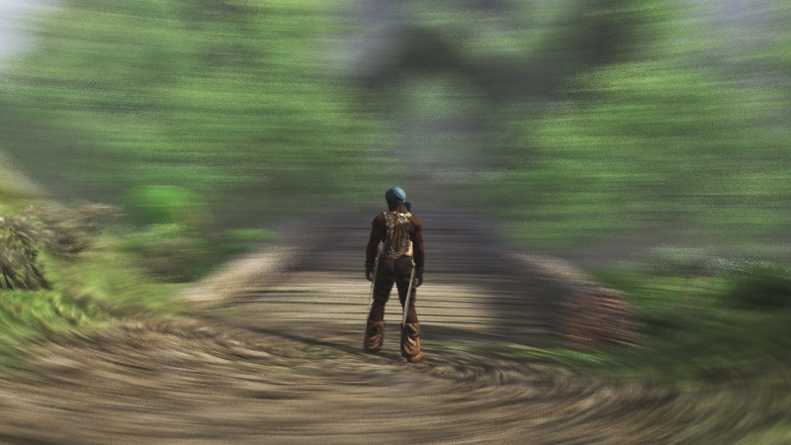
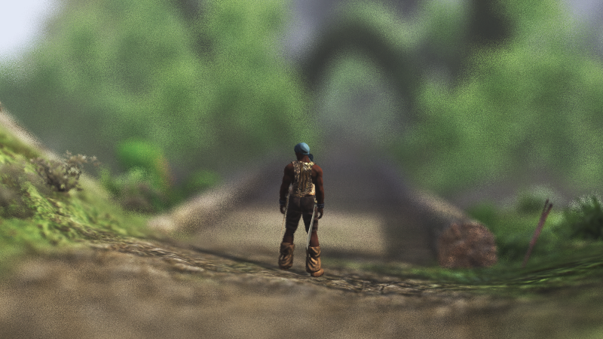
Results
 | Bbox scan | Pixar |  |  | Our method
 |  | 4 | 16 | 64
static | 23.6 | 23.6 | 23.6 | 23.6 | 23.6
motion | 2.7 | 9.5 | 17.7 | 21.9 | 23.7
motion x 2 | 1.3 | 6.0 | 14.6 | 20.9 | 24.0
defocus | 1.7 | 4.4 | 8.8 | 13.9 | 23.1
defocus x 2 | 0.7 | 1.8 | 4.4 | 8.8 | 21.9
both | 0.7 | 1.2 | 2.6 | 4.3 | 5.6
both x 2 | 0.4 | 0.6 | 1.1 | 2.0 | 2.9
STE in %, scene Conan
Scene: Age of Conan PC MMO, courtesy of Funcom
Notes:
Our first test scene is from game Age of Conan, where we have added camera motion and defocus blur. In the table, rows motion (*) and defocus correspond to the images on the left.
We can see that for a static scene (*), all algorithms are equally good in terms of sample test efficiency.
Bbox scan (*) is the naive method where we do a 5D coverage test for every sample in the bounding box. This turns out to be a terrible idea as soon as we turn on the stochastic effects.
Pixar’s method (*) performs better, but especially for low sample counts it has limited success. It should be remembered that it is intended for film rendering where the sample counts are usually very high.
(*) Our method works very well for most cases. The only difficult cases are when there’s both motion and defocus blur (*), and even there the results are better than for the other methods.

Slide 52
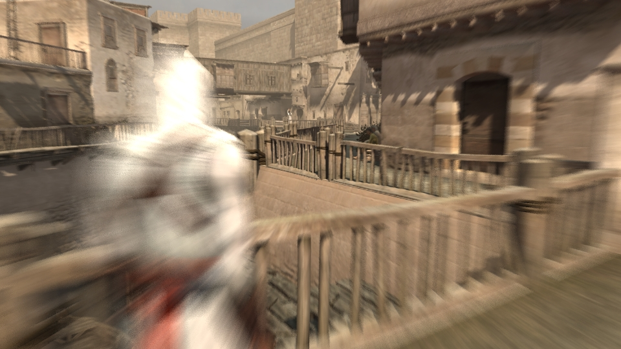
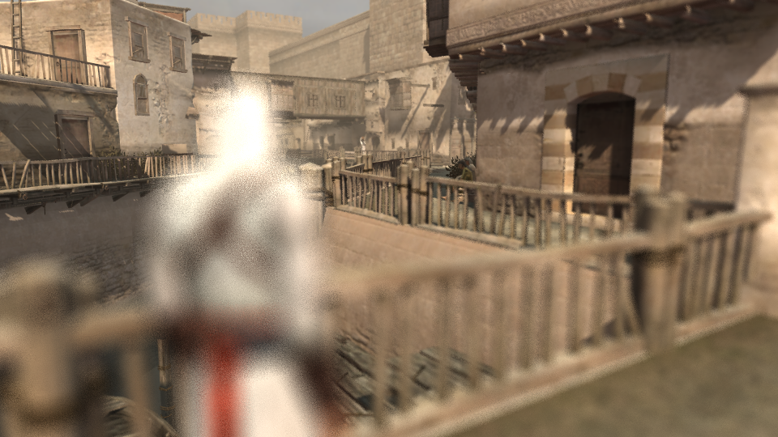
Results
 | Bbox scan | Pixar |  |  | Our method
 |  | 4 | 16 | 64
static | 23.2 | 23.2 | 23.2 | 23.2 | 23.2
motion | 10.8 | 19.5 | 22.4 | 23.1 | 23.4
motion x 2 | 4.3 | 14.8 | 21.2 | 23.0 | 23.6
defocus | 9.5 | 15.1 | 19.0 | 21.1 | 23.2
defocus x 2 | 4.3 | 9.5 | 15.1 | 19.0 | 23.0
both | 4.5 | 6.8 | 7.2 | 10.1 | 14.1
both x 2 | 1.3 | 2.1 | 3.9 | 6.7 | 6.9
STE in %, scene Assassin
Scene: Assassin’s Creed, courtesy of Ubisoft
Notes:
In another game test scene we can see pretty similar results for our method.

Slide 53
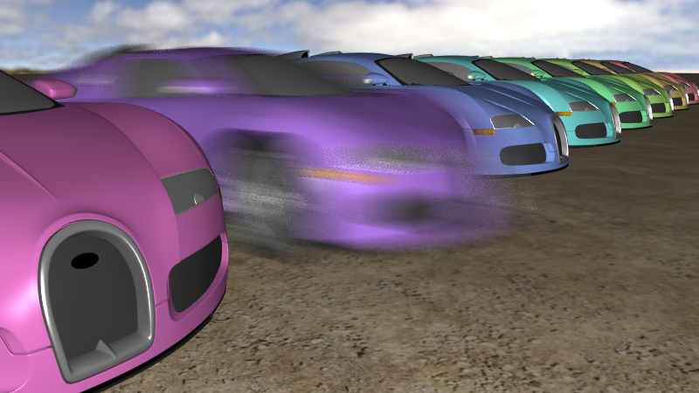
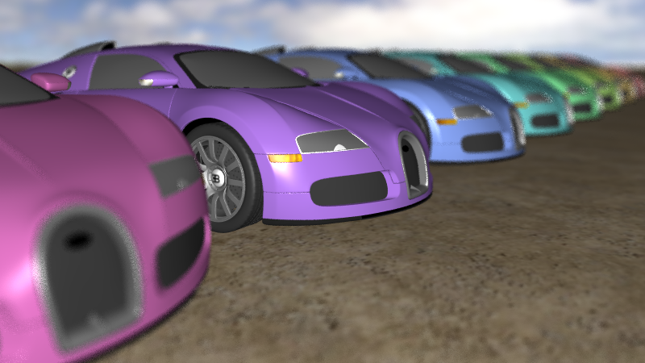
Results
 | Bbox scan | Pixar |  |  | Our method
 |  | 4 | 16 | 64
static | 8.59 | 8.60 | 8.59 | 8.60 | 8.59
motion | 0.50 | 2.97 | 6.43 | 8.02 | 8.63
motion x 2 | 0.14 | 1.27 | 4.70 | 7.40 | 8.69
defocus | 0.19 | 0.59 | 1.53 | 3.13 | 8.57
defocus x 2 | 0.05 | 0.19 | 0.59 | 1.53 | 8.51
both | 0.12 | 0.25 | 0.49 | 1.08 | 4.51
both x 2 | 0.03 | 0.07 | 0.16 | 0.39 | 2.42
STE in %, scene Cars
Notes:
The third scene has lots of very small polygons, so this is something you might see in film rendering.
The efficiency of all methods is quite low even in the static (*) setting, because the triangles are tiny but the bounding box has to be quantized to pixels.
The naive bounding (*) box scan is absolutely devastated. In all interesting cases there’s hundreds of redundant coverage tests for every successful one.
Pixar (*) does a lot better, especially for high sample counts, but for lower sample counts it’s still not that great.
For our method (*), the sample test efficiency remains high, and is practically the same as in static case when there’s only one effect active. Again the efficiency drops for combined motion and defocus blur, but it’s still much better than for the other methods.

Slide 54
Conclusions
Each triangle processed once
Arbitrary sampling patterns
High STE
Future work
  Combined motion + defocus case
Notes:
To conclude, if we look at different acceleration schemes, our method is unique in the sense that it processes each triangle exactly once regardless of sample count. This makes it attractive for pipeline integration, because the structure of the pipeline doesn’t have to be modified by adding loops or such.
Importantly, it also allows arbitrary sampling patterns that are necessary for high quality, and for such algorithms has the highest sample test efficiency.
In future work, we hope to address the efficiency issues that arise when there’s motion and defocus blur at the same time.

Slide 55
Thank You
Notes:
Thank you.

