Slide 1

High-Performance Software
Rasterization on GPUs
Samuli Laine Tero Karras
NVIDIA Research

Slide 2
Graphics and Programmability
Graphics pipeline (OpenGL/D3D)
  Driven by dedicated hardware
  Executes user code in shaders
What’s next in programmability?

Slide 3
Programmable Graphics Pipeline
But what does it mean?
  Another API?
  More programmable stages?
  Coupling between CUDA/OpenCL and OpenGL/D3D?
  Or ”it’s just a program”?

Slide 4
Our Approach
Try and implement a full pixel pipeline using CUDA
  From triangle setup to ROP
Obey fundamental requirements of gfx pipe
  Maintain input order
  Hole-free rasterizer with correct rasterization rules
Prefer speed over features

Slide 5
Project Goals
Establish a firm data point through careful experiment
Provide fully programmable platform for exploring algorithms that extend the hardware gfx pipe
Ideas for future hardware
  Ultimate goal = flexibility of software, performance of fixed-function hardware
Programmable ROP
Stochastic rasterization
Non-linear rasterization
Non-quad derivatives
Quad merging
Decoupled sampling
Compact after discard
etc.

Slide 6
Previous Work: FreePipe [Liu et al. 2010]
Very simple rasterization pipeline
  Each triangle processed by one thread
  Blit pixels directly to DRAM using atomics
Limitations
  Cannot retain inputs order
  Limited support for ROP operations (dictated by atomics)
  Large triangles → game over
We are 15x faster on average
  Larger difference for high resolutions

Slide 7
Design Considerations
Run everything in parallel
  We need a lot of threads to fill the machine
Minimize amount of synchronization
  Avoid excessive use of atomics
Focus on load balancing
  Graphics workloads are wild

Slide 8
Pipeline Structure
Chunker-style pipeline with four stages
  Triangle setup → Bin raster → Coarse raster → Fine raster
Run data in large batches
  Separate kernel launch for each stage
Keep data in input order all the time

Slide 9
Chunking to Bins and Tiles
Frame buffer
Bin
16x16 tiles
128x128 px
Tile
8x8 px
Pixel

Slide 10
Pipeline Stages
Quick look at each stage
More details in the paper

Slide 11
Triangle Setup
Vertex buffer
positions, attributes
Index buffer
. . .
Triangle Setup
edge eqs.
u/v pleqs
zmin
etc.
Triangle data buffer
. . .

Slide 12
Triangle Setup
Fetch vertex indices and positions
  Clip if necessary (has guardband)
  Frustum, backface and between-samples cull
  Setup screen-space pleqs for u/w, v/w, z/w, 1/w
  Compute zmin for early depth cull in fine raster
One-to-one mapping between input and output
  Trivial to employ full chip while preserving ordering

Slide 13
Bin Raster
Triangle data buffer
. . .
Bin Raster
SM 0
Bin Raster
SM 1
Bin Raster
SM 14
. . .
IDs of triangles that overlap bin

Slide 14
Bin Raster, First Phase
Pick triangle batch (atomic, 16k tris)
Read 512 set-up triangles
Compact/expand according to culling/clipping results
  Efficient within thread block
Repeat until has enough triangles to utilize all threads

Slide 15
Bin Raster, Second Phase
Rasterize
  Determine bin coverage for each triangle (1 thread per tri)
  Fast paths for 2x2 and smaller footprints
Output
  Output to per-SM queue → no sync between SMs

Slide 16
Coarse Raster
. . .
Coarse Raster
SM n
One coarse raster SM has
exclusive access to the bin
it’s processing
IDs of triangles that overlap tile

Slide 17
Coarse Raster
Input Phase
  Merge from 15 input queues (one per bin SM)
  Continue until enough triangles to utilize all threads
Rasterize
  Determine tile coverage for each triangle (1 thread per tri)
  Fast paths for small / largely overlapping triangles
Output
  Highly varying number of output items → divide evenly to threads
  Only one SM outputs to tiles of any given bin → no sync needed

Slide 18
Fine Raster
IDs of triangles that overlap tile
Fine Raster
warp n
One fine raster warp has
exclusive access to the tile
it’s processing
Read tile once from
DRAM to shared
Write tile once
to DRAM
Pixel data in FB

Slide 19
Fine Raster
Pick tile, read FB tile, process, write FB tile
Input
  Read 32 triangles in shared memory
  Early z kill based on triangle zmin and tile zmax
  Calculate pixel coverage using LUTs (153 instr. for 8x8 stamp)
  Repeat until has at least 32 fragments
Raster
  Process one fragment per thread, full utilization
  Shade and ROP

Slide 20
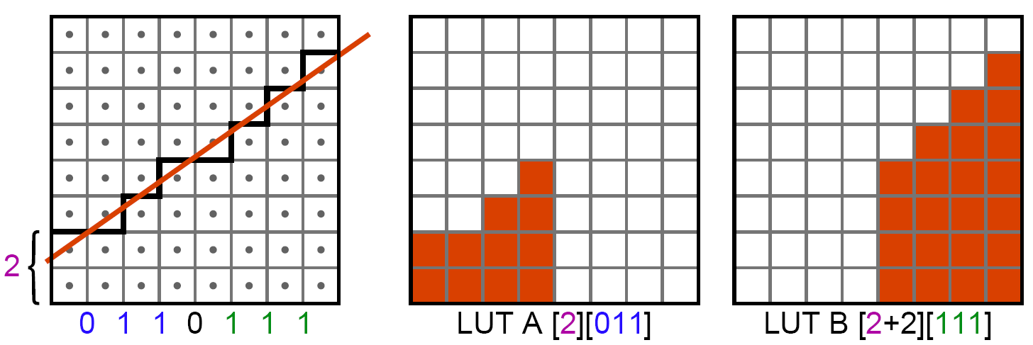
Tidbit 1: Coverage Calculation
Step along edge (Bresenham-like)
Use look-up tables to generate coverage masks
~50 instructions for 8x8 stamp, one edge

Slide 21
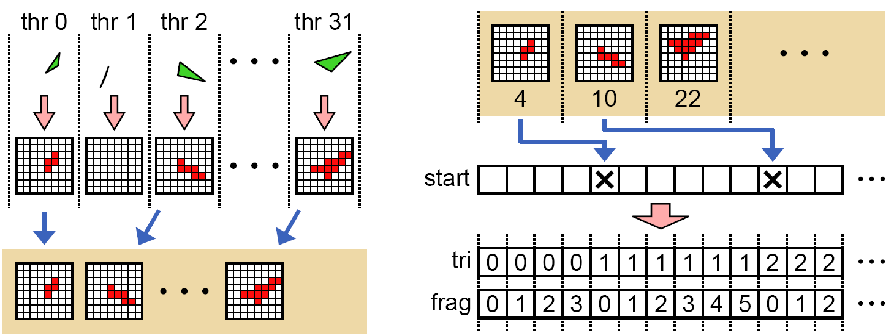
Tidbit 2: Fragment Distribution
Input Phase
Shading Phase
In input phase, calculate coverage and store in list
In shading phase, detect triangle changes and calculate triangle index and fragment in triangle

Slide 22
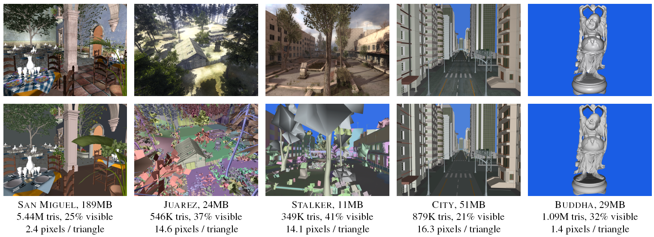
Test Scenes
Call of Juarez scene courtesy of Techland
S.T.A.L.K.E.R.: Call of Pripyat scene courtesy of GSC Game World

Slide 23
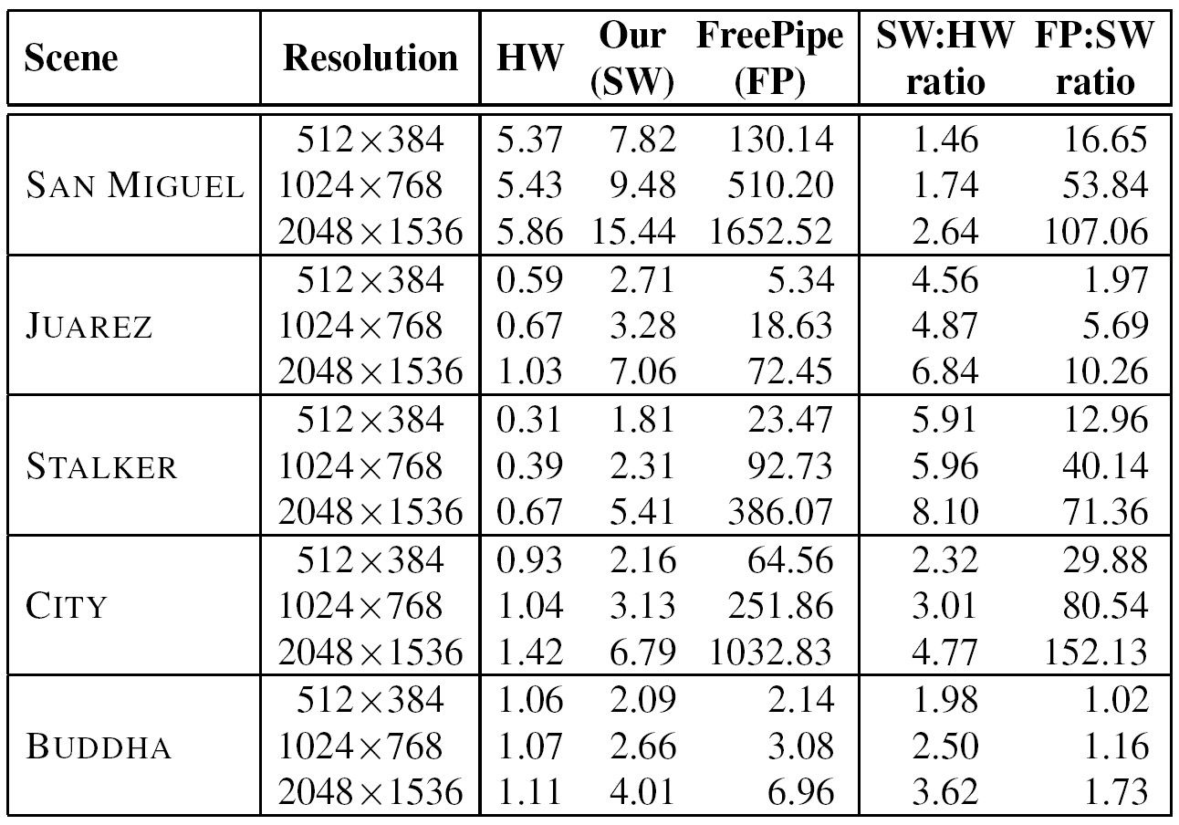
Results: Performance
Frame rendering time in ms (depth test + color, no MSAA, no blending)

Slide 24
Results: Memory Usage
 | San Miguel | Juarez | Stalker | City | Buddha
Scene data | 189 | 24 | 11 | 51 | 29
Triangle setup data | 420.0 | 42.2 | 26.9 | 67.9 | 84.0
Bin queues | 4.0 | 1.5 | 1.2 | 0.9 | 2.0
Tile queues | 4.4 | 2.9 | 2.2 | 2.2 | 1.5
Memory usage in MB

Slide 25
Comparison to Hardware (1/3)
– Resolution
  Cannot match hardware in raster, z kill + compact
  Currently support max 2K x 2K frame buffer, 4 subpixel bits
– Attributes
  Fetched when used → bad latency hiding
  Expensive interpolation
– Antialiasing
  Hardware nearly oblivious to MSAA, we much less so

Slide 26
Comparison to Hardware (2/3)
– Memory usage, buffering through DRAM
  Performance implications of reduced buffering unknown
  Streaming through on-chip memory would be much better
+ Shader complexity
  Shader performance theoretically the same as in graphics pipe
+ Frame buffer bandwidth
  Each pixel touched only once in DRAM

Slide 27
Comparison to Hardware (3/3)
+ Extensibility
  Need one stage to do something extra?
  Need a new stage altogether?
  You can actually implement it
+ Specialization to individual applications
  Rip out what you don’t need, hard-code what you can

Slide 28
Exploration Potential
Shader performance boosters
  Compact after discard, quad merging, decoupled sampling, …
Things to do with programmable ROP
  A-buffering, order-independent transparency, …
Stochastic rasterization
Non-linear rasterization
(Your idea here)

Slide 29
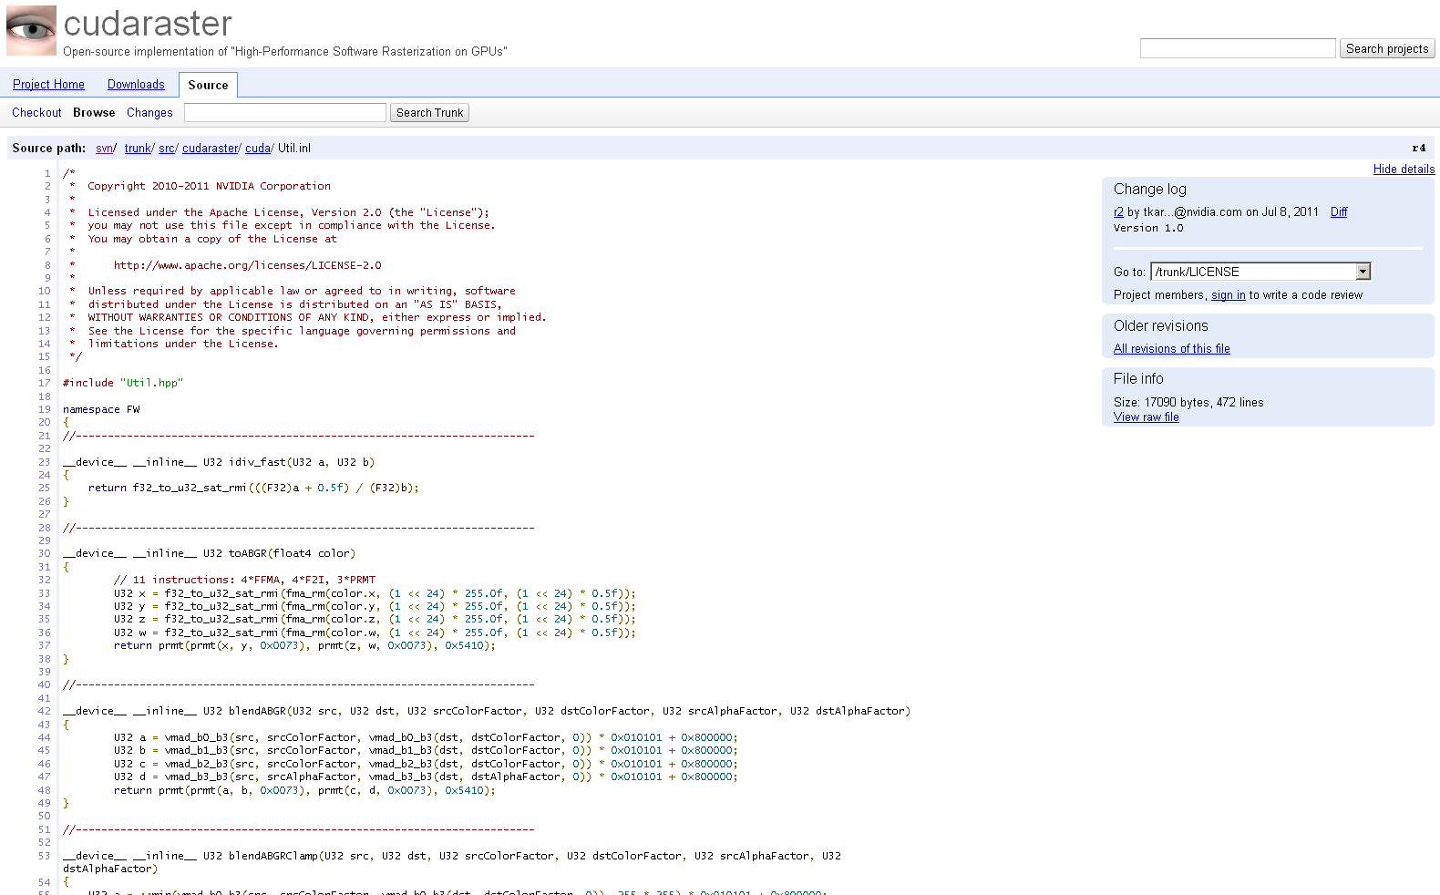
The Code is Out There
The entire codebase is open-sourced and released
http://code.google.com/p/cudaraster/

Slide 30


Thank You
Questions

